Slide 1
Intro to Kingdom Animalae
CHARACTERISTICS AND TRENDS IN COMPLEXITY

Slide 2
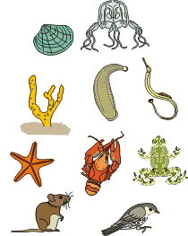
General Characteristics
Multicellular
Heterotrophic
Eukaryotic
Lack cell walls
Notes:
Either Vertebrate or Invertebrate
Parasite, Detritus
Have specialized cells

Slide 3
Specialized Cells
Carry out specialized tasks for the organism
Why bother if single celled organisms can exist?
Animals are larger organisms, more cells packed together, less surface area exposed for taking in nutrients and disposing of wastes. Therefore need efficient systems to carry out essential functions: feeding, respiration, elimination of wastes. These systems require cell specialization.
Specialized cells carry out their particular tasks more efficiently than unspecialized cells.

Slide 4
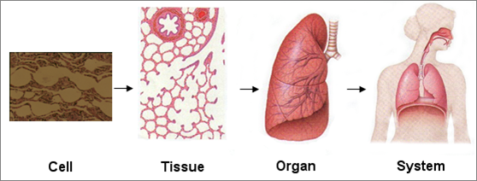
Levels of Organization, p106
Cells
Tissues
Organs
Organ Systems
Organism
Notes:
Specialization = does a better job (protection, support, etc.)

Slide 5
Recall Characteristics of Living Things:
Feeding - herbivores, carnivores, parasites, filter feeders, detrivores
Respiration-exchange of gases
Internal transport - circulatory system; open or closed
Excretion - removal of waste
Response - use of nerve cells to respond
Movement-use of muscles & skeleton
Reproduction-sexual or asexual; live young or eggs

Slide 6
Feeding:
Heterotrophs – Cannot make their own food, instead thy get their nutrients and energy by feeding on organic compounds made by other organisms
Herbivores – eat only plant material
Carnivores – eat only other animals
Omnivores – eat plants and animals
Parasites – feed in or attached to other animals
Detritivores – feed on organic waste of dead plants and animals
Notes:
detritivores are a type of decomposer.
Detritivores consume material to break it down.
Decomposers like bacteria, insects, fungi, earthworms don't eat their food, they decompose it externally.
Decomposers: fungi, insects, earthworms, and bacteria

Slide 7
Notes:
Decomposers: fungi, insects, earthworms, and bacteria

Slide 8
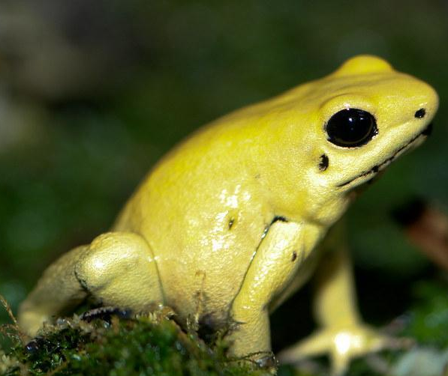
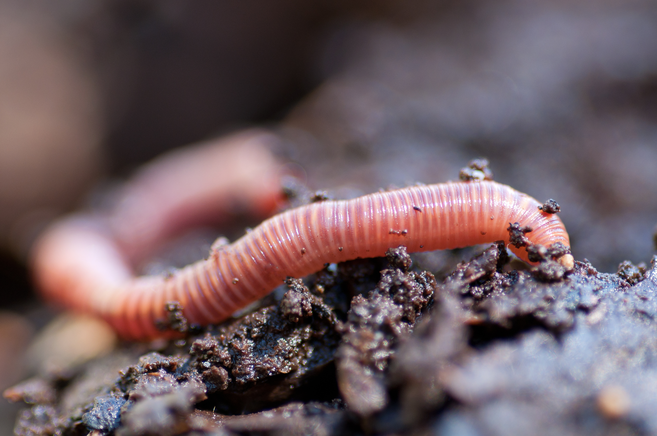
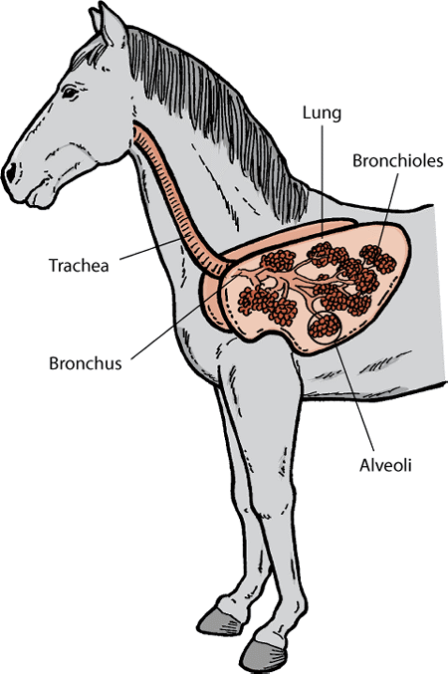
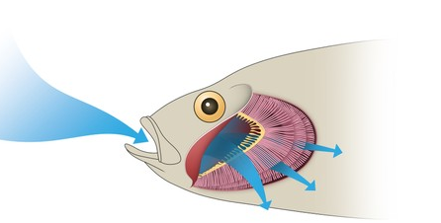
Respiration
All animals consume oxygen and give off carbons dioxide in the process of cellular respiration.
These gases are exchanged by breathing.
Small aquatic animals may breathe through skin.
Larger animals require a respiratory system.

Slide 9
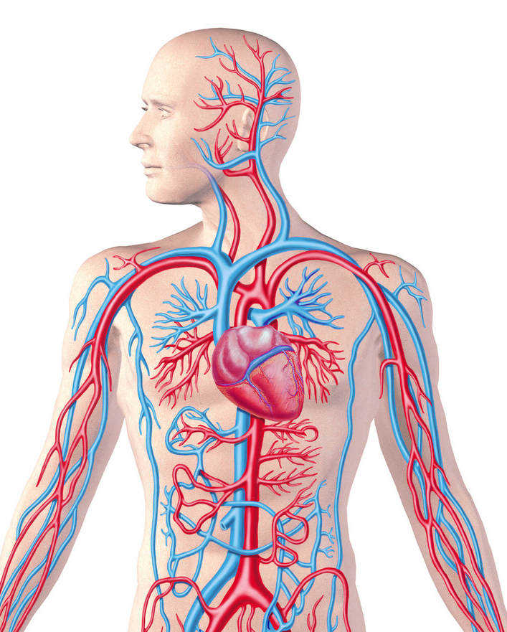
Internal Transport
Some small aquatic animals like worms can function without internal transport system.
Larger animals require a way to transport oxygen, nutrients, and wastes to and from cells deep in the body.
Circulatory System pumps blood through vessels throughout body.

Slide 11
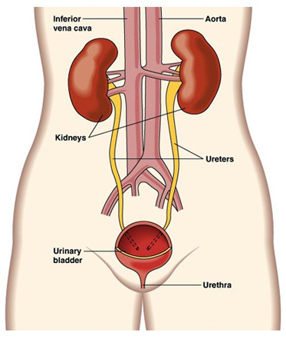
Excretion – Elimination of Waste
Cellular metabolism produces wastes such as ammonia that is toxic in high levels.
Small aquatic animals use diffusion to carry wastes from tissues to surrounding water.
Larger animals require an excretory system to store and dispose of wastes.

Slide 12
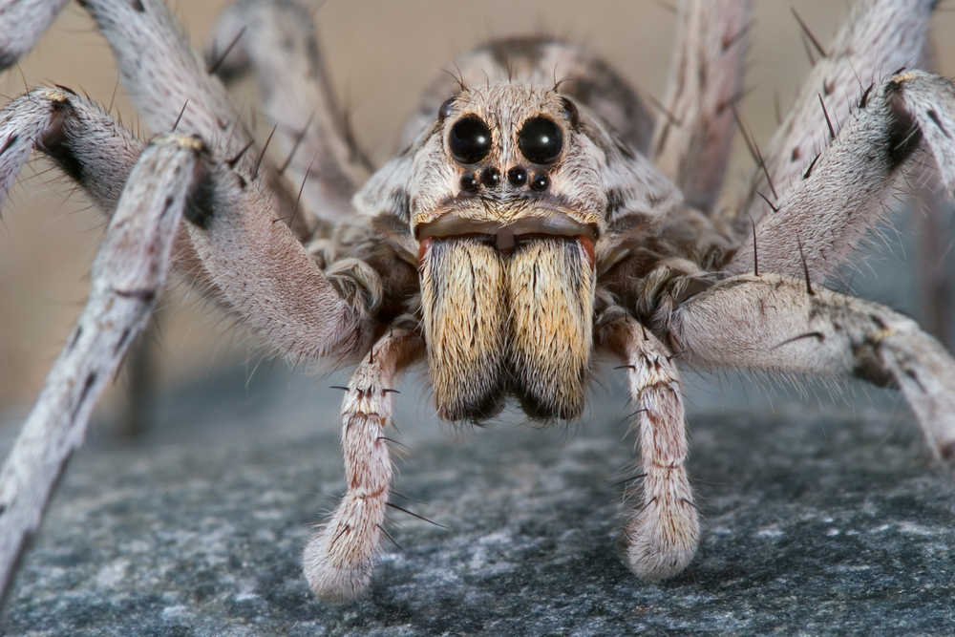
Response to Environment
Organisms need to respond to their environment to:
Find food, spot predators, identify others of their own kind.
Sensory organs: eyes and ears gather information from environment by responding to light, sound, temperature, and other stimuli.
Nervous system is composed of specialized cells (nerve cells).
Brain is control center of nervous system. Processes information and regulates response.

Slide 13
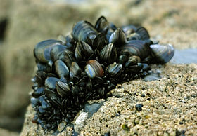
Movement
Some animals are sessile (attached to a substrate entire life). Eg. sponges, barnacles, mussels.
Most are motile (can move around).
Movement requires muscle tissue
More successful animals have muscles that work with a skeleton – which provides greater support.
Exoskeleton – skeleton on outside eg. insects.
Endoskeleton – skeleton on inside: birds, reptiles, mammals.

Slide 14
Reproduction
Methods vary widely
Jellyfish use both asexual and sexual reproduction (both 2n). Not the same as alternation of generations in plants.
Sexual Repro: young born live or hatch from eggs.
Direct Development: born a miniature version of adult.
Indirect Development: eggs hatch to larvae (intermediate stage) → metamorphosis into adult form
Notes:
Not the same as alternation of generations in plants.

Slide 15
Trends in Animal Evolution

Slide 16
Evolutionary Trends
Levels of organization become higher as animals become more complex in form.
Less complex animals carry out essential functions on cellular or tissue level of organization.
More complex organism have increasingly more specialized cells, tissues, organ systems.

Slide 17
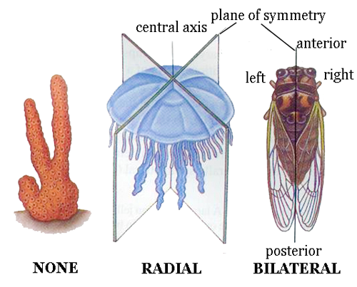
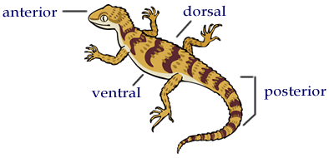
Symmetry, p559
Some have No symmetry - sponges
Lower animals have Radial symmetry. No real head.
Higher animals: Bilateral Symmetry:
Anterior (front end), posterior (back end) dorsal (upper side), ventral (lower side).
General Trend: No symmetry → Radial → Bilateral

Slide 18
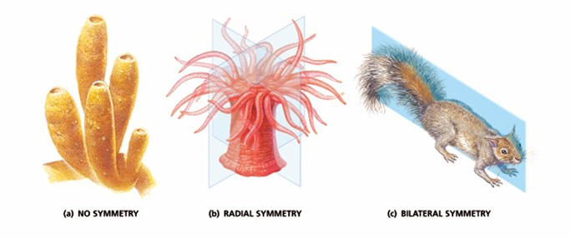

Slide 19
Cephalization, p560
Concentration of sense organs and nerve cells in anterior (head) end.
Animals with bilateral symmetry tend to move with anterior end forward – need to be able to sense their environment.
More pronounced the higher the animal.
Clusters of nerve cells are called ganglia
Brains.
Notes:
Cephalo – means head

Slide 20
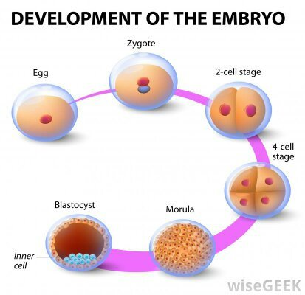
Germ Layers (Tissue Layers)
Notes:
Most animals develop from a fertilized egg cell called a zygote. In animals, fertilization may be internal (inside the body) or external (outside the body).
After fertilization, the zygote of different animal species all have similar, genetically determined stages of development.
Fertilization occurs when a sperm cell penetrates the egg cell, forming a new cell called a zygote.
The zygote divides by mitosis and cell division to form two cells in a process called cleavage.
Once cell division has begun, the organism is known as an embryo.

Slide 21
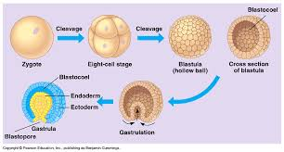

Slide 23
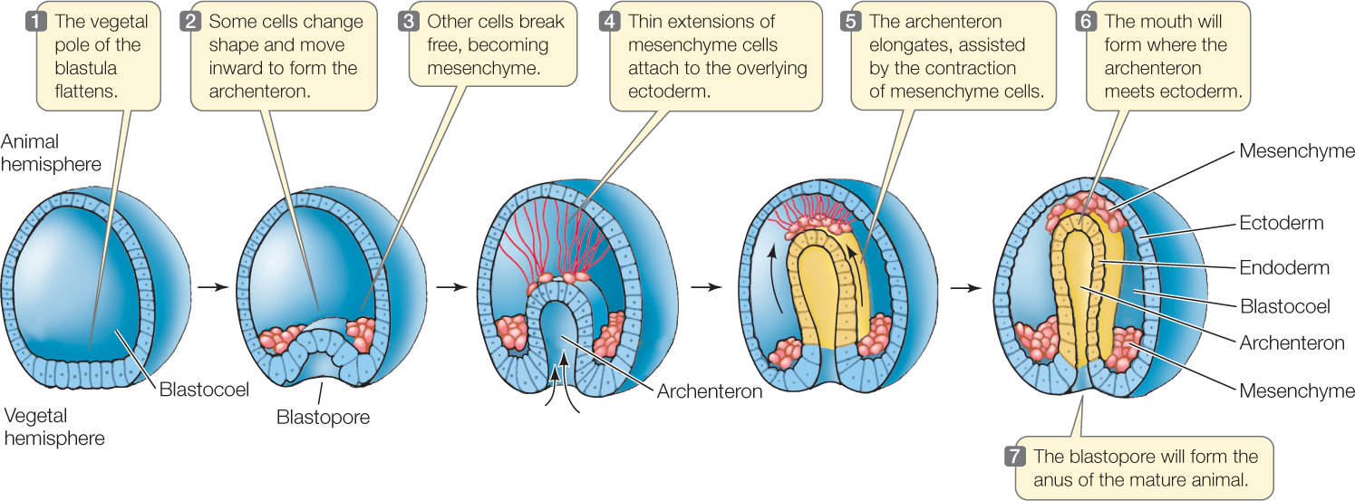

Slide 24
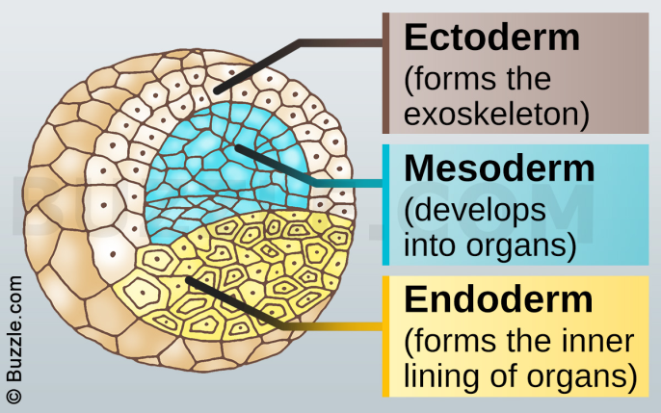

Slide 26
Germ Layers (Tissue Layers)
Endoderm – inner lining (digestion)
Ectoderm – outer lining (protection and sensing)
Mesoderm – middle lining(muscles, circulation, glands, other tissues)
Zygote develops into a blastula. This is when first layer is formed,
second layer formed during gastrula stage.

Slide 27
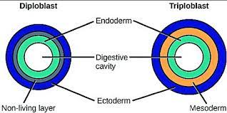
Body plan
Most organisms are generally a hollow tube:
One opening for both nutrients entering and wastes leaving
Two openings (mouth & anus)
Notes:
2 layered tube (2 germ layers)
Or 3 layered tube (3 germ layers)

Slide 28
Body Cavities
Acoelomate = NO coelom (sponges)
Pseudocoelom = have a body cavity but it does not develop from mesoderm
Coelom = body cavity lined with mesoderm
General Trend: Acoelomate → pseudocoelom → coelom
Notes:
Yet sponges have three tissue layers

Slide 29
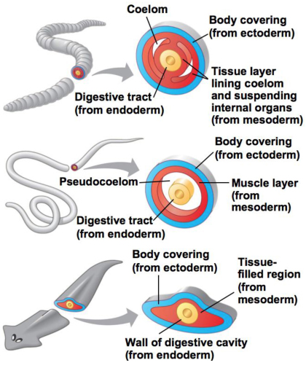

Slide 30
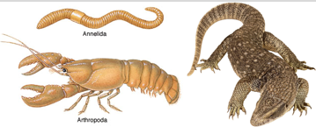
Segmentation
Allows specialization of certain segments.
Eg. specialized limbs (claws, antennae, etc.)
General Trend: No segmentation → segmentation

Slide 31
Simple animals crash course, 11min:
https://www.youtube.com/watch?v=tIfsHPpkSPs
Symmetry, coelom, tissue development, transport, gas exchange, cephalization, reproduction, vascularization

Slide 32
Complex Animals
Crash Course, Annelids and Arthropods, 13min: https://www.youtube.com/watch?v=YQb7Xq0enTI
Chordates, 12 min: https://www.youtube.com/watch?v=kgZRZmEc9j4

Slide 33
Invertebrates
Sponges, Cnidarians, Unsegmented Worms
Chapter 26
Pages 554 - 583

Slide 34
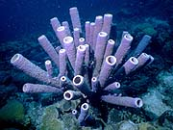
Phylum Porifera: Sponges p 560 - 563
No mouth or gut, and they have no specialized tissues or organ systems.
Sessile
Asymmetrical
Size: 1cm – 2 m
Filter feeders
Use Sexual and Asexual Reproduction
Hermaphrodites
Evolved from single-celled ancestors separately from other multicellular organisms.

Slide 35
Form and Function
Simple body plan
Wall around central cavity
Wall contains thousands of openings called pores.
Special Collar cells have flagella that create a current to draw water through pores into central cavity.

Slide 36
Cnidarians
P 564 - 569

Slide 37
Unsegmented Worms
Pages 570 - 579

