Slide 1
Types of Charge
Static Charge is produced by electron transfer
Notes:
What is static charge? When materials rub together, you might see them cling to each other. Material that behave this way are said to carry an electrical charge. When a charge stays in place for some length of time, it si described as static electricity. Or static charge.
Why does rubbing make material charged?
Recall that all matter is made up of atoms. Most of the mass is in the nucleus. Nucleus contains p and n. p are +, e outside are -.
The overall charge of a material depends ont eh balance between the positive and negative charges in all the atoms of the material. A material may be neutral, positive, or neg.
When two materials are rubbed, elecrons fromt ehatoms of one material may move to the atoms of the other material. The movement of electrons from one atoms to another changes the charge on the atoms. Whena atom loses electrons, it is left with more protons tso its charge is positive. Whena an atom gains electrons, it has more electrons than protons, so neg.

Slide 2
What happens when…
You walk across the carpet, dragging your feet, then reach for the door knob?
Why does this happen?

Slide 3
PHET Simulation: John Travoltage
https://phet.colorado.edu/sims/html/john-travoltage/latest/john-travoltage_en.html
Can this happen with other objects? Lets find out.
Materials: Plastic, Balloon, bits of paper, rice Krispies.

Slide 4
Why does this happen?
https://www.youtube.com/watch?v=yc2-363MIQs&feature=emb_rel_pause

Slide 5
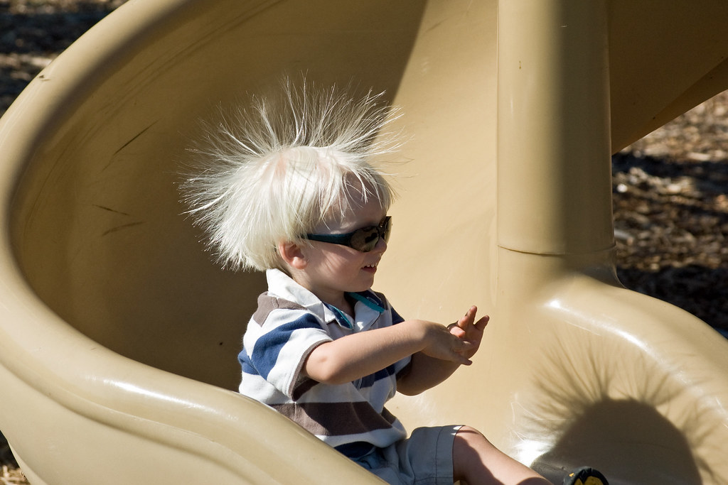
How does this happen?
Static charge or Static Electricity is an imbalance of charges of an object.
The study of static electric charge is called electrostatics.
How does an object become charged?
Notes:
When materials rub together, you might see them cling to each other.
Material that behave this way are said to carry an electrical charge.
Static charge cannot be seen but you can observe its affects with a pith ball.

Slide 6
How does an object become charged?
Transfer of electrons.
Review parts of an atom

Slide 7
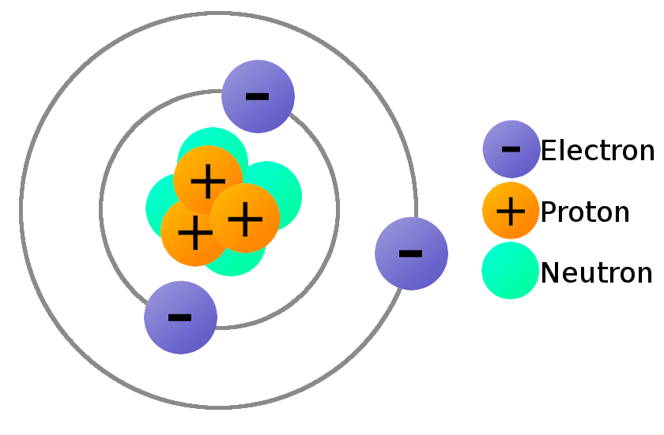
Charges on an atom…..Positive and Negative
Recall that all matter is made up of atoms.
All atoms are neutral (# protons = # electrons)
Protons and Neutrons exist tightly packed within the nucleus of an atom and are held firmly in place, so cannot be rubbed off.
But electrons can be rubbed off because they exist in the space around the nucleus and are not tightly bound to it.
Notes:
ONLY ELECTRONS CAN BE TRANSFERRED.

Slide 8
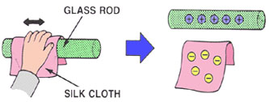
Charging objects
Objects get “charged” when electrons are transferred from one object to another.
Notes:
Pith ball: What happens when you …
Acetate rubbed with paper towel (acetate gets positive, e rubbed off)
Pith ball charged (+) after touching paper towel.
Rub acetate (gets +). Repells pith ball because they are both positive.

Slide 9
Types of Charges
NEUTRAL objects: have equal number of positive and negative charges
POSITIVE object: have MORE positive charges (protons) than negative. (It lost electrons)
NEGATIVE objects: have more negative charges than positive. (It gained electrons)

Slide 10
Can an object lose/gain protons?
Go back and check earlier slides if you are not sure.

Slide 11
What is the overall charge of each?

Slide 12
What is the overall charge of each?

Slide 13
Pith Ball Activity
Acetate Strip
Vinyl Strip
What general rule could you come up with about what you learned about charges today?

Slide 14
Law of Electrical Charge:
Like charges repel
Unlike charges attract.
Charged objects can attract neutral objects.

Slide 15
EXTRA SLIDES BEYOND HERE

Slide 16
The Law of Electric Charge
Structured Inquiry: Cellophane Tape

Slide 17
Static Electricity Video
Ted Ed Electric Vocabulary
https://www.youtube.com/watch?v=MBRTR2dlwvA
Crash Course, first 5 min
https://www.youtube.com/watch?v=TFlVWf8JX4A
Ted Ed
https://www.youtube.com/watch?v=yc2-363MIQs
Extra:
https://www.youtube.com/watch?v=7MY7EqqFFe8

Slide 18
Activity 9A p292
When two objects are rubbed together, what charge does each material acquire?
Complete the chart on page 292.
Follow instructions
Answer: Analysis Questions a-d and Evaluation e-g in COMPLETE SENTENCES.
Notes:
You can make your own pith ball

Slide 19
Static Charge History…The Main Players
Read through Section 9.1 (p274-275 and 285-286).
How did each of the following contribute to information on static charge?
Benjamin Franklin
Charles de Coulomb
Robert Van de Graaf

Slide 20
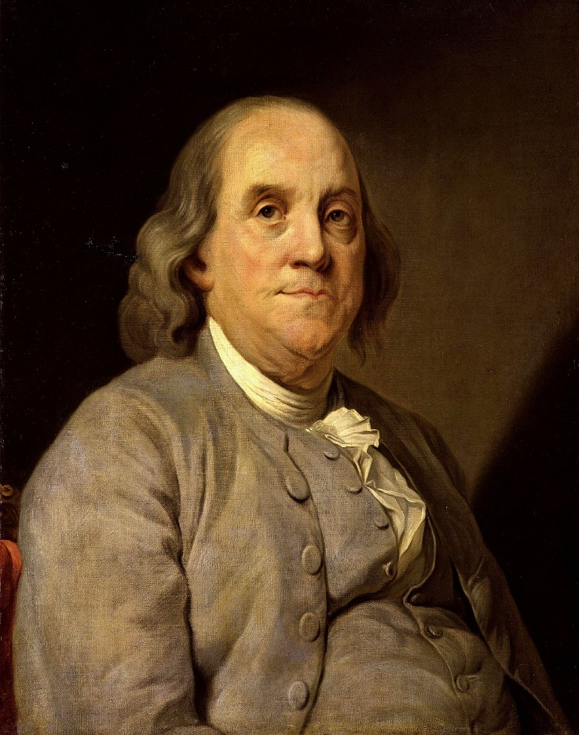
Benjamin Franklin
He believed electric charge was like a “fluid” → if an object had a “natural amount” of fluid it was neither attracted nor repelled by itself
Objects rubbed against each other gained or lost “fluid”
Notes:
Benjamin Franklin first shocked himself in 1746, while conducting experiments on electricity with found objects from around his house. Six years later and exactly 261 years ago today, the founding father flew a kite attached to a key and a silk ribbon in a thunderstorm and effectively trapped lightning in a jar.
a printer, writer, scientist, inventor, statesman, civic leader, and diplomat.
Inventions
lightning rod, bifocals, long arm and the Franklin stove.
Ancient Times
If you ask most people who discovered electricity, they’ll probably tell you Benjamin Franklin did.
This is because everyone has heard the story of Franklin flying his kite during a lightning storm.
This is NOT when electricity was discovered!
Sheldon Explains
An ancient Greek named Thales of Miletus noticed that if amber (hardened tree sap) was rubbed, it had the ability to pick up dust and leaves in about 700BC!
What he was seeing is what we now call “static electricity”
The ancient Greeks had no scientific explanation for this phenomenon.
What they did realize was that sometimes two objects would attract each other, sometimes they would repel.
This developed into the idea that there are two kinds of charge (we call them positive and negative today, which will be discussed shortly).
Like charges repel
Opposite charges attract.
This is usually called the Law of Charges.
The “Franklin” Era
Benjamin Franklin’s Experiments
Benjamin Franklin (1706-1790) did fly a kite on an overcast day (no actual lightning), but he wasn’t the first person to do it!
Several people had tried to do it before him to prove that lightning was electrical, but they’d all been killed.
Most people thought he was a nut to do it. In fact, he had his son set up most of the equipment while he stood back.
Franklin was able to prove that lightning was a discharge of static electricity (this does NOT mean he discovered electricity!!!)
Most of Franklin’s research actually focused on amber and glass rods…
It had been found that if a rubbed amber rod was suspended from a string, and another rubbed amber rod was brought near, the suspended one would move away.
If a suspended rubbed glass rod is brought near another rubbed glass rod, the suspended one would move away.
If a rubbed glass rod and amber rod were brought near to each other, they were attracted.
Therefore, the charge on the glass must be different from the charge on the amber!
Franklin decided to say that…
the glass rod had a positive charge
the amber rod (or the plastic ebonite used today) had a negative charge
Why did he choose to call glass positive and amber negative?

Slide 21
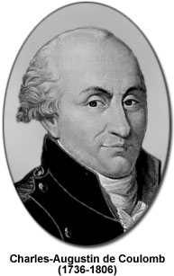
Charles de Coulomb
Coulomb’s Law: strength of electric force increases with increased electric charges and decreases with distance
Unit for size of electric charge is called the coulomb (C)

Slide 22
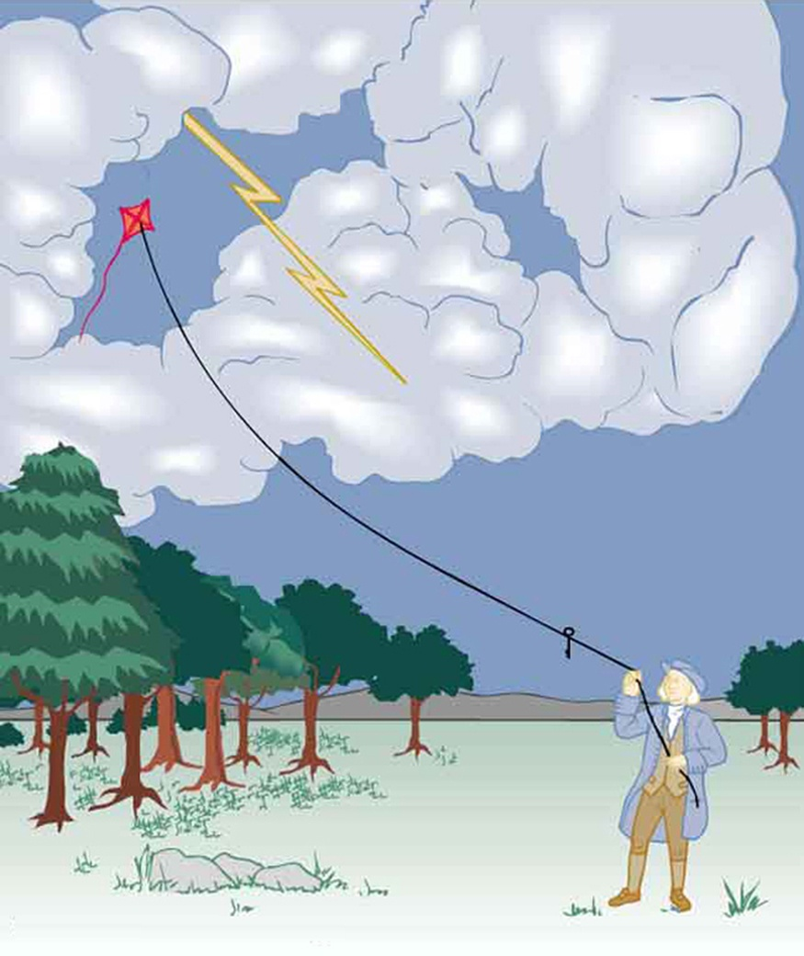
History
About 250 years ago American scientist Benjamin Franklin used the term “negative charges” to describe the rubbed off material.
He said that an excess of positive charges were left behind.
Today we know the negative charges are electrons.
History video:
https://www.youtube.com/watch?v=g5mzFb2hhHY
Notes:
Extra https://www.youtube.com/watch?v=3QLnosS853Q

Slide 23
Static Electricity
CHAPTER
9
Key Ideas
Static electric charges can build up on objects.
Objects become charged by friction, conduction, and induction.
An electric force between static charges can either attract or repel the charges.
The discharge of static electricity in the form of lightning can be dangerous, but static electricity also has useful applications.

Slide 24
At Home Activity:
Place bits of tissue paper on the table.
Rub an inflated balloon on your hair or sweater. Or comb your hair with a plastic comb.
Bring balloon/comb CLOSE to the bits of paper on the table.
What happens? Do some fly away? Why?
Do some paper bits fly off? Why?
Would this work for any object? Try it. Would a metal comb do the same thing? https://www.youtube.com/watch?v=3aB6TyhaSsQ

Slide 25
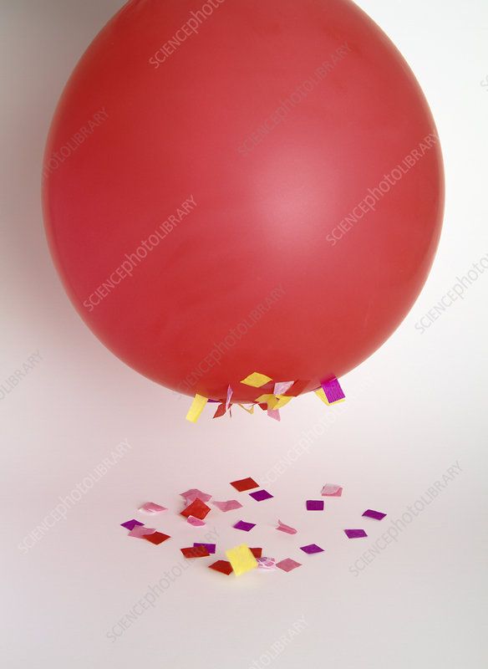
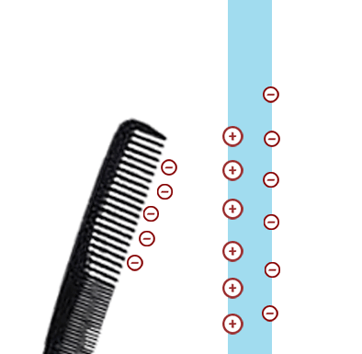
Explanation
Rubbing the balloon transfers electrons from your sweater to the balloon, making it negative.
The negative balloon attracts the positive charges in the bits of paper causing them to fly up and stick to the balloon.
Why do some fly off? Some negative charges are transferred to the bits of paper, charging them negative. The balloon is big and has a lot of negative charges still on it and remains negative. The balloons big negative charge repells the negative bits of paper causing them to fly off.
It helps if you draw this out on paper with negative and positive charges.

