Slide 1
Cell Cycle Chapter 8 p164-170
Notes:
Name the two ways: sex and asex

Slide 2
VOCABULARY
mitosis
cytokinesis
prophase
spindle
metaphase
anaphase
telophase
cell cycle
interphase
sister chromatids
Homologous chromosomes
parent cell
daughter cells

Slide 3
The Importance of Cell Division:
To produce new cells to increase the size of the organism.
To replace damaged and old cells
For unicellular organisms to reproduce

Slide 4
Cell Cycle is made up of two stages:
INTERPHASE – (Growth and development)
CELL DIVISION (mitosis and cytokinesis)
All Eukaryotic cells reproduce by the cell cycle
Notes:
Cells reproduce to replace damaged cells and essential part of life cycle. (producing offspring for single celled ameba.

Slide 5
1. INTERPHASE: Growth and Development
Cell spends most of its time in interphase
Subdivided into 3 phases:
G1 phase– gap phase. Regular cell growth and development
S phase – DNA synthesis
G2 phase – synthesis of organelles copies and other materials required for division

Slide 7
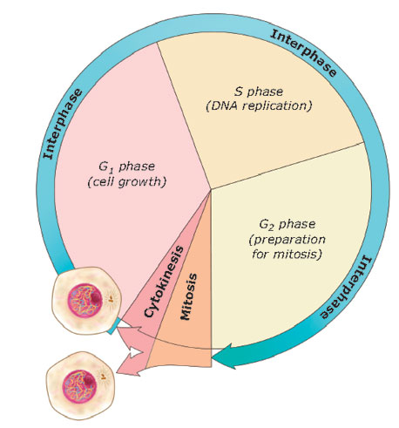
2. CELL DIVISION (Mitosis and Cytokinesis)
Mitosis - (M phase) Nucleus divides in two. 4 phases.
Cytokinesis – cytoplasm divides, forming two distinct cells.

Slide 9
Early Prophase
Chromosomes become visible as 2 identical chromatids attached by a centromere.
Centrioles separate and move to opposite sides of nucleus.
Notes:
Prophases is the longest phase of mitosis.
early prophase The mitotic spindle begins to form. The spindle is a structure made of microtubules, strong fibers that are part of the cell’s “skeleton.” Its job is to organize the chromosomes and move them around during mitosis. The spindle grows between the centrosomes as they move apart.
The nucleolus (or nucleoli, plural), a part of the nucleus where ribosomes are made, disappears. This is a sign that the nucleus is getting ready to break down.
and prometaphase

Slide 11
Late Prophase
Spindle fibers form and attach to chromosomes.
Nucleolus disappears, Nuclear membrane breaks down.
Notes:
early prophase The mitotic spindle begins to form. The spindle is a structure made of microtubules, strong fibers that are part of the cell’s “skeleton.” Its job is to organize the chromosomes and move them around during mitosis. The spindle grows between the centrosomes as they move apart.
The nucleolus (or nucleoli, plural), a part of the nucleus where ribosomes are made, disappears. This is a sign that the nucleus is getting ready to break down.
and prometaphase

Slide 12
Chromatid vs Chromosome
Duplicated chromosomes each consist of two connected copies, called sister chromatids, connected by a centromere

Slide 13
Metaphase
Chromosomes line up along the middle of the cell
Spindle fibres connect to centromeres to guide chromosome movement.
Notes:
Shortest phase

Slide 14
Notes:
In metaphase, the spindle has captured all the chromosomes and lined them up at the middle of the cell, ready to divide.
All the chromosomes align at the metaphase plate (not a physical structure, just a term for the plane where the chromosomes line up).
At this stage, the two kinetochores of each chromosome should be attached to microtubules from opposite spindle poles.
Before proceeding to anaphase, the cell will check to make sure that all the chromosomes are at the metaphase plate with their kinetochores correctly attached to microtubules. This is called the spindle checkpoint and helps ensure that the sister chromatids will split evenly between the two daughter cells when they separate in the next step. If a chromosome is not properly aligned or attached, the cell will halt division until the problem is fixed.

Slide 15
Anaphase
Sister chromatids separate(becoming individual chromosomes)
Chromosomes move away from each other, migrating to the poles end of the cell.
Notes:
The protein “glue” that holds the sister chromatids together is broken down, allowing them to separate. Each is now its own chromosome. The chromosomes of each pair are pulled towards opposite ends of the cell.
Microtubules not attached to chromosomes elongate and push apart, separating the poles and making the cell longer.
All of these processes are driven by motor proteins, molecular machines that can “walk” along microtubule tracks and carry a cargo. In mitosis, motor proteins carry chromosomes or other microtubules as they walk.

Slide 17
Telophase
Chromosomes begin to decondense and return to their “stringy” form.
Nuclear membranes forms around chromatin
The mitotic spindles break down
Nucleoli reappear.
2 new nuclei form.

Slide 19
Mitosis and Cytokinesis overlap

Slide 20
Cytokinesis
Begins before mitosis is fully complete (begins in anaphase, ends telophase).
The cytoplasm and organelles are divided, and two separate cells form.
The cells then enters interphase.

Slide 21
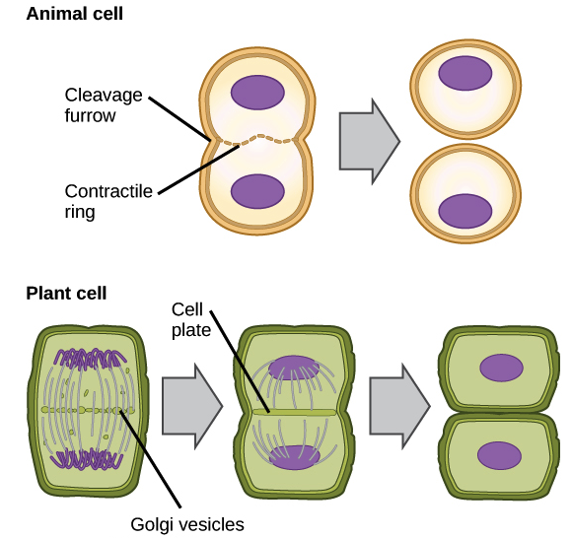
Cytokinesis in Animal Cells
Cells indent or cell membrane pinches in between the two nuclei.
Notes:
n animals, cell division occurs when a band of cytoskeletal fibers called the contractile ring contracts inward and pinches the cell in two, a process called contractile cytokinesis. The indentation produced as the ring contracts inward is called the cleavage furrow. Animal cells can be pinched in two because they’re relatively soft and squishy.

Slide 22
Cytokinesis in Plant Cells: Cell Plate forms
In plant cells a Cell Plate forms
Plant cells are much stiffer and surrounded by a cell wall.
Membrane-bound vesicles form between the two nuclei.
The vesicles fuse together form the cell plate.
Cell plate grows outward, forming a new cell membrane for each daughter cell.
Notes:
lant cells are much stiffer than animal cells; they’re surrounded by a rigid cell wall and have high internal pressure. Because of this, plant cells divide in two by building a new structure down the middle of the cell. This structure, known as the cell plate, is made up of plasma membrane and cell wall components delivered in vesicles, and it partitions the cell in two.

Slide 23
How long does the cell cycle take?
Depends on the cell.
A typical human cell might take about 24 hours to divide, but fast-cycling mammalian cells, like the ones that line the intestine, can complete a cycle every 9-10 hours

Slide 24
Check your understanding
What happens to the DNA in a cell during interphase? Why is this step important for the reproduction process?
In two or three sentences, describe what the cell cycle is.
Notes:
1. DNa is copied

Slide 25
Home work
Mitosis WS
Ameoba Sisters video on mitosis
https://www.youtube.com/watch?v=f-ldPgEfAHI
Notes:
Exit Slip:
1. How do the traits of the parent and offspring compare to each other in asexual reproduction? 2. What are the benefits and limitations of single-celled organisms that undergo the process of asexual reproduction?3. Humans are constantly shedding dead skin cells. How do we replace them? 4. An old sequoia tree weighs any tons and has billions of cells. These trees start out as tiny seeds. How do these trees become so large?

Slide 26
Extra Slides Beyond here

