Slide 1
DNA STRUCTURE
Structure, Function, Replication
Chapter 7

Slide 2
Learning Goals
List the contributions of various scientists to the idea that DNA carries the genetic code
Describe the structure and function of DNA
Summarize the process of DNA replication

Slide 3
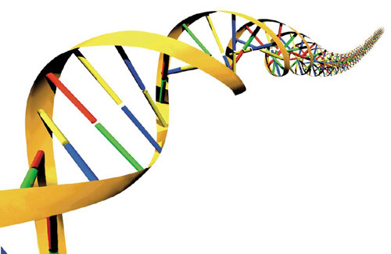
DNA (Deoxyribonucleic Acid)
DNA is an organism's genetic material .
DNA caries the genetic code: the genetic information transmitted from one generation to the next that contains the instructions an organism needs to develop, live and reproduce.
(almost) every cell has exact copy
DNA is a macromolecule
DNA is a nucleic acid

Slide 4
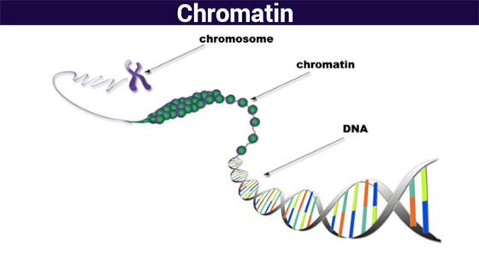
DNA exists in a loose, thread-like material called chromatin.
Chromatin condenses into chromosomes just before a cell divides.

Slide 5
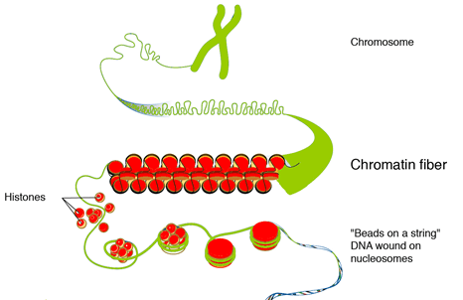
What is Chromatin?
Chromatin is a mixture of DNA and proteins that form chromosomes.
A DNA molecule wraps around histone proteins to create tight loops known as nucleosomes.

Slide 6
When was the DNA molecule “discovered”?
DNA was first observed by a German biochemist named Frederich Miescher in 1869.
But for many years, researchers did not realize the importance of this molecule.

Slide 7
DNA Structure: 1950 Rosalind Franklin
Rosalind Franklin: DNA's unsung hero
https://www.youtube.com/watch?v=BIP0lYrdirI
Discovered the twisted shape of DNA.
James Watson and Francis Crick built models.

Slide 8
DNA STRUCTURE
It was not until 1953 that James Watson, Francis Crick, Maurice Wilkins and Rosalind Franklin figured out the structure of DNA — a double helix — which they realized could carry biological information.
Watson, Crick and Wilkins were awarded the Nobel Prize in Medicine in 1962 "for their discoveries concerning the molecular structure of nucleic acids and its significance for information transfer in living material."
Franklin was not included in the award, although her work was integral to the research.

Slide 9
How do we know about DNA’s function?
1928 British Scientist Frederick Griffith was studying two different strains of pneumonia bacteria.
Only one of the two caused the disease.
The cultures were visibly different from each other.
Disease-causing → smooth colonies
Harmless bacteria → rough colonies
Notes:
1928 British Scientist Frederick Griffith was studying two different strains of pneumonia bacteria.
Only one of the two caused the disease.
The cultures were visibly different from each other.
Disease-causing → smooth colonies
Harmless bacteria → rough colonies
The difference was due to the presence of mucous coat in S strain bacteria, whereas the R strain bacteria lacked them.

Slide 10
Experiment
Griffith injected both S and R strains to mice.
The one which was infected with the S strain developed pneumonia and died while that infected with the R strain stayed alive.
Notes:
In the second stage, Griffith heat-killed the S strain bacteria and injected into mice, but the mice stayed alive. Then, he mixed the heat-killed S and live R strains. This mixture was injected into mice and they died. In addition, he found living S strain bacteria in dead mice.

Slide 11
Second Stage
Griffith heat-killed the S strain bacteria and injected into mice, but the mice stayed alive.
Notes:
Griffith heat-killed the S strain bacteria and injected into mice, but the mice stayed alive. Then, he mixed the heat-killed S and live R strains. This mixture was injected into mice and they died. In addition, he found living S strain bacteria in dead mice.

Slide 12
Second Stage
Then, he mixed the heat-killed S and live R strains. This mixture was injected into mice and they died.
In addition, he found living S strain bacteria in dead mice.
Notes:
Griffith heat-killed the S strain bacteria and injected into mice, but the mice stayed alive. Then, he mixed the heat-killed S and live R strains. This mixture was injected into mice and they died. In addition, he found living S strain bacteria in dead mice.

Slide 13
Notes:
1928 British Scientist Frederick Griffith was studying two different strains of pneumonia bacteria.
Only one of the two caused the disease.
The cultures were visibly different from each other.
Disease-causing → smooth colonies
Harmless bacteria → rough colonies

Slide 14
Hypothesis
Material in dead bacteria can transform living bacteria

Slide 15
Results: Transformation
Something had been transferred from the heat-killed disease-causing bacteria to the live harmless bacteria, transforming them into live disease-causing bacteria.

Slide 16
Conclusion
R strain bacteria had been transformed by S strain bacteria.
The R strain inherited some 'transforming principle' from the heat-killed S strain bacteria which made them virulent.
And he assumed this transforming principle as genetic material.

Slide 17
1944. Oswald Avery, Maclyn McCarty, Colin MacLeod repeated the experiment.
Treated extract from heat-killed bacteria with enzymes to destroy carbohydrates, lipids and proteins. → The transformation still occurred.
Also treated extract to destroy RNA
→ Transformation still occurred.

Slide 18
Transformation did NOT occur when DNA was destroyed
→ DNA was the transformation factor (DNA is responsible for the transfer of genetic information)

Slide 19
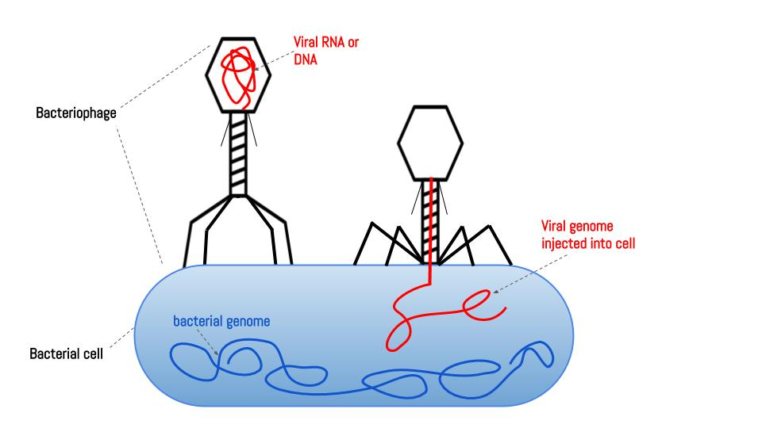
Alfred Hershey and Martha Chase, 1952
Bacteriophage – virus that infects bacteria.
Notes:
Composes of DNA core and protein coat. Attach themselves to bacteria and inject a material into the bacterium.
Injected material is replicated, lyses, infected more.
Because

Slide 20
Conclusion
They proved viral DNA is injected into the bacteria.
Protein coat remains on outside.
Because the material injected into the bacterium produces new bacteriophages, it must contain the genetic code.

Slide 21
Video
Ameba Sisters: DNA Structure and Function, 9 min
https://www.youtube.com/watch?v=_POdWsii7AI
Crash Course:THIS ONE https://www.youtube.com/watch?v=8kK2zwjRV0M
DNA Structure: 5 min
https://www.youtube.com/watch?v=C1CRrtkWwu0

Slide 22
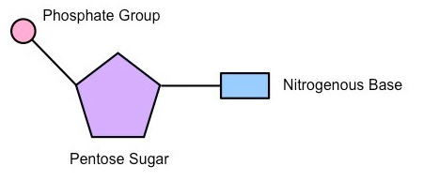
Nucleotides
DNA is made up of repeating units called nucleotides
Each nucleotide is made up of one each of:
phosphate group,
sugar molecule (5 carbon sugar called deoxyribose),
nitrogenous base

Slide 23
There are FOUR Nitrogenous Bases:
Purines:
Pyrimidines:
adenine (A),
guanine (G)
thymine (T),
cytosine (C).

Slide 24
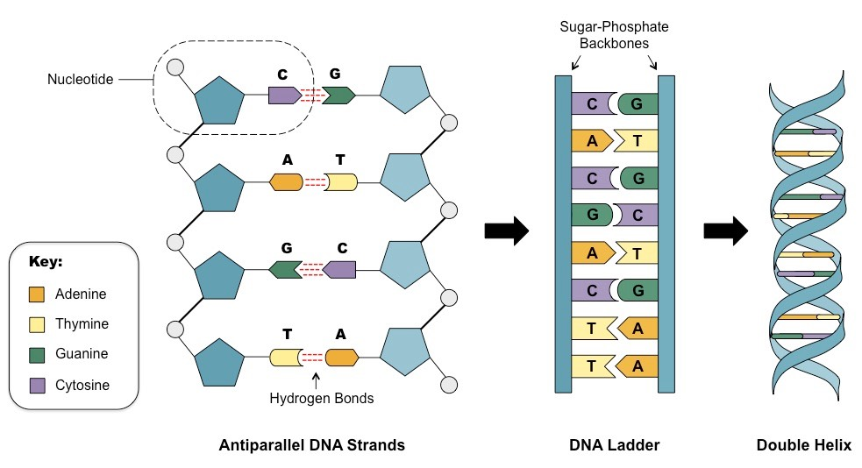
DNA Structure
.

Slide 25
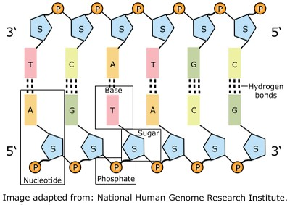
DNA molecule shape
“Sides” of the ladder =sugar and phosphate molecules joined to each other.
“Rungs” = are made up of pairs of nitrogenous bases, one from each of the strands.

Slide 26
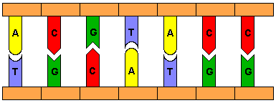
The nitrogenous bases pair up in the middle:
A only pairs with T
C only pairs with G

Slide 27
The base pairs are held together by hydrogen bonds

Slide 28
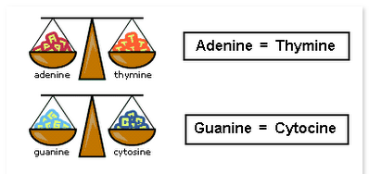
Chargaff's Rule (Base Pair Rule):
DNA from any cell should have a 1:1 ratio of pyrimidine (C, T) and purine (A, G) bases.

Slide 29
How can each cell have an exact copy of DNA?
DNA Replication
p144

Slide 30
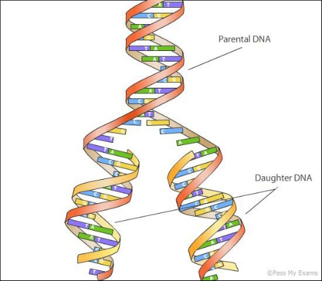
DNA REPLICATION = DNA Synthesis
DNA REPLICATION is the process by which DNA copies itself before a cell divides. 3 steps.
Notes:
MGH: https://www.youtube.com/watch?v=2LnXpaVUG0Y

Slide 31
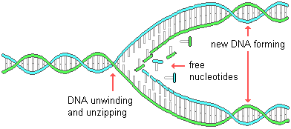
DNA Replication (coordinated by enzymes)
DNA helix unwinds,
Notes:
Remember it is the sequence of bases is the code that determines the trait or protein.

Slide 32
Unzipping
Helicase unzips the strands
Hydrogen bonds between the base pairs are broken and the two strands separate.
Each strand becomes a template for the attachment of complementary bases.
Eg. T A C G T T will bind with A T G C A A.

Slide 33
DNA Replication (coordinated by enzymes)
Enzyme DNA polymerase attaches Complementary nucleotides
Enzymes insert bases, provide covalent sugar-phosphate link to extend the growing DNA chains).
Enzyme (DNA polymerase) “proof reads” the bases, repairs if necessary.
Notes:
Remember it is the sequence of bases is the code that determines the trait or protein.

Slide 34
Enzyme Ligase links up fragments

Slide 35
DNA Replication is “Semi-Conservative”
DNA Replication is Semi-conservative which means that each of the two copies produced contain one of original strand and one new strand.

Slide 36
Practice
DNA WS

