Slide 1
Human Reproduction
Chapter 4
Pages 108-119

Slide 2
Humans have both Primary and Secondary Sexual Characteristics
Primary Sex characteristics:
present at birth.
structures directly involved in reproduction (testes, ovaries, and external genitalia).
Secondary sex characteristics: other changes that occur during puberty (changes in height and body shape).

Slide 3
What is Puberty?
Puberty is the maturation into an adult body capable of sexual reproduction.
Average onset for males is 12 yr
Females: 11 yr
Until around 18

Slide 4
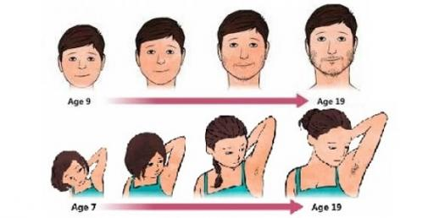
Puberty

Slide 5
Male Secondary Sexual Characteristics
Secondary characteristics in males help distinguish male from female but not directly involved in reproduction:
growth spurt;
Hair growth - Face, underarm, and pubic region
deepening of voice.
Broader shoulders

Slide 6
Puberty in Girls
Growth spurt
Breast development
Widening of the hips
Underarm and pubic hair

Slide 7
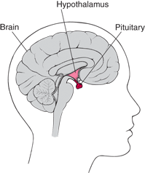
What initiates Secondary Sexual Characteristics?
In males, hormones released from the pituitary gland in the brain stimulate the testes to produce more male sex hormone called testosterone.

Slide 8
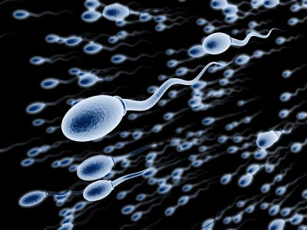
Male Reproductive System
The whole purpose of the male reproductive system is to produce sperm AND to deliver sperm to egg.

Slide 9
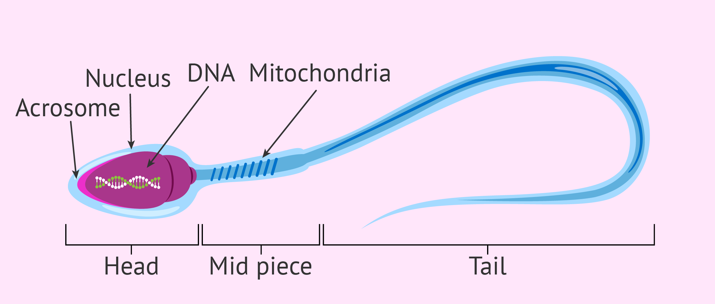
Structure of Human Sperm Cell: Three Regions
Notes:
List the functions of each section of sperm

Slide 10
Structure of Human Sperm Cell
Head – contains haploid nucleus, acrosome – contains enzymes
Middle piece – mitochondria ( )
Tail – is a flagellum (for locomotion)
Notes:
List the functions of each section of sperm

Slide 11
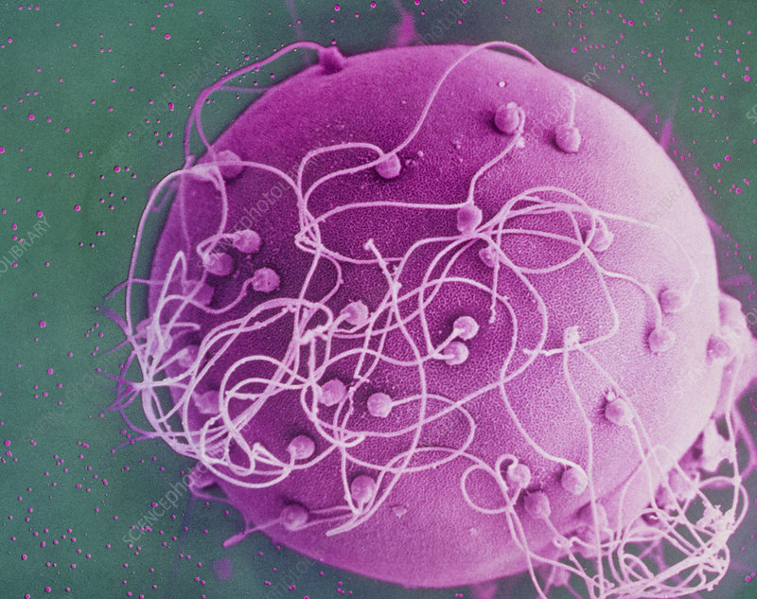
Sperm are MUCH smaller than egg

Slide 12
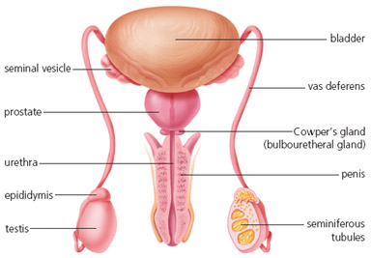

Slide 13
TESTES – (two outside body)
Produce sperm and testosterone
SCROTUM – sac containing testes
SEMINIFEROUS TUBULES –
coiled tubes in testes
Where diploid cells undergo meiosis →haploid sperm
EPIDIDYMIS – where mature sperm are stored.

Slide 14
Male Reproductive Structures
VAS DEFERENS – tube carries sperm to urethra
URETHRA – tube leading to outside of body
located in the penis
PENIS – specialized organ to enter female during sexual intercourse
Notes:
What connects ---- to urethra

Slide 15
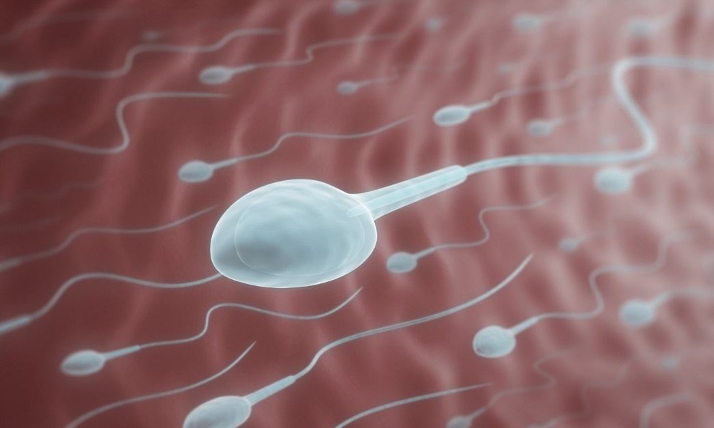
Accessory Glands:
Secrete seminal fluid (sugar for energy) through ducts.
Seminal vesicles
prostate gland
Cowper’s gland (Bulbourethral gland)
SPERM + SEMINAL FLUID = SEMEN

Slide 16
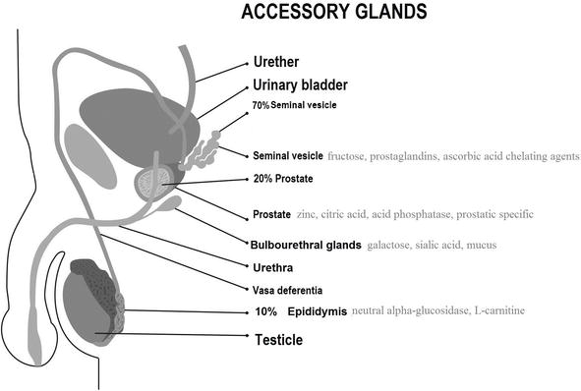
DID YOU KNOW?
Sperm don’t actually travel through the accessory glands.
The glands secrete fluid through ducts that connect to the vas deferens.
Sperm don’t travel through bladder either

Slide 17
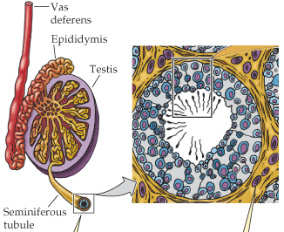
Sperm Production and Development
Sperm begin as diploid cells in seminiferous tubules
Undergo mitosis to increase in number
Gradually pushed closer to center
Undergo meiosis → haploid
Finish maturing in epididymis
200-300 million sperm produced each day
Notes:
Why so many?

Slide 18
Check your Understanding
HW: Read pages 108-110
Answer CYU p111
What is the purpose of the male reproductive system?
Identify each part and its function/contribution.
Discuss how a sperm cell structure is suited to its function, Know the path sperm takes from where it is produced, stored and leaves the body.
What structure does the sperm NOT pass through?

Slide 19
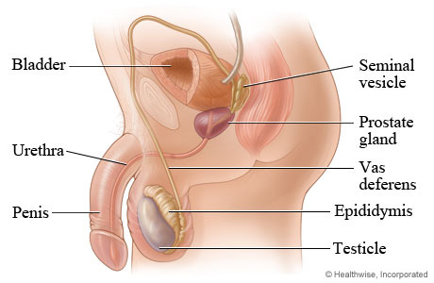
Male Reproductive System

Slide 20
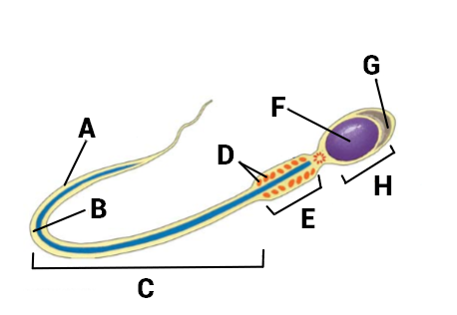
Notes:
What is the purpose of …
How does function relate to form?

Slide 21
