Slide 1
Pregnancy
Fertilization to Birth

Slide 2
Sexual Reproduction in Humans

Slide 3
Miracle of Life: 9 months in 4 minutes
Or this one Ted Ed https://www.youtube.com/watch?v=fKyljukBE70

Slide 4
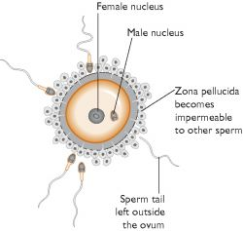
Fertilization: fusion of egg and sperm nuclei
Only about 100 sperm make it to the egg.
Sperm cells reach a jelly-like coating surrounding the egg cell and release substances that digest a path through the coating.
When one sperm penetrates the egg, the egg releases a protein preventing other sperm from getting in.
Fertilization occurs in the fallopian tube.
Notes:
Millions of sperm released into vagina during intercourse. Most die on the way, only about 100 make it to oviduct

Slide 5
Fertilized Egg → Zygote
Within about 30 hr, zygote begins to divide
During the first week, zygote develops into a mass of many cells, which then hollows out and is called a blastula.

Slide 6
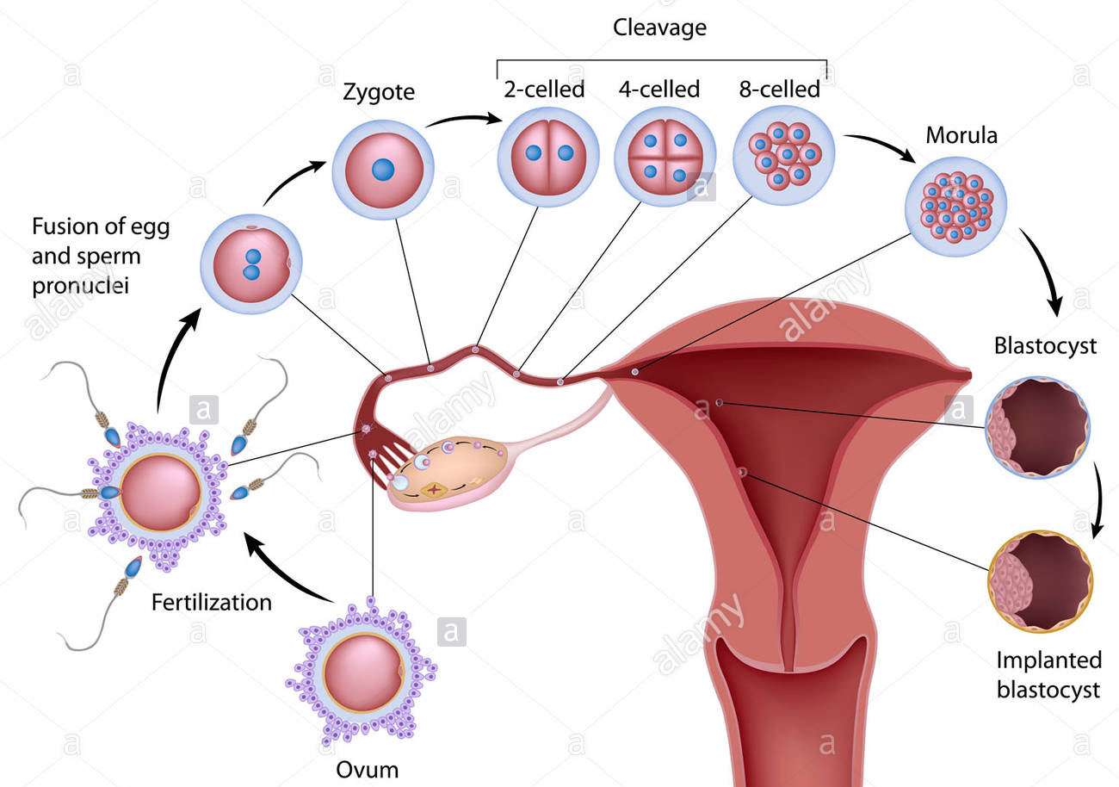

Slide 7
Embryonic Stem Cells
The cells of the blastula are embryonic stem cells.
Stem cells are unspecialized cells that have the ability to reproduce themselves.
All tissues and organs will develop from these cells.
Notes:
Zygote divides to about 150 (stem) cells
Stem cells are unspecialized cells that have the ability to reproduce themselves. When stem cells undergo cell division, the daughter cells will either remain stem cells or differentiate into a specialized cell.
As stem cells divide during fetal development, they lose their ability to grow into all the different types of cells. These can only differentiate into certain families of tissues.
As fetus develops further, stem cells are found in only certain tissues. Stem cells in a specific tissue can only form into the types of cells found in that particular tissue. Eg stem cells in bone marrow can only differentiate into blood cells, not muscle cells.

Slide 8
Differentiation
During the second week, the blastula cells become organized into three distinct layers of cells. (endoderm, mesoderm, ectoderm)
Differentiation is a process of unspecialized cells developing into specialized cells (development of organs and body structures)
Notes:
We have about 200 specialized types of cells in our body

Slide 9
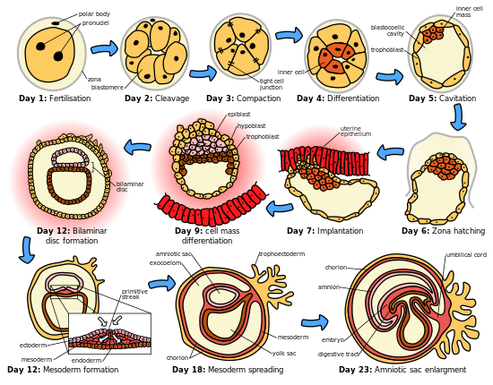

Slide 10
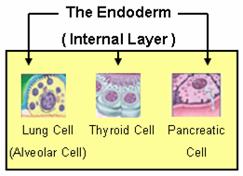
Endoderm – inner layer
Forms: lungs, liver, and lining of the digestive system

Slide 11
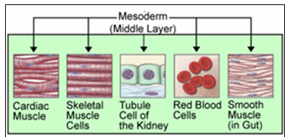
Mesoderm – middle layer
Forms: kidneys, skeleton, muscles, blood vessels, and reproductive organs

Slide 12
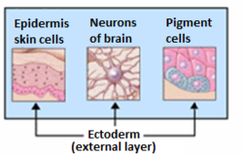
Ectoderm – outer layer
Forms: skin and nervous system

Slide 13
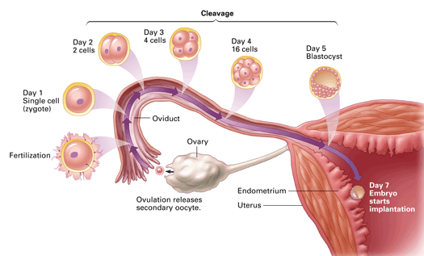
Implantation
After about 1 week, developing zygote reaches the uterus,
where it implants into endometrium (lining of uterus)
and is now an embryo.

Slide 14
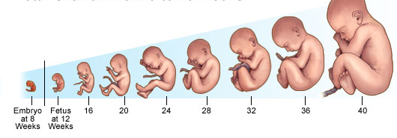
Embryo to Fetus
After about 8 weeks the embryo is called a fetus.
Continues to develop for a total of about 38 weeks.

Slide 15
What happens during fetal development?
During fetal development, the organs and parts of the body continue to develop.
The body adds a great deal of mass
At birth, the human baby is made up of trillions of cells.

Slide 16
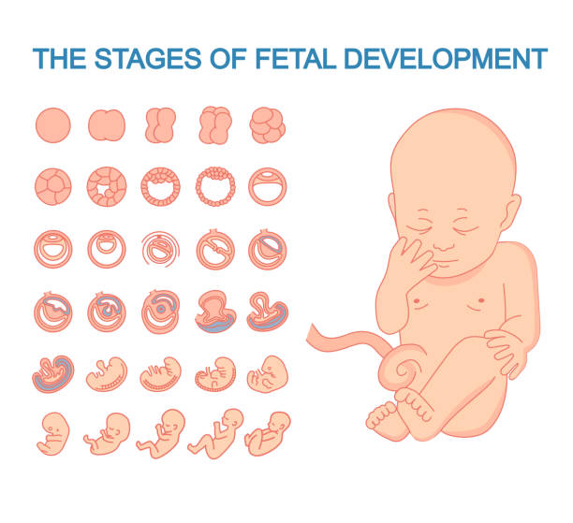

Slide 17
Pregnancy (Gestation)
Pregnancy (gestation) is the time an offspring develops inside mother
about 38 weeks in humans
88 weeks for elephants
3.5 weeks for squirrels
Divided into three trimesters (three-month periods)
Surprising effects of pregnancy, Ted Ed. 6 min
https://www.youtube.com/watch?v=F_ssj7-8rYg

Slide 18
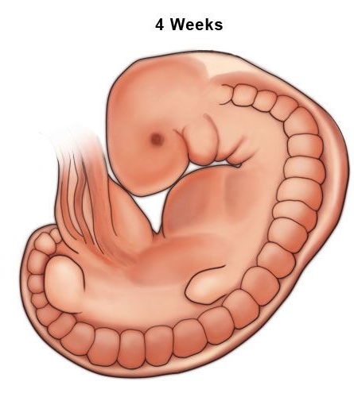
First Trimester: Fertilization to Third Month
After implantation, hormones are released to prevent menstruation.
Amniotic Sac forms around embryo, filled with amniotic fluid (to support, protect and maintain warm environment for embryo).
By end of fourth week, brain and nervous system are developing, heart is beating.
Embryo is about 5 mm long
Notes:
now 500x bigger than zygote

Slide 19
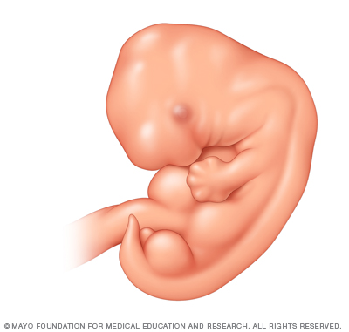
First Trimester: Fertilization to Third Month
End of week 5: eyes, ears, nose start forming
Limb buds and tail visible
https://www.youtube.com/watch?v=8312a32dcQc
5min
Notes:
now 500x bigger than zygote

Slide 20
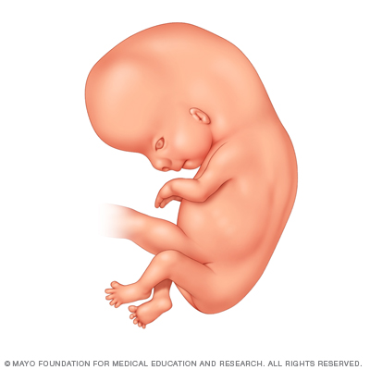
First Trimester
End of week 8, embryo has beginnings of all organs and is called a fetus
Size of lima bean
Receives nutrition from mother through placenta
Fetal waste diffuse into mother’s blood system

Slide 21
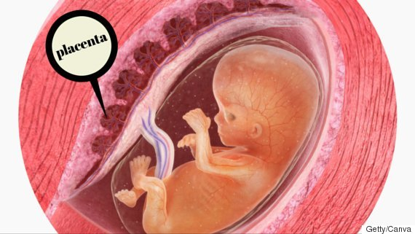
Placenta
Placenta is disk-shaped organ that grows to 20-30cm in diameter
attaches to the wall of uterus, and baby's umbilical cord arises from it.

Slide 22
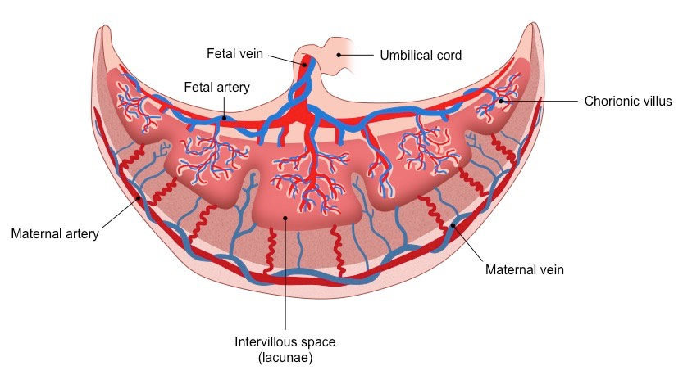
Placenta
Contains vessels from mother and fetus.
Nutrients and oxygen diffuse from mother’s blood into fetus
waste products diffuse from fetus → mother.

Slide 23
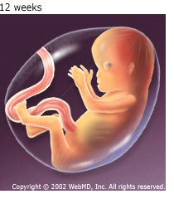
By End of Third Month
Muscles, bones Sex organs forming
Fetus can flex arm and leg muscles
Hiccup
Heart circulates blood
12cm long, 50g,
Mom doesn’t look pregnant yet
Notes:
Mother gains 1kg
Little more than a golf ball, about 2 AA batteries

Slide 24
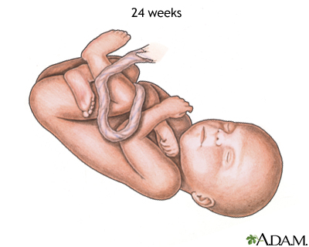
Second Trimester: Intense growth
Heartbeat detected by stethoscope
Movement felt by mom
At 24 weeks: fingers, toes, eyelashes
Covered in fine hair
Fetus sucking and swallowing amniotic fluid, excreted as urine
From 8 cm → 30cm by end of 6 month

Slide 25
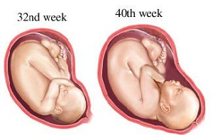
Third Trimester
Organ systems functioning
Rapid brain development
Fetus puts on most of its mass
Sleep and wake patterns
React to stimuli
Eyelids are open
Upside down
37 weeks is considered full term
45-55cm, up to 4.5 kg (average: 53cm, 3,4 kg)
Notes:
7.5 pounds

Slide 26
Birth
Labor and Delivery. 3 min
https://www.youtube.com/watch?v=dYu-0rOnLpA
Labour begins (muscles of uterus contracts ). About 266 days (nine months) after fertilization.
Cervix dilates (opens), baby forced through birth canal (vagina)
Amniotic membrane breaks
When cervix widens to 10cm, uterine contractions push baby’s head into birth canal
Once head and shoulders are free, rest slips out.
When baby is out, placenta delivered
Umbilical cord is cut.

Slide 27
Male Pelvis Female Pelvis

Slide 28
How do twins form?
And what's the difference between identical and fraternal twins?

Slide 29
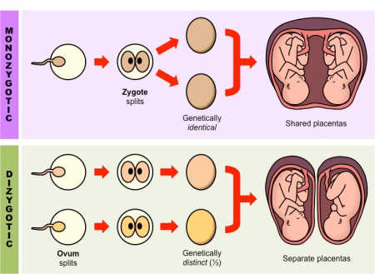
Twins
Identical Twins – one fertilized egg splits at zygote stage or early embryo stage. Share same placenta. Genetically identical.
Fraternal Twins – when two eggs released at same time, both get fertilized. Two placenta.
Genetically different from each other.

Slide 30
Homework
Read pages 117-120
Answer CYU p121 #1-12
Surprising effects of pregnancy, Ted Ed. 6 min
https://www.youtube.com/watch?v=F_ssj7-8rYg
pregnancy stages described 20min: https://www.youtube.com/watch?v=izOa3-AX8zQ

Slide 32
NOVA: Life’s Greatest Miracle 53 min
https://www.pbs.org/video/nova-lifes-greatest-miracle/

