Slide 1
ALGAE
Chapter 20
Living proof of evolutionary trends
Notes:
Living proof of evolutionary trends

Slide 4
General Characteristics of Algae
Eukaryotic
Aquatic
All Photosynthetic (Autotrophic)
Aquatic
Have Cell walls made of cellulose
Most are Multicellular, some Unicellular (resemble protists)
A life cycle called alternation of generations (Sexual and asexual reproduction)
Notes:
Therefore all have chlorophyll. Therefore, they all use chlorophyll)
b) All algae have chlorophyll A
c) Some algae have evolved different types of chlorophyll and/or accessory pigments to help capture more light energy. (or different wavelengths of light)
. so they must remain close to a source of water.
so they cannot go too far from a source of water without drying out.
Vary in size from microscopic to over 60 meters in length.

Slide 5
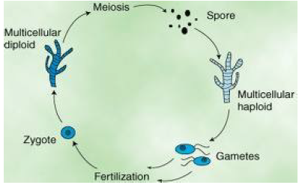

Slide 6
3 types of Asexual Reproduction in Algae
1. Fragmentation – piece breaks off and grows into a new individual
2.Asexual spores = haploid
3.Mitotic division = simple cell division

Slide 7
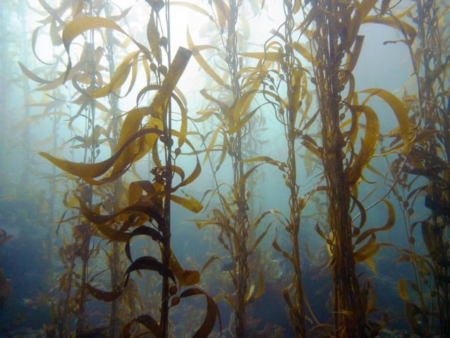
Algae – Mostly Multicellular
Eg. giant kelp, brown algae,
Green Algae
Red Algae
Notes:
Latin for seaweed

Slide 8
Most Algae are classified into Kingdom Plantae
Because they are:
Photosynthetic
mostly multicellular
eg. Ulva p438, Brown Algae, Red p439, 441
Eg. Seaweed like Kelp

Slide 9
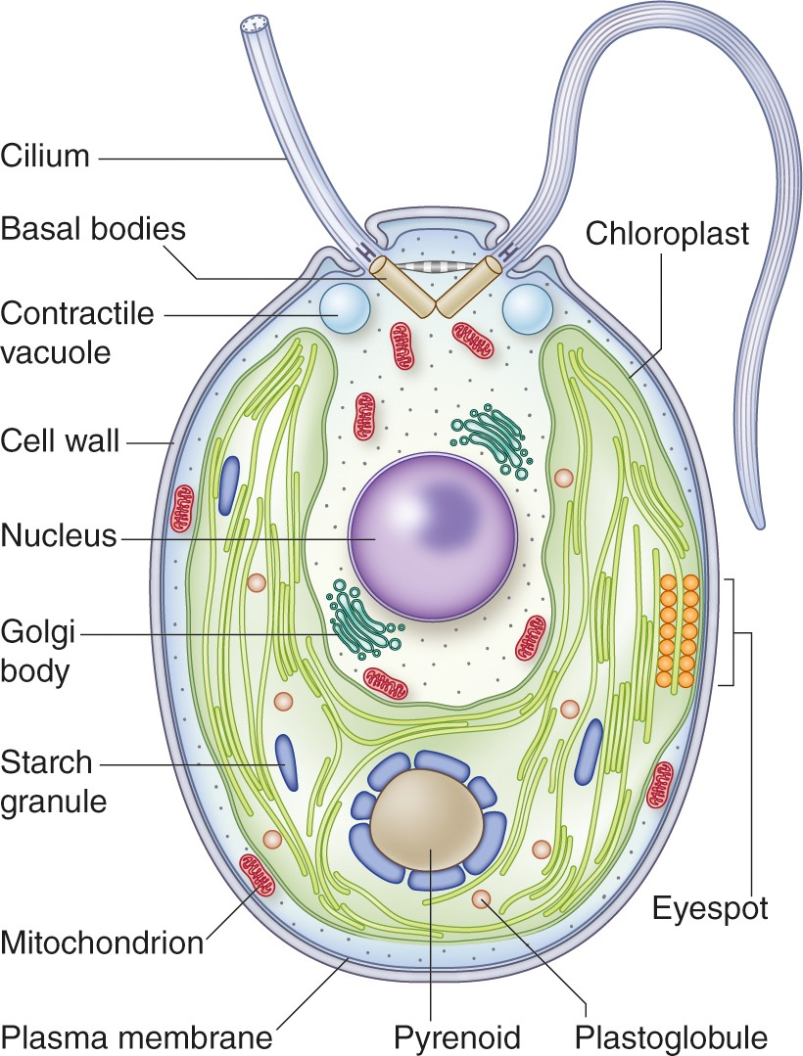
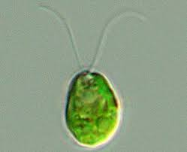
Some algae can be unicellular and even be classified as protists
Eg. Green algae Chlamydomonas p 437
Has flagella and light sensing eye spot

Slide 10
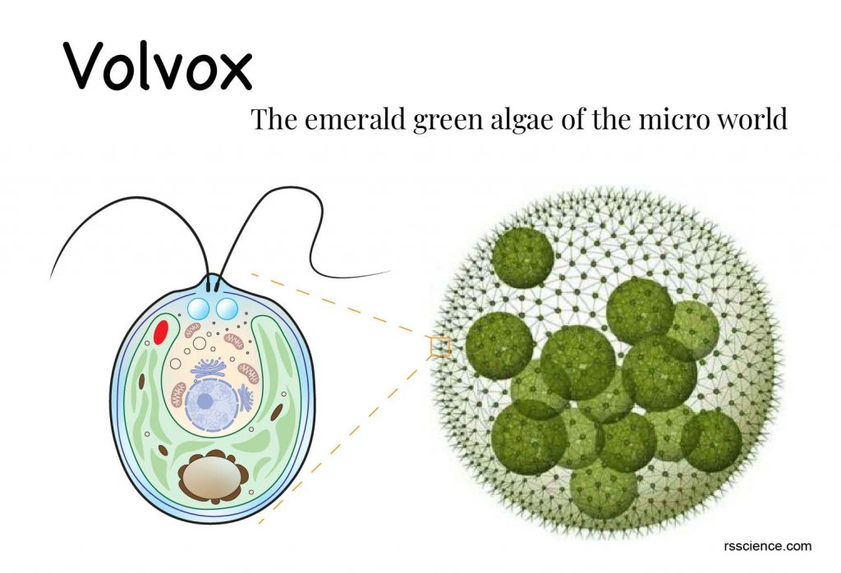
Some algae are colonial (Volvox), p437

Slide 11
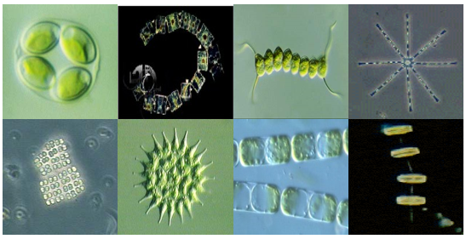
BUT Some algae can be classified as Protists
Because some are:
Unicellular, motile, live in colonies.
Have cilia or Flagella (therefore motile (have cilia or flagella)
Eg. Diatoms, dinoflagellates
Colonies: Assemblage of individual cells work together but do not have specialized cells.
Eg. Green Algae: Volvox
Notes:
Euglena, - protist but has chlorophyll

Slide 12
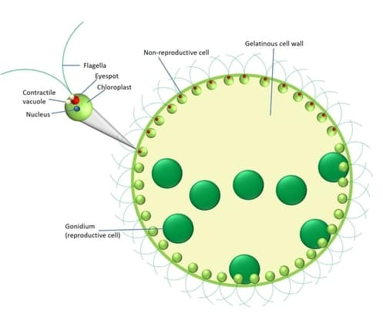
Volvox - Multicelluar, colonial

Slide 13
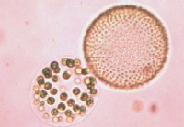
Eg. Coenobium: Colony with constant number of cells, which cannot survive alone; specific tasks among groups of cells is common

Slide 14
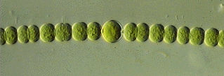
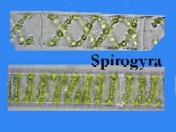
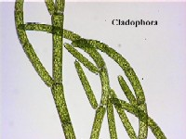
Filaments: daughter cells remain attached after cell division and form a cell chain; adjacent cells share cell wall

Slide 15
What’s the advantage of being Unicellular?
Unicellular organisms can function independently from one another, although each organism may require another organism for the sexual part of their reproductive cycle.
Eg. Chlamydomonas:
P 437, 440

Slide 16
What are some advantages of being Multicellular?
Notes:
Multi-cellular organisms have many cells working together, and some of those cells are specialized

Slide 17
Advantage of being Multicelluar
You’re bigger, so fewer things can eat you.
Allows for specialization of cells (tissues).
More surface area for photosynthesis,
Some cells can be expendable: The death of one cell doesn’t cause the death of the organism
It’s easier to stay in one place: some cells hang on, and some cells photosynthesize.
Notes:
If something decides to eat you, if you’re in a big group, chances are you won’t be the one that gets eaten. (I don’t have to swim faster than a shark; I just have to swim faster than you!!!)

Slide 18
How are Algae Classified?
Types of chlorophyll and accessory pigments
How they store their food.
Three Main Groups:
Brown algae, Green algae, and Red algae.

Slide 19
What does a plant need to survive?

Slide 20
What does a plant need to survive?
Sunlight
Water
Nutrients
To reproduce

Slide 21
Algae
Have no specialized tissue to transport water.
Have no specialized tissue to conserve water
Their gametes need to swim
They DO have chlorophyll for photosynthesis
How do algae overcome some obstacles?

Slide 22
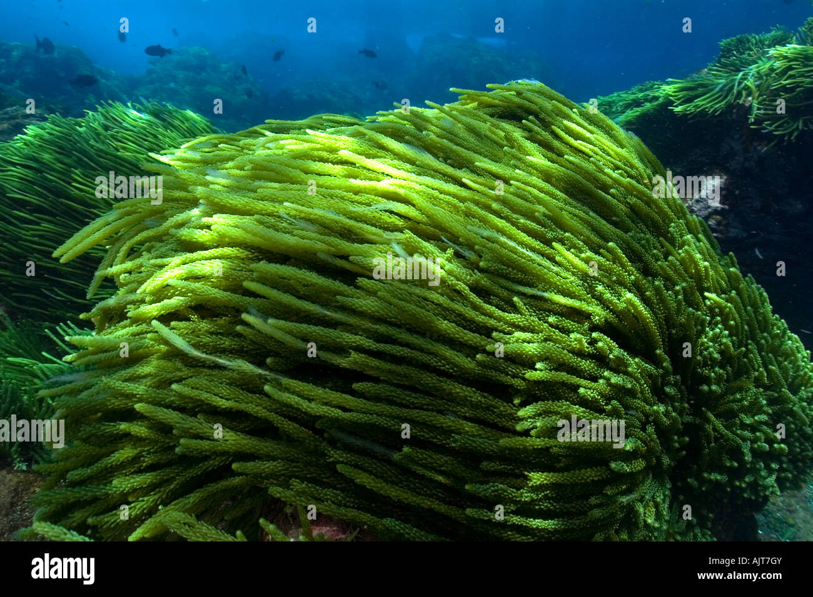
First Plants originated from the sea
Sea provides:
support,
Constant temperature,
bathes whole plant with nutrients,
Medium for reproduction.

Slide 23
Advantages of being Aquatic
No need to transport water
No need to conserve water or prevent evaporation
Water bathes plant in nutrients and carries away wastes
No specialized structures for support: Structures can be very thin (better for exchange of gasses, water, nutrients)
Water provides medium in which gametes can swim
Notes:
No roots, stems, leaves

Slide 24
Advantages of being Aquatic
No need to transport water
No need to conserve water or prevent evaporation
Water bathes plant in nutrients and carries away wastes
No specialized structures for support: Structures can be very thin (better for exchange of gasses, water, nutrients)
Water provides medium in which gametes can swim
Algae have No roots, stems, leaves

Slide 25
Advantages of living in an Aquatic Environment
No danger of drying out
No specialized tissues needed for carrying water
No specialized structures needed for support
Reproductive cells can swim through water
Structures can be very thin
(better for exchange of gasses, water, nutrients)

Slide 26
Disadvantages
Water absorbs (blocks) much of the sun’s energy that chlorophyll needs as it passes through it
particularly, sea water absorbs large amounts of red and violet wavelengths
Especially at lower depths
How do algae overcome this?

Slide 27
Algae
Must get water and nutrients directly from environment.
Therefore must have very thin tissues so nutrients and waste can diffuse through cells.
Also, what about algae (seaweed) living deep below the surface where there is less light?

Slide 28
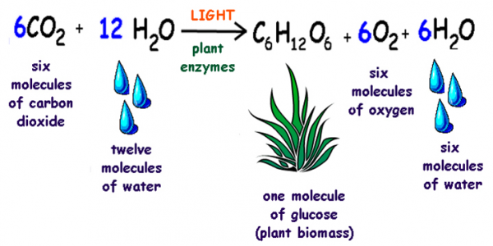
Review Photosynthesis
v

Slide 29
Photosynthesis happens in the chloroplast and uses pigment called chlorophyll
All algae use chlorophyll type a
Green Algae use chlorophyll a and b
Notes:
Chlorophyll a absorbs protons and facilitates the transfer of light energy into food energy with help from accessory pigments, such as chlorophyll b, a molecule with many similar characteristics.

Slide 30
Different chlorophylls
Many algae have evolved different chlorophylls and accessory pigments that absorb different wavelengths:
All plants use chlorophyll a
Chlorophyll b
Chlorophyll c
Chlorophyll d
Accessory pigments
Accessory pigments have a slightly different molecular structure than chlorophyll a that facilitate absorption of different colors on the light spectrum.
Notes:
Accessory pigments are light-absorbing compounds, found in photosynthetic organisms, that work in conjunction with chlorophyll a. They include other forms of this pigment, such as chlorophyll b in green algal and higher plant antennae, while other algae may contain chlorophyll c or d.

Slide 31
Photosynthesis happens in the chloroplast and uses pigment called chlorophyll
All algae use chlorophyll type a
Green Algae use chlorophyll a and b
Chlorophyll a absorbs red light very well,
Chlorophyll b absorbs blue light very well.
Notes:
Chlorophyll a absorbs protons and facilitates the transfer of light energy into food energy with help from accessory pigments, such as chlorophyll b, a molecule with many similar characteristics.

Slide 32
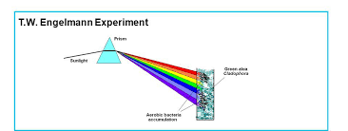
How do we know this?
1881, German plant physiologist, T. W. Engelmann, wanted to find which part of the light spectrum algae use in photosynthesis.
He placed filamentous green algae under a microscope, and shone different wavelengths of light.
Notes:
Action Spectra = the rate of a physiological activity plotted against wavelength of light.

Slide 33
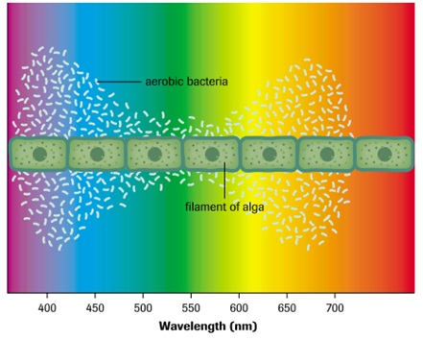
How do we know this?
Since algae give off oxygen when they photosynthesise, a good way to measure the efficacy of each wavelength for photosynthesis was to measure the oxygen output.
To measure the oxygen output, Englemann placed aerobic (oxygen needing) bacteria along the filament.
He figured that they would go where the oxygen was being produced the most.
Notes:
Action Spectra = the rate of a physiological activity plotted against wavelength of light.

Slide 34
Photosynthesis:
After a few minutes, the bacteria had congregated around the portions of the filament illuminated by red and blue light.
He found that the bacteria went to the parts of the table where the red and the blue light were being shone.
He therefore concluded that red and blue light were the best types of light for photosynthesis in green algae.
Assuming that the bacteria were congregating in regions where oxygen was being evolved in photosynthesis, Engelmann concluded that red and blue light are the most effective colors for photosynthesis for green algae

Slide 35
Photosynthesis:

Slide 37
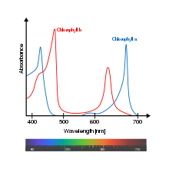
We now know that green algae use chlorophylls a and b for photosynthesis.
Chlorophyll a absorbs red light very well,
Chlorophyll b absorbs blue light very well.

Slide 38
Problem:
Ocean water absorbs most of the green and red light
Leaving more of the blue light at greater depths.
Dim blue light contains very little energy that chlorophyll a can use
So it might be difficult for algae with chlorophyll “a” to photosynthesise deep in the ocean.
Notes:
So the deeper you go, the dimmer and more blue the light becomes.

Slide 39
Chlorophyll b absorbs blue light.
Plants that receive less sunlight have more chlorophyll “b” in their chloroplasts to absorb more blue light
An increase in chlorophyll B is an adaption to living in the shade, as it allows the plant to absorb a broader range of wavelengths of light.
Chlorophyll ‘b’ transfers the extra energy it absorbs to chlorophyll ‘a’.

Slide 40
Different chlorophylls
Many algae have evolved different chlorophylls and accessory pigments that absorb different wavelengths:
Chlorophyll b
Chlorophyll c
Chlorophyll d
Accessory pigments
Accessory pigments have a slightly different molecular structure than chlorophyll a that facilitates absorption of different colors on the light spectrum.
Notes:
Accessory pigments are light-absorbing compounds, found in photosynthetic organisms, that work in conjunction with chlorophyll a. They include other forms of this pigment, such as chlorophyll b in green algal and higher plant antennae, while other algae may contain chlorophyll c or d.

Slide 41
Chlorophyll b transmits green light and mainly absorbs blue and red light. Captured sun energy is handed over to chlorophyll a, which is a smaller but more plentiful molecule in the chloroplast.
Carotenoids reflect orange, yellow and red light waves. In a leaf, carotenoid pigments cluster next to chlorophyll a molecules to efficiently hand off absorbed photons. Carotenoids are fat soluble molecules, also believed to play a role in dissipating excessive amounts of radiant energy.
Xanthophyll pigments pass along light energy to chlorophyll a and act as antioxidants. The molecular structure gives xanthophyll the ability to accept or donate electrons. Xanthophyll pigments produce the yellow color in fall leaves.
Anthocyanin pigments absorb blue-green light and aid chlorophyll a. Apples and autumn leaves owe their vibrancy to reddish, violet anthocyanin compounds. Anthocyanin is a water-soluble molecule that can be stored in the plant cell vacuole.

Slide 42
Plants that receive less sunlight have more chlorophyll B in their chloroplasts.
An increase in chlorophyll B is an adaption to the shade, as it allows the plant to absorb a broader range of wavelengths of light.
Chlorophyll B transfers the extra energy it absorbs to chlorophyll A.

Slide 43
Accessory pigments
Accessory pigments are light-absorbing compounds that work in conjunction with chlorophyll a.
They absorb different wavelengths of light than chlorophyll and pass the energy they absorb on for photosynthesis.
Reflect different wavelengths of light than chlorophyll → wide range of algae color
Notes:
Accessory pigments are light-absorbing compounds, found in photosynthetic organisms, that work in conjunction with chlorophyll a. They include other forms of this pigment, such as chlorophyll b in green algal and higher plant antennae, while other algae may contain chlorophyll c or d.

Slide 44
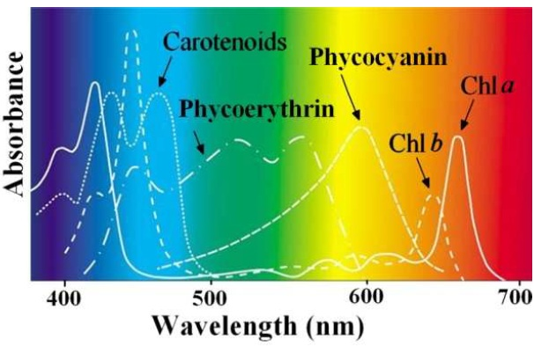
Each photosynthetic pigment will absorb different wavelengths of light.
Different wave lengths of light penetrate the ocean surface to different depths.
That is why you will find different algae at different parts of the intertidal zone.

Slide 45
How are Algae Classified?
Algae are classified by
their types of chlorophyll and accessory pigments
How they store their food.
Three Main Groups:
Brown algae, Green algae, and Red algae.

Slide 46
Practice
Algae WS

Slide 47
Extra Slides Beyond Here

Slide 48
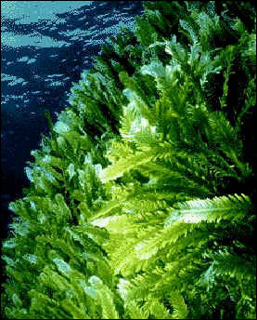
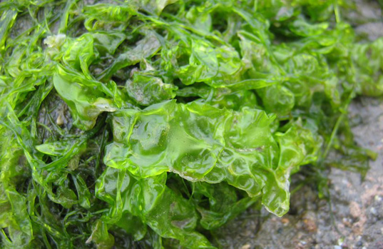
GREEN ALGAE = PHYLUM CHLOROPHYTA
Chorophylls a & b (just like higher plants
Store food as STARCH, inside their plastids (just like higher plants)
Have relatively stiff cell walls made out of cellulose (just like higher plants)
Believed to give rise to land plants
Found in shallow water (intertidal zone) as the sunlight that chlorophyll a and b uses doesn't penetrate the ocean well.
Notes:
Cellulose is an organic compound – polysaccharide
Cellulose is the main substance in the walls of plant cells, helping plants to remain stiff and upright.

Slide 49
Chlorophyta: (Green Algae)
About 8000 species
Mostly aquatic, but some live on glaciers, on tree trunks or in extremely wet terrestrial environments
At one point in their lifecycle, they closely resemble a tangled matt of moss
Notes:
All plants, algae, and cyanobacteria which photosynthesize contain chlorophyll "a". A second kind of chlorophyll is chlorophyll "b", which occurs only in "green algae" and in the plants.

Slide 50
Examples of Green Algae:
Udotea cyathiformis Acetabularia calyculus Cymopolia barbata

Slide 51
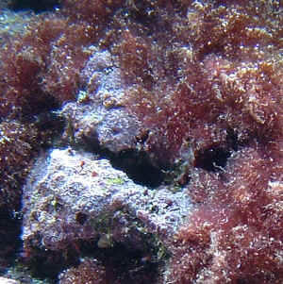
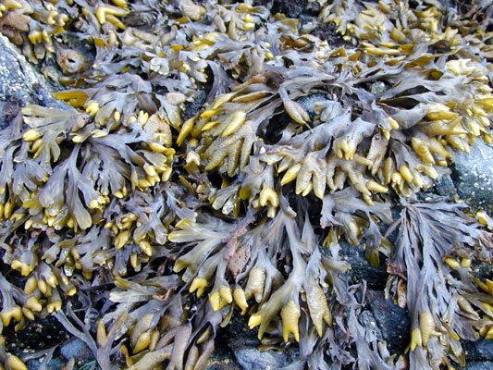
BROWN ALGAE = PHYLUM PHAEOPHYTA
Most common type of multicellular algae

Slide 52
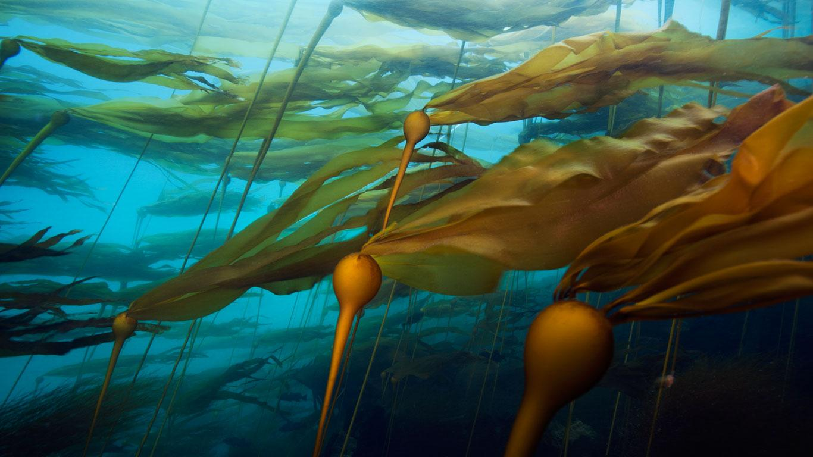
Phaeophyta: (Brown Algae)
Cool water: Found in shallow coastal waters in temperate and arctic zones
Contain chlorophylls a & c
Also contain accessory (carotenoid) pigment fucoxanthin
They store their food as special starches and oils

Slide 53
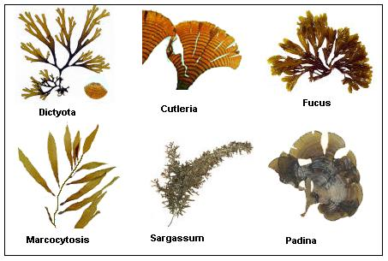

Slide 54
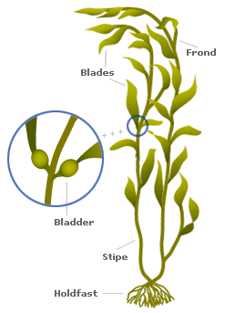
Blades
Stipe
Holdfast

Slide 55
The thallus (or body) of the brown kelp algae, is made of:
a) Holdfast - base used to attach to rock or bottom
b) Stipe - flexible and used for flotation - most without vascular tissue so not the same as the stem of a land plant

Slide 56
c) Pneumatocyst - air bladder to help blades float at surface d) Blade - leaf like structure that floats on surface to collect sunlight for photosynthesis and energy.

Slide 57
Examples of Brown Algae: (not always brown)
Dictyota pfaffii Dictyota menstraulis

Slide 58
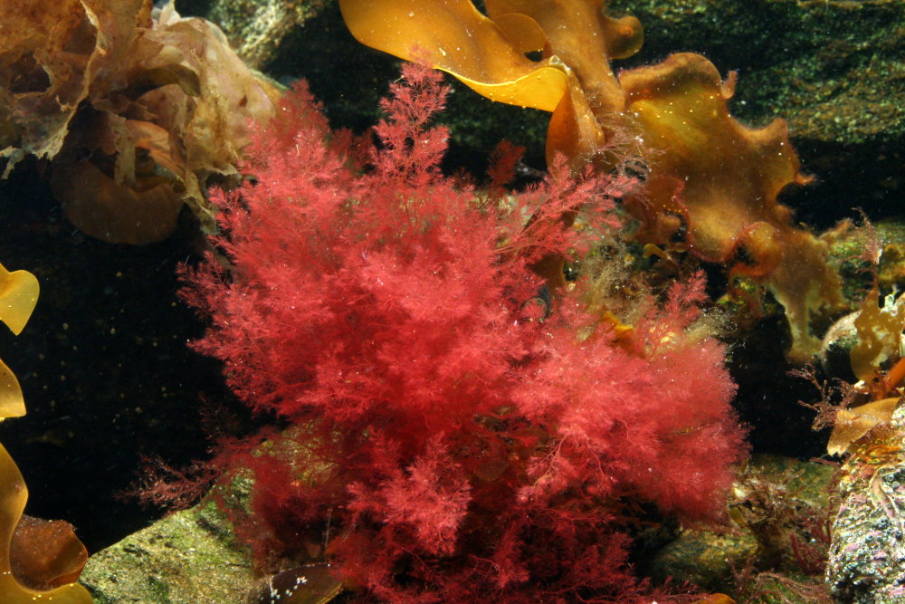
RED ALGAE = PHYLUM RHODOPHYTA
CONTAIN CHOROPHYLL a & sometimes d
Also have accessory pigment Phycoerythrin and phycobillins
Store their food as floridean starch
Live deeper in the oceans because is very efficient at absorbing blue light
6000 species (mostly marine)
Chloroplasts look very much like cyanobacteria’s
Notes:
red algae has a pigment that can penetrate deep into the ocean (absorbs blue light)

Slide 59
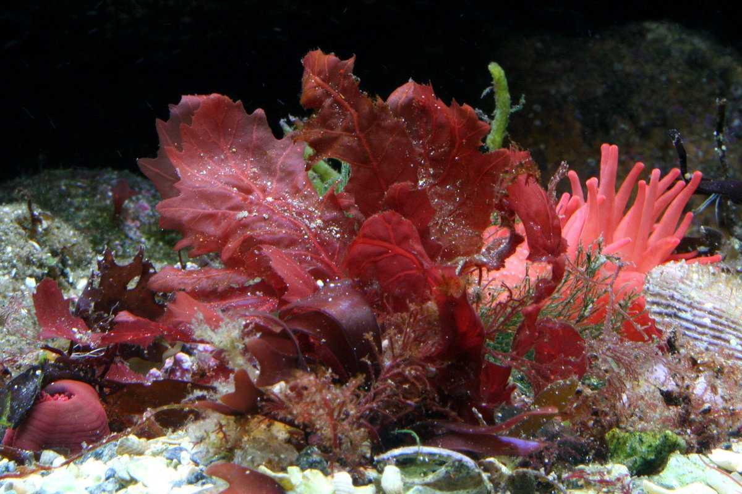
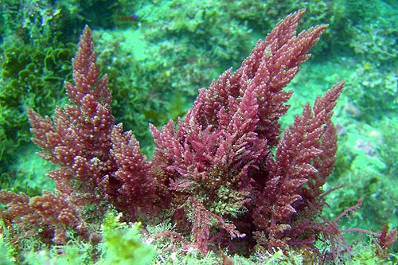
Examples of Red Algae:
Halymenia floresia Pleonosporium dasyoides Amphiroa hancockii

Slide 60
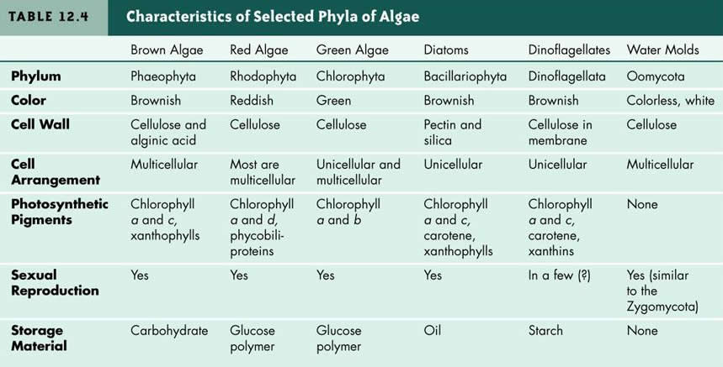

Slide 61
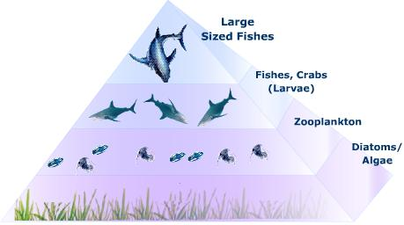
Importance of Algae
Major source of oxygen: single cell algae produce oxygen than anything else.
Major source of food for fish (and thus indirectly of many other animals), are a keystone in the aquatic food chain of life; they are the primary producers of the food that provides the energy to power the whole system.
oxygen is produced through a process called photosynthesis, where algae and plants use sunlight, water and carbon dioxide to produce the oxygen.
Notes:
Algae, the major food of fish (and thus indirectly of many other animals), are a keystone in the aquatic food chain of life; they are the primary producers of the food that provides the energy to power the whole system.

Slide 62
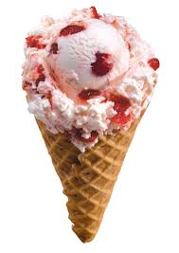
Other Uses of Algae
Food for people and livestock
high in iodine therefore improves thyroid function and decreases goiter issues
shampoo (thickener)
ice cream thickener
pharmaceuticals
paint
agar
pie fillings
canned meat

Slide 63
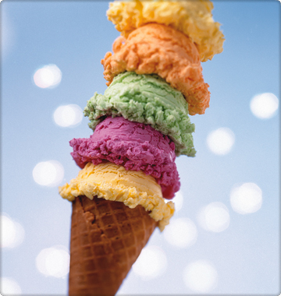
More Uses
Seaweeds, e.g., the kelps and the red algae (nori), have long been used as a source of food, especially in Asia.
Kelp are also much used as fertilizer, and kelp ash is used industrially for its potassium and sodium salts.
agar and carrageen, used as a stabilizer in foods, cosmetics, and paints.

Slide 64
Check your understanding
What are common characteristics among algae
What are some adaptations to life in water?
How are algae classified?
List the differences between colonial and multicellular algae
Define alterations of generations
Discuss various ways algae reproduce
What is the importance of algae in the world?
What are some uses of algae in everyday life?

Slide 65
Algae Life Cycle

Slide 66
Practice
Read pages 433 – 439
Answer Section Review Qs 1,2,3 on page 439
Complete 1-14 on vocabulary sheet

Slide 67
Assignment
1. Write a paragraph explaining how the following adaptations contribute to the survival of algae in water and might not contribute to the survival of algae on dry land
Thin leaf like structures
No waterproof covering
No stem like structures
No system of internal tubes
2. Write a paragraph explaining the restriction that aquatic life places on algae’s photosynthetic ability, the proof of this theory, and the adaptations it has resulted in

Slide 68
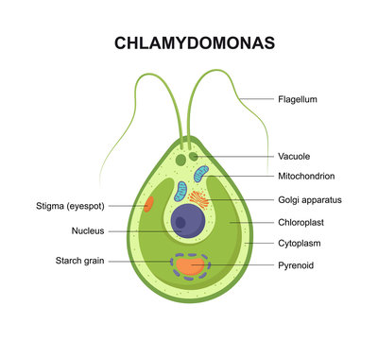
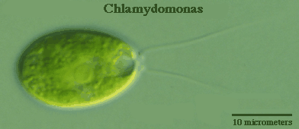
Reproduction in Chlamydomonas (green algae)
Single-celled, spend most of life in haploid stage, reproducing asexually, dividing to make haploid zoospores.
In unfavorable conditions, it will switch to sexual repro
As mature cell is already haploid, it simply releases gametes instead of zoopsores.
“+” and “-” gametes look the same = isogamy.
Gametes fuse (syngamy) to make a zygote
Zygote sinks, grows a protective wall to withstand harsh conditions, grows when conditions are favorable. Divides by meiosis → 4 haploid cells.

Slide 69
Volvox
Multicelluar, colonial

Slide 70
Reproduction in Algae

Slide 71
Reproduction in Ulva
Alternation of generations
Both phases are multicellular
Sporophyte is 2n
Gametophyte is n
Gametes look different (heterogamy)
Zygote does not rest but instead divides into multicellular 2n sporophyte.
Sporophyte produces n zoospores by meiosis,
Zoospores grow into different types of gametophytes.
All three phases look the same to naked eye

Slide 72
Reproduction in Fucus (brown algae)
Alternation of generations and heterogamy (gametes look different)
Resembles land plants: no multicellular n gametophyte.
Only 2n sporophyte is multicellular, with different reproductive areas → eggs, sperm
Zygote sinks, grows into new 2n sporophyte

Slide 74
Asexual Reproduction in Algae
1. Fragmentation – piece breaks off and grows into a new individual
2. Spores = haploid
3. Mitosis = simple cell division used in single celled algae

Slide 75
Sexual Reproduction in Algae
Two gametes fuse to form a zygote
There are two types of gametes:
1. Isogamy = identical gametes (isogametes), same size & structure.
When isogametes fuse =conjugation.
Isogametes are differentiated by + and – (like fungus)
2. Heterogamy = gametes differ in size & structure. Larger = egg; smaller = sperm. When egg & sperm fuse called fertilization

