Slide 1
Taxonomy and Classification
Chapter 15
Pages 318-333

Slide 2
Learning Goals
taxonomic principles for classifying organisms
• binomial nomenclature
• First Peoples knowledge on classification
• similarities and differences between domains and kingdoms

Slide 3
Taxonomy vs Classification: What’s the difference?
Taxonomy describe relationships between items.
Classification simply groups items according to one or two attributes.
taxonomy: Greek “taxis,” meaning arrangement, and
“nomia,” meaning distribution or method.
taxonomy deals primarily with the description, identification, nomenclature, and classification of organisms.
It is essential to classify living organisms into different groups and subgroups.
Notes:
humans and whales are two unrelated organisms from different perspectives; however, both are considered mammals and taxonomically related
The scientific definition of taxonomy is that it involves the classification of organisms both alive and extinct. Also, it includes the naming and arranging of organisms in higher groups. So what does taxonomy mean? Taxonomy involves studying living organisms such as animals, plants, microorganisms, and humans to classify them in different categories to study further and identify. For instance, humans and whales are two unrelated organisms from different perspectives; however, both are considered mammals and taxonomically related.

Slide 4
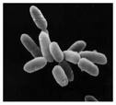
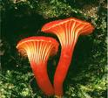
Why Classify?
Scientists have identified over 2.5 million identified species
It is estimated there may be 20 million more that have not been discovered.
Need a way of keeping track of all of these!

Slide 5
Why Classify?
To work with the overwhelming diversity of life, we need a system of biological classification that names and orders organisms in a logical manner.

Slide 6
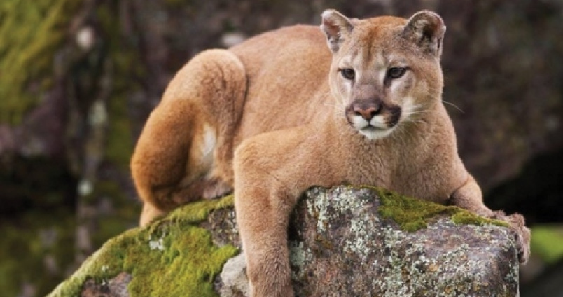
Notes:
What is this called

Slide 7
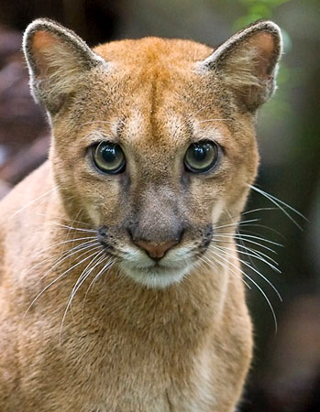
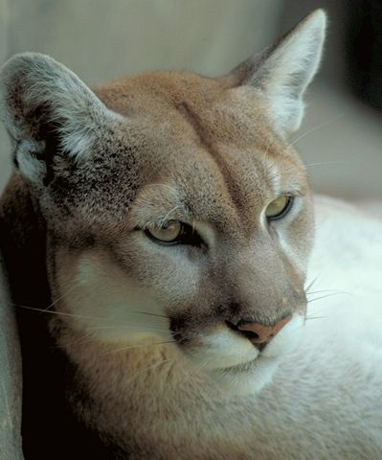
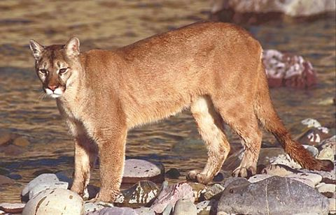
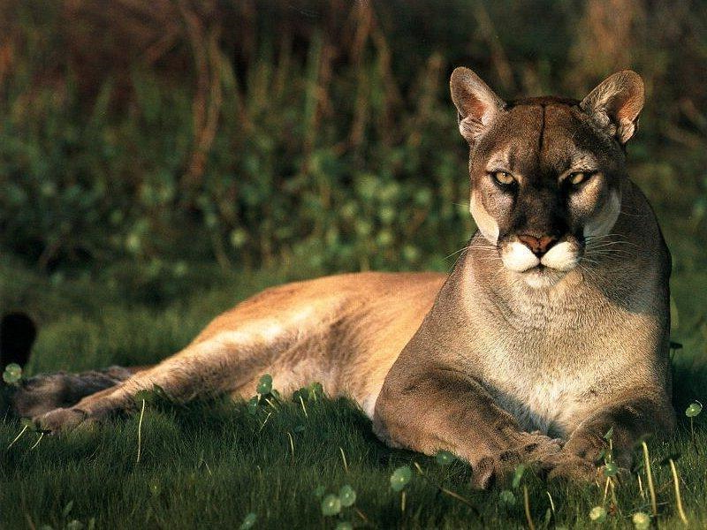
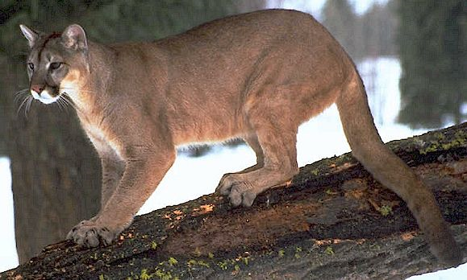
Why is a naming system important?
Florida panther
Cougar
Mountain lion
Catamount
Puma
They are all the SAME animal!
Their difference is their regional “common name”
Notes:
One of the biggest challenges is having different names for the same organism in different parts of the world

Slide 8
What makes a good classification system?
A good classification system must assign a universally accepted name for each organism
And provides a basis for grouping based on relationships
Crash Course https://youtu.be/F38BmgPcZ_I
Notes:
Avoids confustion of regional names – puma / mountain lion
makes it easier for biologists to communicate
makes it easier to identify a species

Slide 9
History of Naming of Organisms
Originally biologists used common names to describe the physical characteristics of the organisms
Unfortunately not everyone used the same characteristics and many of these names were very long.
Modern naming is based on Greek and Latin words as they were understood everywhere.

Slide 10
History of Taxonomy
Swedish botanist, Carl Linnaeus (1707-1778) developed a two part naming system for each organism called: Binomial Nomenclature
Puma concolor
Homo sapiens
Notes:
Names are descriptive

Slide 11
Binomial Nomenclature
1st name = Genus - always capitalized.
2nd name is = species – lower case, normally describes a characteristic
Eg. Red Maple: Acer rubrum
rubrum mean red
E.g. Urusus americanus, the black bear.
The whole name is in italics or underlined

Slide 12
Finish crash course at 6min

Slide 13
Classifying Organisms
Linnaeus then developed a system of classification by grouping organisms based on similar characteristics like (shared body structures) .
These groups are called taxa (singular = taxon).
He Introduced the HIERARCHY of class, order, genus, species.
Initially his system originally had only TWO Kingdoms:
plants and animals
Notes:
NOT based on colour
Created workable “keys” to identify plants and animals from his works

Slide 14
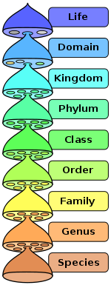
Levels of Organization Today
Domain
Kingdom
Phylum
Class
Order
Family
Genus, species
Notes:
King Phillip came over

Slide 15
Organized based on their features.
Each “level” becomes more specific until there is only one organism in a category – this is the species level.
Organisms in each taxon become more closely related as you move down

Slide 16
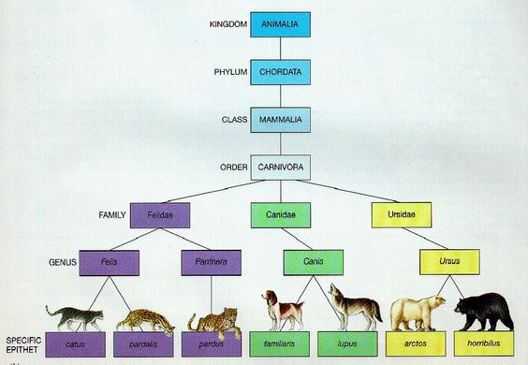

Slide 17
Mnemonic
Kids Playing Chicken On Freeways Get Squished
Kings Play Chess On Fancy Glass Stools
King Phillip Came Over For Good Soup
Kids Prefer Cheese Over Fried Green Spinach
Kings Prefer Chocolate Over Fudge Generally Speaking

Slide 18
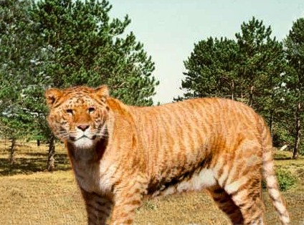
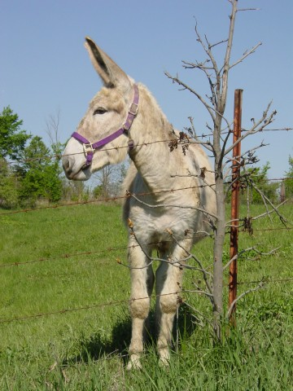
What defines a Species?
Smallest taxon
A population of organisms that share similar characteristics and that can breed with one another to make viable progeny
If two species share many features but are clearly separate biological units, they are classified as different species within the same genus.
Sometimes different species can produce offspring, but that offspring isn’t fertile
Eg. Horse and donkey = mule (sterile)
Eg. Lion and tiger = Liger (sterile)

Slide 19
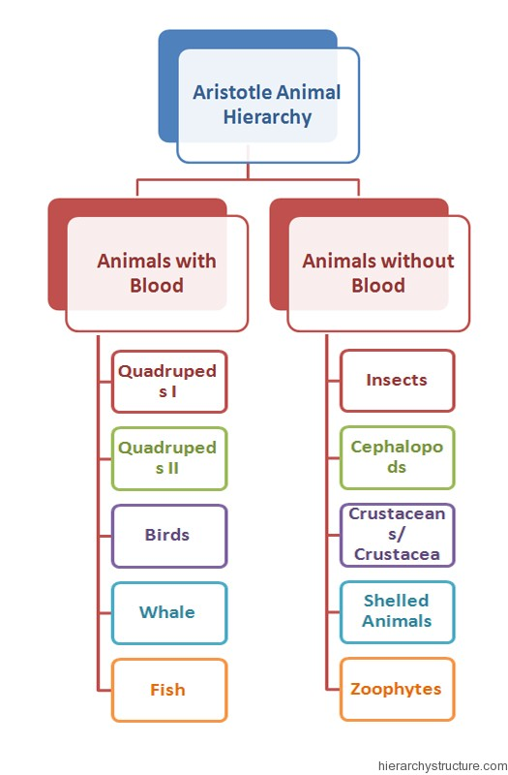
Other ways of Classifying
Aristotle developed the first system of classification of animals based on physical characteristics.
Animals with "red blood." were vertebrates (animals with a backbone)
Animals without red blood correspond to invertebrates.
Notes:
divided animals into two groups, then 5 genera/group, then into species within each genus.

Slide 20
Aboriginal classification (Australians)
Aboriginal classification had SIMILARITIES to western taxonomy:
Hierarchical: organisms grouped in levels, each higher level containing the ones below it.
Binary: often based on use, age, stage in life cycle, sex, social status, and totemic association (symbolic of clan)
eg,. edible or inedible, totemic or non-totemic.
Notes:
Totemic = symbolic or representative of a particular quality or concept.
serving as the emblem of a family or clan and often as a reminder of its ancestry;

Slide 21
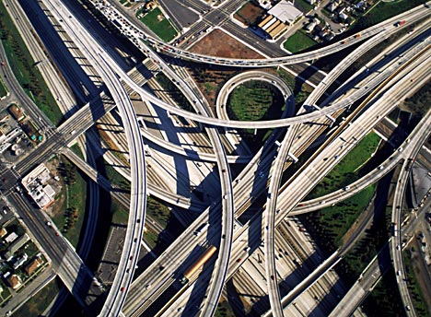
What factors contribute to how organisms are classified?
Evolutionary connections
Homologous structures
Embryonic development

Slide 22
Summary
A good system of classification must be agreed upon by all and Groups organisms by attributes and relationships.
Hierarchical grouping, gets more specific the further down you go.
Organisms are more closely related the farther down you go.
All organisms have a binomial nomenclature.

Slide 23
Check your understanding
Why are classification systems useful?
What are some characteristics of a good classification system?
Describe the importance of the classification of system developed by Carolus Linaeus
Identify the different taxa that make up the classification system developed by Linnaeus
Explain how the 6Kingdom system represents evolutionary trends
Discuss characteristics of organisms placed in each of the 6 kingdoms.

Slide 24
makes it easier for biologists to communicate (avoids confusion of regional names)
makes it easier to identify a species

Slide 25
Check your understanding
What is taxonomy?
What are the 7 taxa?
Why is taxonomy important in the study of biology?
Canis lupus is the scientific name for the grey wolf. What is the species name for the grey wolf? What is the genus?
The term “cavemen” could refer to Homo neaderthalensis. Is Homo neaderthalensis in the same species as humans? Is Homo neanderthalensis in the same genus as humans?
Which of two of the three organisms must be more closely related?

Slide 26
Practice
Read pages 317 - 322
Classification Reading Check worksheet
Naming WS

Slide 28
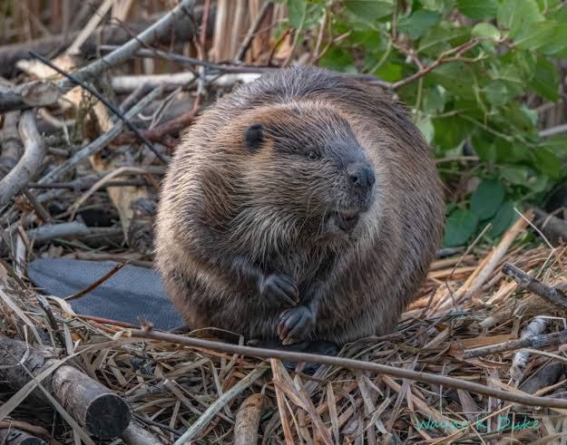
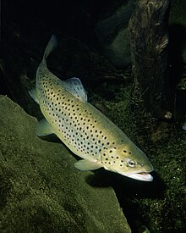
Beavers classified as fish?
Bible says Jesus sacrificed his flesh for his people on Good Friday, so people would refrain from eating flesh meat in his honor on Fridays.
Eating meat was associated with feasting.
For many, eating fish was okay.
Loophole: As the beaver lived in the water and swam with the fishes, it was considered a fish and therefore okay to eat on Fridays.

Slide 30
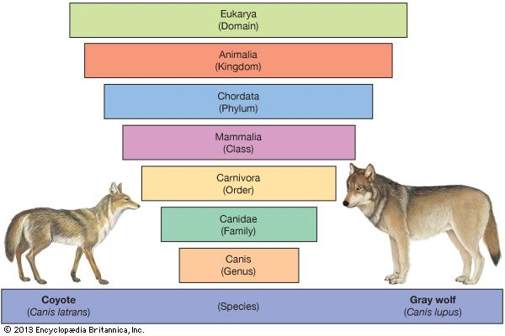

Slide 31
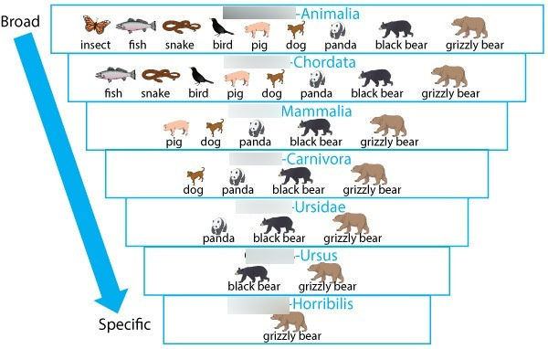

Slide 32
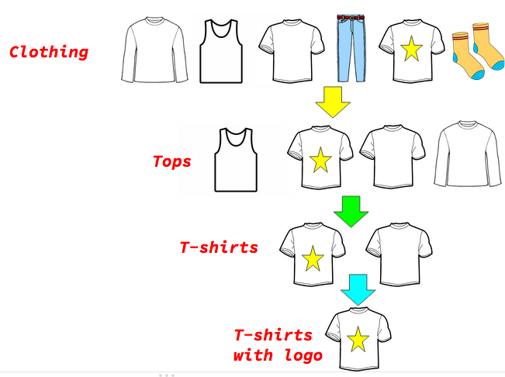
Notes:
You could divide them into groups like pants, tops, underwear, etc.
Then subdivide each pile into smaller groups: tank tops, long sleeves, T-Shirts, etc.
As you keep dividing based on more specific details, you are them with a single piece of clothing.

Slide 33
Check your understanding
What is taxonomy?
What are the 7 taxa?
What are the 6 kingdoms?
Why is taxonomy important in the study of biology?

Slide 34
Summary
Linnaeus created a classification system in the 1700s based on organism characteristics.
Many of the groupings still hold up today, but taxonomy is constantly changing due to new technology (especially DNA)
The 3 domain and 6 kingdom system is the most modern
The system goes: Domain, Kingdom, Phylum, Class, Order, Genus, Species
Binomial nomenclature = scientific name (Genus species)

Slide 35
Practice
Classification Reading Check WS
Describe each kingdom
Taxonomy Worksheets

Slide 36
Extra Slides Beyond here

Slide 37
Beavers classified as fish?
Bible says Jesus sacrificed his flesh for his people on Good Friday, so people would refrain from eating flesh meat in his honor on Fridays.
Eating meat was associated with feasting.
For many, eating fish was okay.
Loophole: As the beaver lived in the water and swam with the fishes, it was considered a fish and therefore okay to eat on Fridays.

Slide 38
What factors contribute to how organisms are classified?
Evolutionary connections
Homologous structures
Embryonic development

Slide 39
Basis for Classification
Evolutionary connections
Homologous structures
Embryonic development

Slide 40
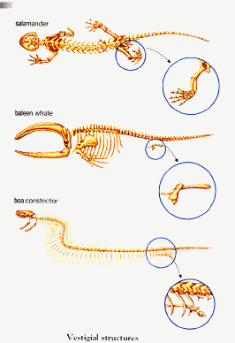
Examples of Vestigial Structures

Slide 41
Summary
Linnaeus created a classification system in the 1700s based on organism characteristics.
Many of the groupings still hold up today, but taxonomy is constantly changing due to new technology (especially DNA)
The 3 domain and 6 kingdom system is the most modern
The system goes: Domain, Kingdom, Phylum, Class, Order, Genus, Species
Binomial nomenclature = scientific name (Genus species)

Slide 43
What is Taxonomy?
Taxonomy – The science of naming, identifying, and classifying organisms. It is the universal system which describes and groups living things based on DNA, physical, and structural evidence.

Slide 44
makes it easier for biologists to communicate (avoids confusion of regional names)
makes it easier to identify a species

Slide 45
Check your understanding
Why are classification systems useful?
What are some characteristics of a good classification system?
Describe the importance of the classification of system developed by Carolus Linaeus
Identify the different taxa that make up the classification system developed by Linnaeus
Explain how the 6Kingdom system represents evolutionary trends
Discuss characteristics of organisms placed in each of the 6 kingdoms.

