Slide 1
VIRAL LIFE CYCLE
Lytic Cycle and Lysogenic Cycle

Slide 2
Infection
Viruses can not reproduce on their own, they require a host cell to replicate.
If the viral capsid contains the same proteins as on host cell membrane, the virus attaches to the outside.
The protein capsule shifts and inserts its nucleic acid (DNA or RNA).

Slide 3
Infection: Two types
Lytic pathway and the lysogenic pathway
Some viruses can switch between the 2 pathways, some use only one.

Slide 4
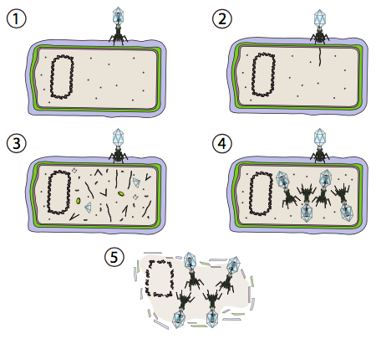
Lytic Pathway
Host cell ruptures (lysis) and viral particles released.
See Fig.17-4 p. 358
Notes:
Viruses can interact with their hosts in two distinct ways: the lytic pathway and the lysogenic pathway. Some viruses are able to switch between the two pathways while others only use one. The distinguishing characteristic of the lytic life cycle is catastrophic death of the host cell by lysis and simultaneous release of viral particles. In Figure 16.2.216.2.2, the stages of the lytic pathway are depicted. In this case, a T4 bacteriophage (the term “phage” is used for bacterial viruses) is used as an example. In step 1, the virus attaches to the cell wall. In step 2, the virus injects its genetic material (dsDNA) into the cytoplasm of the bacteria. In step 3, the viral DNA is being replicated and the genes on the viral DNA are being transcribed and translated into viral proteins. Expression from the host genomic DNA is arrested. In step 4, viruses are assembled from the proteins and DNA. And finally, once the viral factory has used up the cell’s energy and material resources in making more viruses, it performs a final coup de grace, as cell is destroyed to free the viruses to exit and find more host cells. The T4 phage used in this example only undergoes this pathway and not the lysogenic pathway.

Slide 5
Lytic Pathway Eg. T4 bacteriophage
Step 1, the virus attaches to host cell.
Step 2, the virus injects its genetic material into host cell.
Notes:
Viruses can interact with their hosts in two distinct ways: the lytic pathway and the lysogenic pathway. Some viruses are able to switch between the two pathways while others only use one. The distinguishing characteristic of the lytic life cycle is catastrophic death of the host cell by lysis and simultaneous release of viral particles. In Figure 16.2.216.2.2, the stages of the lytic pathway are depicted. In this case, a T4 bacteriophage (the term “phage” is used for bacterial viruses) is used as an example. In step 1, the virus attaches to the cell wall. In step 2, the virus injects its genetic material (dsDNA) into the cytoplasm of the bacteria. In step 3, the viral DNA is being replicated and the genes on the viral DNA are being transcribed and translated into viral proteins. Expression from the host genomic DNA is arrested. In step 4, viruses are assembled from the proteins and DNA. And finally, once the viral factory has used up the cell’s energy and material resources in making more viruses, it performs a final coup de grace, as cell is destroyed to free the viruses to exit and find more host cells. The T4 phage used in this example only undergoes this pathway and not the lysogenic pathway.

Slide 6
Take Over
Host cell cannot distinguish between its own or viral DNA.
Viral proteins are translated and viral DNA is replicated
Host cell begins to make messenger RNA which will start shutting down & taking over

Slide 7
Lytic Pathway
Step 3, the viral DNA gets replicated by host
genes on the viral DNA get transcribed and translated into viral proteins.
Expression from the host genomic DNA is arrested.
Notes:
attachment, penetration, transcription, biosynthesis, maturation, and lysis.
Viruses can interact with their hosts in two distinct ways: the lytic pathway and the lysogenic pathway. Some viruses are able to switch between the two pathways while others only use one. The distinguishing characteristic of the lytic life cycle is catastrophic death of the host cell by lysis and simultaneous release of viral particles. In Figure 16.2.216.2.2, the stages of the lytic pathway are depicted. In this case, a T4 bacteriophage (the term “phage” is used for bacterial viruses) is used as an example. In step 1, the virus attaches to the cell wall. In step 2, the virus injects its genetic material (dsDNA) into the cytoplasm of the bacteria. In step 3, the viral DNA is being replicated and the genes on the viral DNA are being transcribed and translated into viral proteins. Expression from the host genomic DNA is arrested. In step 4, viruses are assembled from the proteins and DNA. And finally, once the viral factory has used up the cell’s energy and material resources in making more viruses, it performs a final coup de grace, as cell is destroyed to free the viruses to exit and find more host cells. The T4 phage used in this example only undergoes this pathway and not the lysogenic pathway.

Slide 8
Lytic Pathway
Step 4, virus particles are assembled from the proteins and DNA.
Step 5: Lysis: Cell ruptures,
viruses exit and find more host cells to infect.
T4 phage only undergoes this pathway and not the lysogenic pathway.
Notes:
And finally, once the viral factory has used up the cell’s energy and material resources in making more viruses, it performs a final coup de grace, as cell is destroyed to free the viruses to exit and find more host cells. The T4 phage used in this example only undergoes this pathway and not the lysogenic pathway.

Slide 9
Lytic pathway
The lytic pathway can produce a huge number of viral particles.(tens of thousands)
But a waste of resources if hosts are few and far between
Notes:
The lytic pathway can produce a huge number of viral particles between infection and lysis, as many as several tens of thousands, for example from a rabies-infected cell. Therefore, this pathway is well suited for conditions in which potential host cells are plentiful. On the other hand, this is a waste of resources if there are relatively few potential hosts. Imagine a few bacteria that have floated off from the colony: if a phage infected a bacteria in the main colony, commandeering the bacteria to create thousands of viral particles, most of those particles would infect new hosts and make many thousands more soldiers in this viral army. But if the virus infected one of the breakaway bacteria, then once it killed its host by lysis, the viral particles would have few, if any, other potential hosts, and eventually all the viral particles just break down from various environmental conditions. What would a better survival strategy for the virus in such a situation?

Slide 10
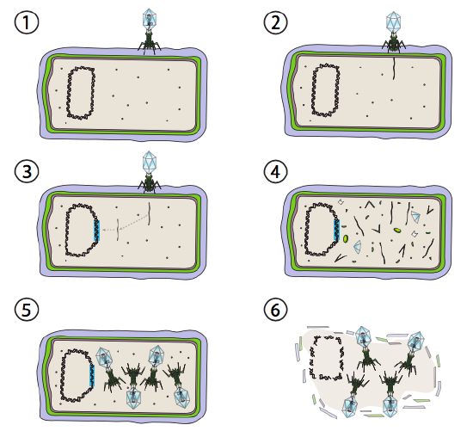
The Lysogenic Pathway p359
Virus integrates into host genome, and remains dormant until environmental conditions change (likelihood of more host cells to infect).
Eg: HIV, herpes (cold sores), chicken pox, Hepatitis C
Notes:
and remains transcriptionally quiescent until environmental conditions change and reflect a likelihood of more host cells to infect
Temperate viruses use both pathways

Slide 11
Lysogeny
Lysogeny is the biological process in which a bacterium is infected by a bacteriophage that integrates its DNA into that of the host such that the host is not destroyed.

Slide 12
Eg. Lambda (λ) bacteriophage
Initial stages of infection are the same as the lytic cycle:
1. Attachment
2. Injection.
Notes:
and remains transcriptionally quiescent until environmental conditions change and reflect a likelihood of more host cells to infect

Slide 13
The Lysogenic Pathway
3. Integration:
Under conditions that encourage lysogeny, the viral DNA is integrated into the host genome (DNA).
integrated piece is called a prophage
viral genome remains mostly hidden and inactive.
Notes:
The only significant exception is a gene encoding a λ repressor that prevents the next step and keeps the virus dormant.

Slide 14
The Lysogenic Cycle, p359
A provirus is a virus genome that is integrated into the DNA of a host cell.
In the case of bacterial viruses, proviruses are often referred to as prophages.
However, proviruses are distinctly different from prophages and these terms should not be used interchangeably
Notes:
. Attachment b. Entry c. Integration of DNA/provirus formation d. Spontaneous provirus activation e. Replication f. Assembly g. Lysis & Release

Slide 15
Dormancy phase
Prophage remains dormant within the host cell.
Host cell continues as if it wasn’t infected
May replicate for many generations
Advantage: presence of prophage may prevent other viral infections & add useful DNA
Notes:
the cell will become virulent and enters the lytic cycle,
Stress: – tiredness, cold, emotional stress
. Attachment b. Entry c. Integration of DNA/provirus formation d. Spontaneous provirus activation e. Replication f. Assembly g. Lysis & Release

Slide 16
Prophage may remain part of host DNA for many generations.
Host cell continues to divide as normal, replicating bacteriophage DNA...

Slide 17
The Lysogenic Pathway
Activation:
When conditions change (like drop in temperature or nutrients), the prophage becomes activated,
removes itself from host’s DNA, and enters the lytic cycle
Notes:
HIV: binds, the two strands of viral RNA are released along with reverse transcriptase, which reads an RNA template and synthesizes DNA and complementary DNA strand →double- stranded DNA version of the viral genome. viral dsDNA is integrates into the host genome
The integrated viral DNA is called a provirus. The provirus can lay dormant, but if it is activated, then it is transcribed and the resulting viral RNA is transported out of the nucleus (5).

Slide 18
The Lysogenic Pathway
5. Assembly and accumulation of virions
6. Lysis and release of the viral particles.
Notes:
HIV: binds, the two strands of viral RNA are released along with reverse transcriptase, which reads an RNA template and synthesizes DNA and complementary DNA strand →double- stranded DNA version of the viral genome. viral dsDNA is integrates into the host genome
The integrated viral DNA is called a provirus. The provirus can lay dormant, but if it is activated, then it is transcribed and the resulting viral RNA is transported out of the nucleus (5).

Slide 20
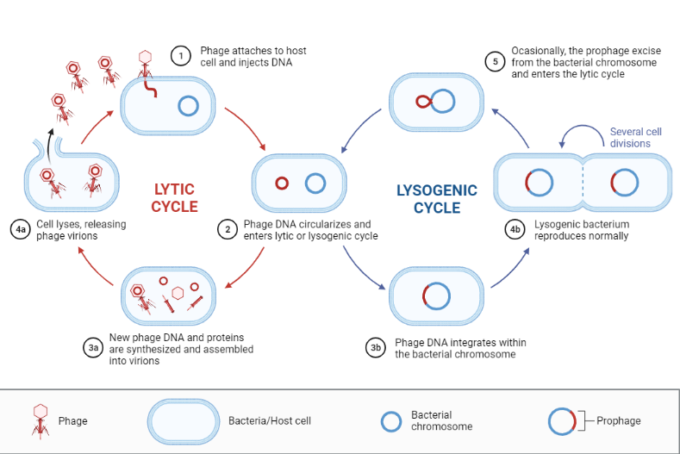
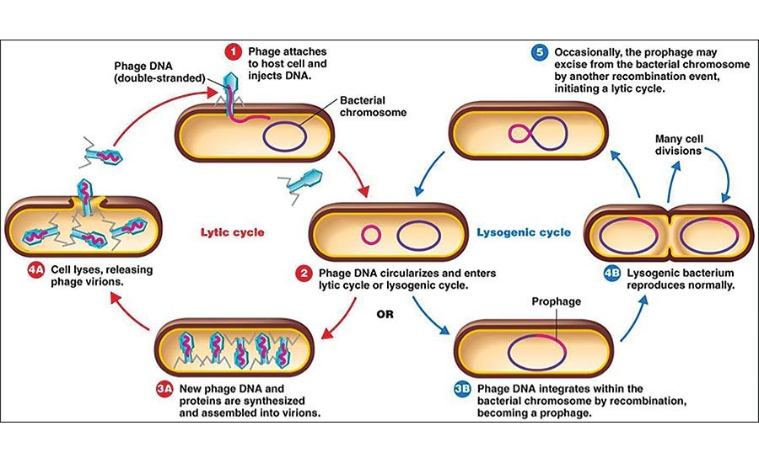

Slide 21
Can the whole virus enter the cell?
Yes: HIV, KSHV and herpes simplex virus.
In SARS-CoV-2 and similar viruses, entry occurs through membrane fusion mediated by the spike protein, either at the cell surface or in vesicles.

Slide 22
Retrovirus
A Retrovirus has RNA instead of DNA as its genetic material.
e.g. HIV.
After infection, virus produces a DNA copy of its RNA genes
Then, the viral DNA is inserted into host’s DNA
May become dormant for a time before becoming active.
Retroviruses have been of great interest because they are associated with important diseases, including cancers, AIDS, and neurologic diseases.
Notes:
It uses an enzyme called reverse transcriptase
Has been linked to some cancers
reverse transcriptase to become part of the host cells' DNA.,
each virion contains two complete copies of the single-stranded RNA genome.

Slide 23
Lentivirus
A Lentivirus is a retrovirus that causes chronic and deadly disease characterized by long incubation periods, in humans and other mammalian species.
Includes human immunodeficiency virus (HIV), which causes AIDS.

Slide 24
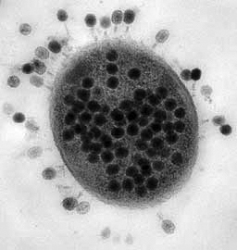
Viral Infection
Once the virus is inside the host cell, two different processes may occur:
Some viruses replicate immediately, killing the host cell (lytic)
Others replicate, but do not kill the host cell immediately (lysogenic)

Slide 26
What are the implications of the Lysogenic Cycle?
Viruses can remain dormant in the host’s DNA for long periods of time
Changes in environment (stress) can cause a flare-up of the disease
You’ve heard of some of these: Herpes, Cold Sores, etc.

Slide 27
Viruses are Host Specific
Many viruses are only able to infect certain types of cells
Certain species and certain tissues
HIV infects T-cells of the immune system
The Cold Virus infects cells associated with sinuses

Slide 28
Practice:
Use notes and pages 357-359 of text to answer
Viral Life Cycle Worksheet

