Slide 1
9.2 Charging Objects
Friction, Conduction, and Induction
p279-281

Slide 2
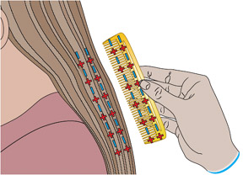
Charging by Friction: Rubbing two objects together
Remember: Charging an object can only occur by the transfer of electrons from one object to another.
Notes:
In this example, both hair and comb start neutral but after being rubbed together the comb is neg and hair positively charged.
When a charged object touches another object, electrons can be transferred between the objects. Electrons transfer from the object that has the more negative charge to the one that has the more positivecharge.

Slide 3
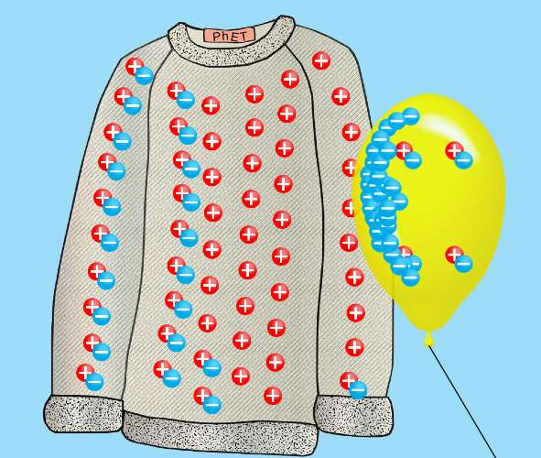
Example of Friction causing transfer of electrons between a balloon and sweater
Both items start relatively neutral
Latex has a higher affinity for electrons than the sweater
Rubbing allows electrons to be pulled off sweater to balloon,
Leaving both objects with an imbalance of charge:
Sweater “+” balloon “-”
Notes:
Rubber has a much greater attraction for electrons than animal fur/hair/sweater. As a result, the atoms of rubber pull electrons from the atoms of animal fur, leaving both objects with an imbalance of charge.

Slide 4
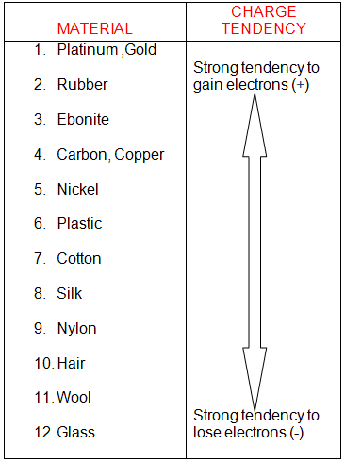
Electrostatic Series
Some materials are more likely than others to gain or lose electrons.
The Electrostatic Series is a list of materials in order of how easily they are to gain/lose electrons.
See p276 of text book

Slide 5
Electrostatic Series
What type of charge does rubber acquire when rubbed with a nylon cloth?
What type of charge does the nylon cloth acquire?
How does the size of the charge on the rubber compare to the size of the charge on the cloth?

Slide 6
Insulators and Conductors
Material that do not let electrons move through them easily are called insulators. (glass, air, plastic, rubber, and wood.)
Material that do let electrons move through them easily are called conductors (copper, aluminum, gold, and silver).
Notes:
Grounding.

Slide 7
Electrostatic Series
A list of materials that are more likely to attract a negative charge when friction is applied to them.
What type of charge does rubber acquire when rubbed with a nylon cloth?
What type of charge does the nylon cloth acquire?
How does the size of the charge on the rubber compare to the size of the charge on the cloth?

Slide 8
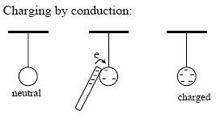
Charging By Conduction (Contact)
Charging by Conduction occurs when objects touch and an electric charge is transferred from one object to the other.
Notes:
Eg. Walk across a carpet and get a spark by touching a metal doorknob, yu are transferrig someof your charge to the doorbkow by conduction.

Slide 9
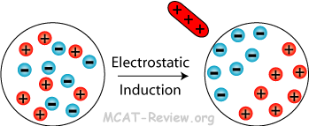
Charging by Induction
Occurs when objects are charged WITHOUT TOUCHING.
Eg. Build up of dust on TV or computer screen.
Notes:
When screen is turned on, it begins to buld up a charge. When a neutral dust particle coes near the screen, the screen induces an opposite charge onteh near side of the dust particle and a similar charge on the far side. The dust is attracted tot the screem.

Slide 10
Charging by Induction example.
Example: build up of dust on the computer screen:
When a computer is turned on, it begins to build up a charge
When a neutral dust particle come near the screen, the screen induces a opposite charge on the near side of the dust particle and a similar charge on the far side.
The dust is attracted to the screen

Slide 11
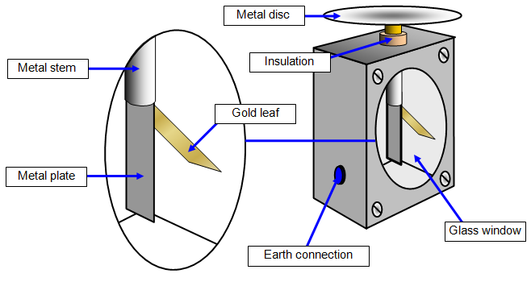
Electroscope - first electrical measuring instrument.
An electroscope is an instrument that detects static electricity by using thin metal or plastic leaves, which separate when charged.

Slide 12
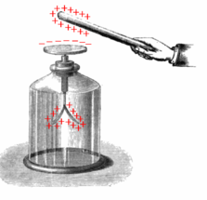
How it works
Electrical charges move to the metal ball/disk and down to the foil leaves, which then repel each other.
Since each leaf has the same charge (positive or negative), they repel each other.
Try this simulator:
https://simpop.org/electroscope/electroscope.htm
Explanation: https://www.youtube.com/watch?v=ectl3po7MuI
Notes:
Charging Electroscope by Induction: Touch the electroscope and bring a charged rod close. If the charged rod is negative, electrons from the electroscope will flow onto your body. Now remove your hand and then move the charged rod away. The electroscope will be left with a deficit of electrons giving it a positive charge.

Slide 13
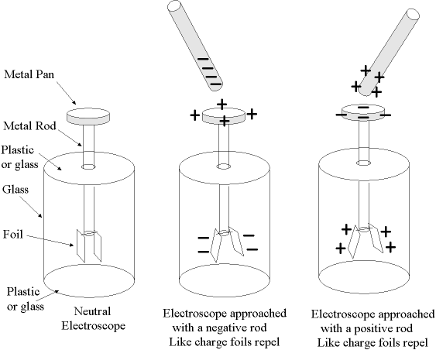
Electroscope

Slide 14
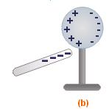
In class demo: Charging by Induction.
Bring a negatively charged rod near – but not touching the sphere , the rod will repel the electrons in the sphere. The negative charges will move down the leaves and the leaves will repel each other.
The sphere is left with a temporary positive charge.
If the negative rod is removed, the electrons will move back to the sphere and the sphere will become neutral again.
Notes:
Example: dust build up on TV or computer screen

Slide 15
Bozeman Science
Slow but good. This guy give good explanation with diagram.
https://www.youtube.com/watch?v=dwJ-MM7yu4E

Slide 16
Grounding
Grounding: Removing all excess charges from electroscope by touching it (discharging) , making it neutral.
A grounded object is connected directly to Earth by a conductor.
An electroscope containing conducting metal but holds a static charge. Why?
Notes:
An electroscope containing conducting metal but holds a static charge because it is not in direct contat with its surroundinsg.

Slide 17
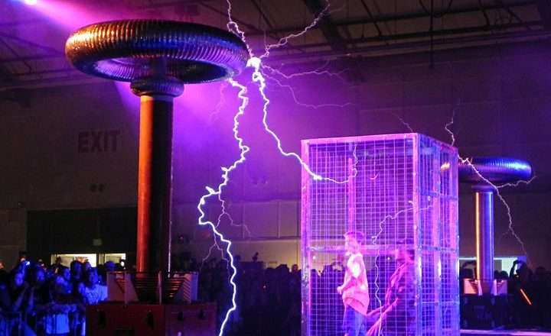
Isolating Charges: Faraday Cage
A Faraday Cage is a grounded metal screen surrounding a piece of equipment to exclude electrostatic influences.
Notes:
Car is the safest place in a lightning storm. Cell phones don’t work well in elevators. Car radio in tunnels.

Slide 18
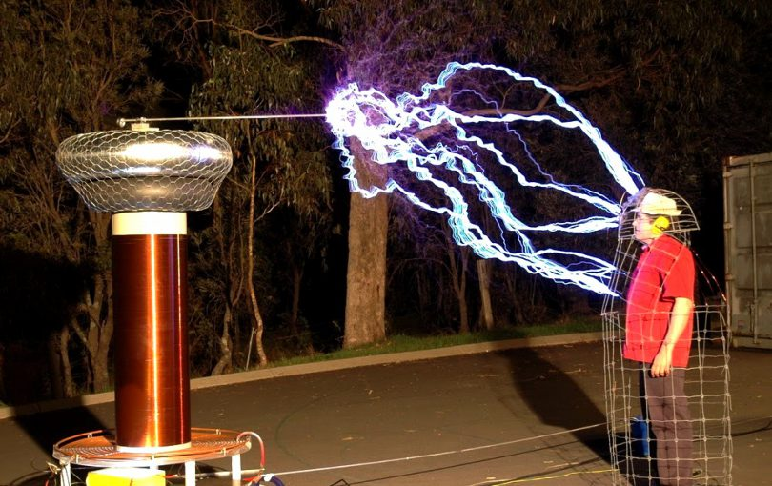

Slide 19
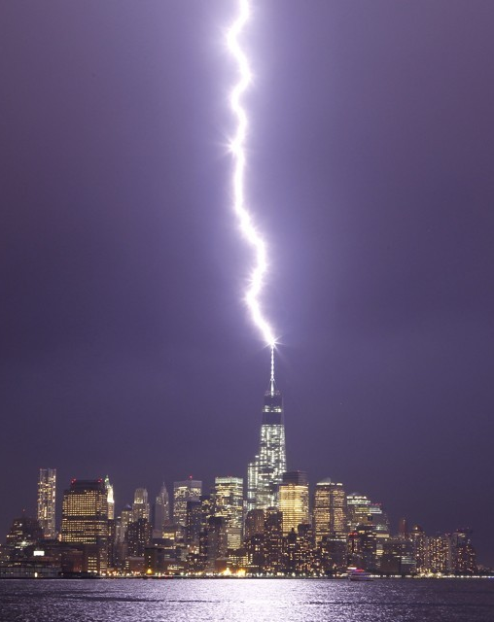
Attracting Charges: Lightning Rod
A Lightning Rod - Receives concentrated charges and conducts them safely to the ground (not through your building so your electronics don’t get fried).
Must be a conductor and usually pointed to receive a greater concentration of charge.
Notes:
What does it need to be made of?

Slide 20
Activity 9B Electroscope p 294-295
Use an electroscope to investigate how different materials are charged by induction and conduction.
Follow instructions in you text.
Answer Questions a-j

Slide 21
Homework
Answer questions a-j of Activity 9B In COMPLETE SENTENCES.
Read pages 281-283
Answer CYU p284 #2, 4, 5, 7, 8, 9
WB p

