Slide 1
DICHOTOMOUS KEY

Slide 2
What is a Dichotomous Key?
A dichotomous key is a written set of TWO choices that leads to the name of an organism.
Based on visible characterists
Used in Field Guides to identify unknown organisms
“Dichotomous” means “divided into two parts”. Therefore, dichotomous keys always give two choices in each step.
Often a Yes/No

Slide 3
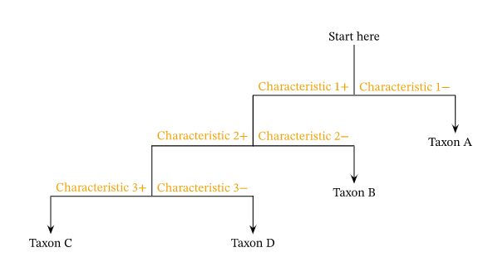
Flow chart
Notes:
The following are the steps to use a chart-style dichotomous key to identify a specimen:
Observe the specimen you are going to identify.
Start at the top of the chart.
Trace downward until you reach the first junction.
Read the two options.
Decide which option best describes your specimen.
Follow the direction, left or right, that corresponds to step 5.
Repeat steps 3 to 6 until you have reached a taxon at the end of a branch.
Your specimen has been identified!

Slide 4
Table format

Slide 5
Observe the specimen you are going to identify.
Start at the top of the list.
Read the description in row 1 of the dichotomous key.
Read the two options, 1a and 1b, in the dichotomous key.
Decide which option best describes your specimen.
Follow the direction that corresponds to the appropriate description.
Repeat steps 3 through 6 from this list for all of the remaining rows of the dichotomous key until you reach a taxon.
Your specimen has been identified!

Slide 6
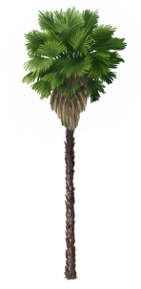
Example:
Notes:
Statement 1 says “leaves are simple and flat.” No.
2 says “tree is short and bushy.” Since the tree in the picture is quite tall, we will follow the instructions at 2b to go to statement
3. Statement 3 says “leaves are palmate (fan) shaped.” Yes - follow the instructions at 3a which tell us that this tree is a fan palm, which has the scientific name W. robusta.

Slide 7
You find an organism that has no wings, no shell, and 8 legs.

Slide 8
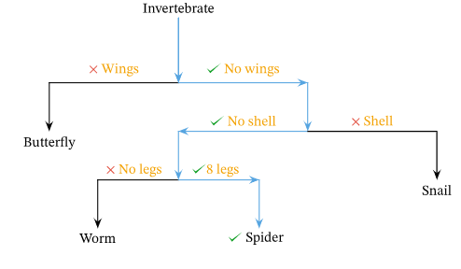

Slide 9
What similarities do you see?
What differences?
What could make a YES/NO question?

Slide 10
Colour, Ears, tail, etc

Slide 11
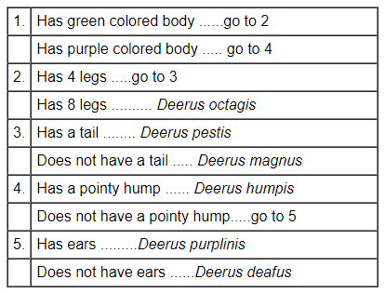

Slide 12
Practice
Identify Salamanders using Dichotomous Key, in class
Assignment: Create your own Dichotomous Key for Norms

Slide 13
Key Points
A dichotomous key is a tool used to identify a specimen from a defined group of specimens using a series of yes or no questions.
Dichotomous keys come in two versions, one that looks like a list and one that looks like a chart.
In order to use a dichotomous key, start from the top and make decisions as you read downward until you reach the identity of your specimen.
In order to make a dichotomous key, first observe your specimens, then organize your information into a table, and finally make your dichotomous key from the information in the table.

Slide 14
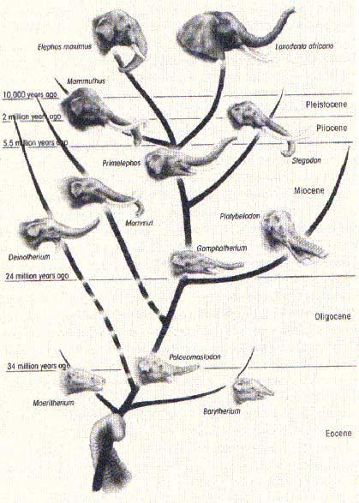
What is a Cladogram?
from Greek clados "branch" and gramma "character“

Slide 15
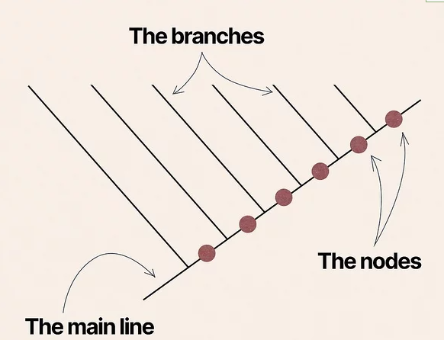
What is a Cladogram?
Cladogram → diagram that shows evolutionary relationships between organisms
Based on morphological characteristics (shapes, arrangement of body structures)

Slide 16
What is a Cladogram?
Helps scientists understand how one lineage broke away from another in the course of evolution.
uses lines that branch off in different directions ending at a clade, a group of organisms with a last common ancestor.
Theoretical
does not indicate time or the amount of difference between groups.

Slide 17
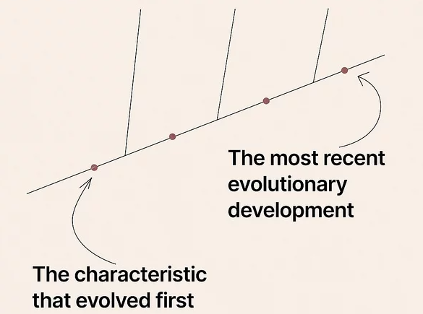

Slide 18
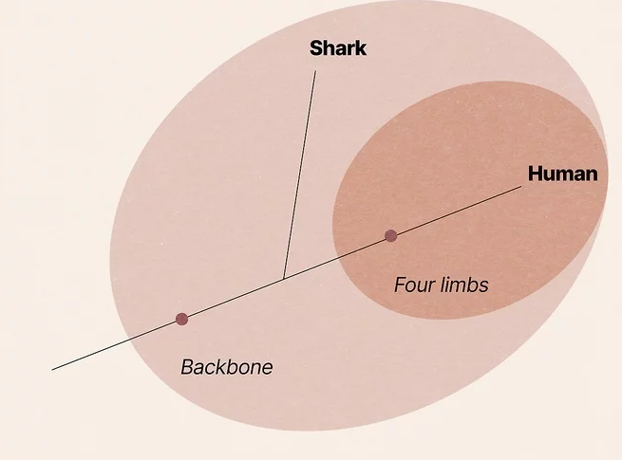

Slide 19
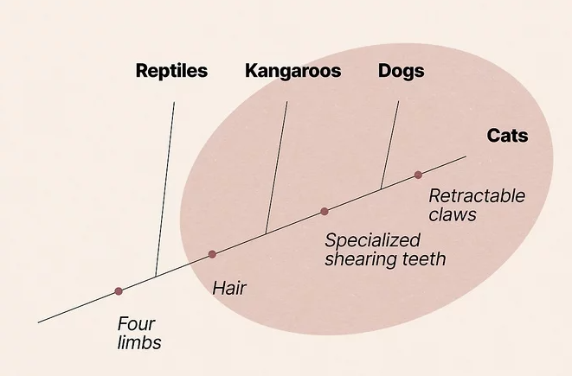
What characteristics do kangaroos, dogs and cats all share?
Of these animals, you could say that kangaroos, dogs, and cats all share 2 of the characteristics (four limbs and hair).
In this example, reptiles would be considered an outgroup—they only have 1 characteristic in common with the other groups, and likely have significantly more differences. On a cladogram, they're the first animal that branches off the main line
Notes:
Of these animals, you could say that kangaroos, dogs, and cats all share 2 of the characteristics (four limbs and hair).
In this example, reptiles would be considered an outgroup—they only have 1 characteristic in common with the other groups, and likely have significantly more differences. On a cladogram, they're the first animal that branches off the main line

Slide 20
Cladogram – not drawn to scale, don’t know how long ago when next trait occurred.
The main line of a cladogram represents the passage of time. The start of the line is the furthest back in the past, typically millions of years ago.
The nodes of a cladogram represent common ancestors that evolved a particular physical trait or characteristic. All of the animals that branch off at or after a node share that trait or characteristic (and that common ancestor).
The branches of a cladogram show when each animal split off from the main line. The node where an animal branches off is the last characteristic that animal has in common with the animals that branch off further up the line.

Slide 22
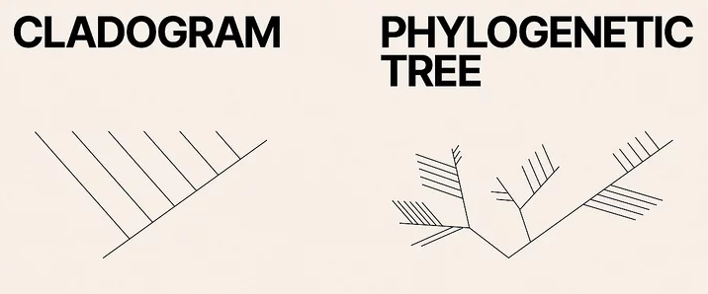
Phylogenetic Tree
In contrast, phylogenetic trees show relationships based on molecular evidence (DNA and other molecular data)
often indicate time spans between branching points.
Common ancestry
Both may have branches

Slide 24
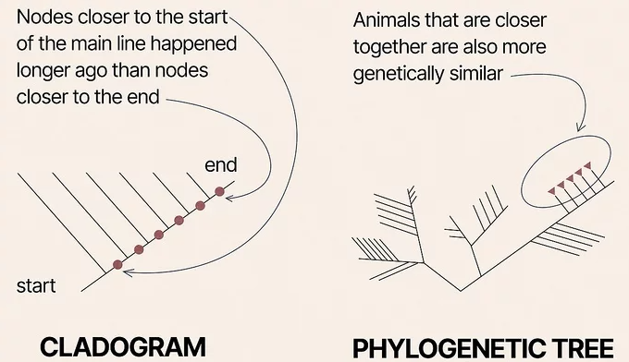
Notes:
On a phylogenetic tree, animals that are closer together are also more genetically similar. This isn't necessarily true on a cladogram that doesn't use any molecular evidence.

