Slide 1
Electrostatic Series
Some materials are more likely to gain or lose electrons

Slide 2
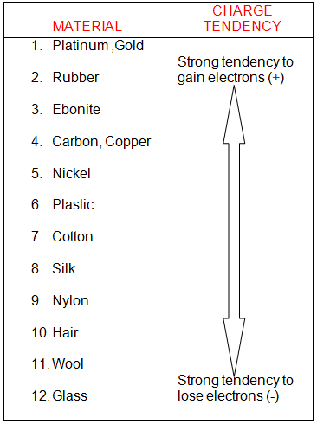
Electrostatic Series
The Electrostatic Series is a list of materials in order of how easily they are to gain/lose electrons.
See p276 of text book

Slide 3
Electrostatic Series
What type of charge does rubber acquire when rubbed with a nylon cloth?
What type of charge does the nylon cloth acquire?
How does the size of the charge on the rubber compare to the size of the charge on the cloth?

Slide 4
Insulators and Conductors
Insulators: Materials that do not let electrons move through them easily
Eg. glass, air, plastic, rubber, and wood
Conductors: Materials that do let electrons move through them easily
Eg. copper, aluminum, gold, and silver
Notes:
Grounding.

