Slide 1
Electric Current

Slide 2
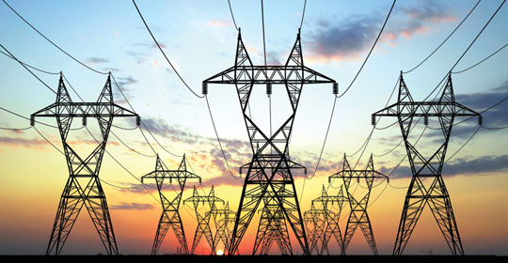
Current Electricity
Current Electricity is the flow of an electric charge through a conductor.
Notes:
The flow of electric charges is called electric current (I).
Water current in river

Slide 3
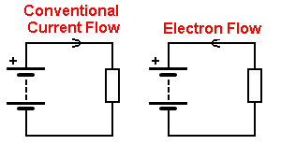
Direction of Current
Conventional Current:
positive → negative terminal
Electron Flow: We now know it is the electrons that are moving (from negative → positive terminal)
Notes:
Initially it was thought that positive charges were moving so movement was always described as from positive to neg terminal.

Slide 4
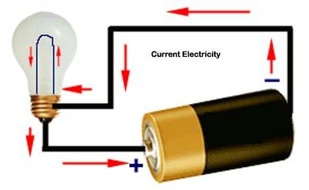
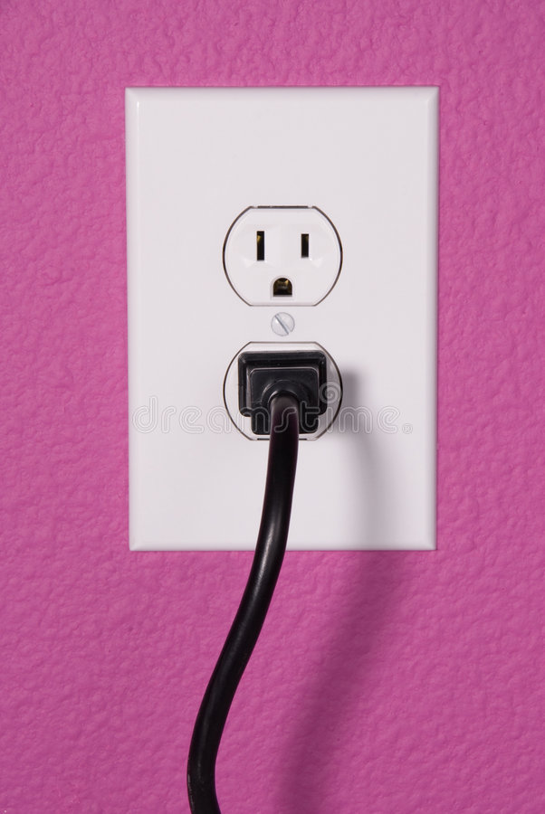
Types of Current
Direct Current (DC): electrons travel in only one direction.
Eg. batteries and solar cells,
Alternating Current (AC) results when electrons periodically reverse direction.
Eg Wall outlets in North America reverse current direction 60 times/sec.
Notes:
Electric current that flows continuously in a single direction is called a direct current, or DC. In a direct current circuit, current is caused by electrons that all line up and move in one direction.
Within a wire carrying direct current, electrons hop from atom to atom while moving in a single direction. Thus, a given electron that starts its trek at one end of the wire will eventually end up at the other end of the wire.
When the electrons in alternating current switch direction, the direction of current and the voltage of the circuit reverses itself.
The rate at which alternating current reverses direction is called its frequency, expressed in hertz. Thus, standard household current in the United States is 60 Hz.

Slide 5
Measuring Electric Current (I)
Electric current is the amount of charge passing through a point in a circuit in a given time.
Units: Amperes (A)
1 ampere = 1 Coulomb /second.
1 Coulomb is the charge of 6.25 x10 ¹⁸ electrons
Typical lightbulb has about 1 Amp of current flowing through it.
Notes:
Water current in river

Slide 6
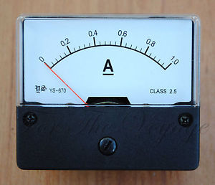
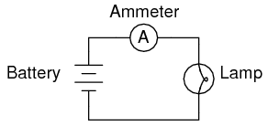
Ammeter measures current
An ammeter is an instrument that measures current at one point in a circuit.

Slide 7
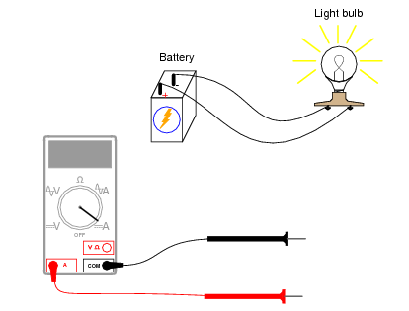
Reading an Ammeter
An ammeter is connected in series within the circuit.

Slide 8
Practice Conversions:
525 mA = _____________ A
3.2 mA = _____________ A
4780 mA = ____________ A
2.9 A = _______________mA

Slide 9
Practice Conversions:
525 mA = 0.525 A
3.2 mA = 0.0032 A
4780 mA = 4.780 A
2.9 A = 2900mA

Slide 10
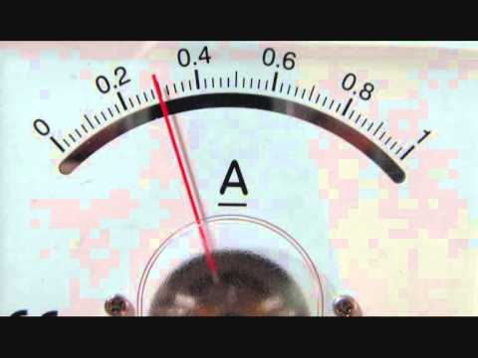
Reading an Ammeter
How many Amps?

Slide 11
Reading an Ammeter
0.3 Amps
Or 300mA

Slide 12
Other Conversions
K h d ___ d c m
King Henery died by drinking chocolate milk
Kilo = 1000 or 10 3, milli = 1/1000 or 10 -3, micro() 10-6

Slide 13
Calculating Current
Current (I) is expressed by the equation:
I = Current (in Amps)
Q = Total Charge (in Coulombs)
t = time (in seconds)
Notes:
One coulomb is equal to the charge of 6.25 x 10 ¹⁸ electrons.
One ampere represent the current of one coulomb of charge per second.
Do calc current WS
the quantity of charge is related to the number of electrons flowing past, To make this connection between the current and the number of electrons, one must know the quantity of charge on a single electron.
Q_{electron} = 1.6 x 10⁻¹⁹ C

Slide 14
Simple Calculations:
1. A lamp has 5000C of charge flowing through it in 10 minutes. What is the current in the lamp?

Slide 15
Simple Calculations:
A light has 5000C of charge flowing through it in 10 minutes. What is the current in the light?
I = Q/t
I = 5000C/600 sec
I = 8.33 Amp

Slide 16
Simple Calculations:
2. An electric heater has a current of 18A. How many minutes will it take for 55kC of charge to flow through it?

Slide 17
Simple Calculations:
2. An electric heater has a current of 18A. How many minutes will it take for 55kC of charge to flow through it?
t= Q/I
t= 55 000/18
t = 3055.6 sec = 51 minutes

Slide 18
Practice
An ammeter reads 10 A. How many electrons flow through the circuit in 1 min?
Notes:
1 amp = 1 coulomb /sec
10 amps = ?/60 sec
Q = I x t
Q = 10 x 60 sec
Q = 600 coloumbs

Slide 19
Practice
An ammeter reads 10 A. How many electrons flow through the circuit in 1 min?
First find the number of Coulombs, then convert to electrons.
Remember: 1 C = 6.25 x10 ¹⁸ electrons
Notes:
1 amp = 1 coulomb /sec
10 amps = ?/60 sec
Q = I x t
Q = 10 x 60 sec
Q = 600 coloumbs

Slide 20
Practice
An ammeter reads 10 A. How many electrons flow through the circuit in 1 min?
Q = I x t
= 10 A x 60 sec
= 600 C (Coulombs)

Slide 21
Practice
An ammeter reads 10 A. How many electrons flow through the circuit in 1 min?
Q = I x t
= 10 A x 60 sec
= 600 C (Coulombs)
# electrons = 600C x 6.25 x10 ¹⁸ electrons/C
= 3.75 x10 ²¹ electrons

Slide 22
Simple Calculations:
3. You hook up an ammeter in a circuit. It reads 4.6A. If you have a bulb hooked up in this circuit, how many electrons will flow through the lamp in 45 seconds?

Slide 23
Simple Calculations:
3. You hook up an ammeter in a circuit. It reads 4.6A. If you have a bulb hooked up in this circuit, how many electrons will flow through the lamp in 45 seconds?
Q = I x t
Q = 4.6 A x 45
Q = 207 Coulombs, then convert to electrons
N = 207 C x 6.25 x 10 ¹⁸ electrons = 1294 x 10¹⁸
1 C

Slide 24
Simple Calculations:
4. Your ammeter reads 672mA. If current flows through the circuit for 30 seconds, how many electrons will pass through a bulb during this time?

Slide 25
4. Your ammeter reads 672mA. If current flows through the circuit for 30 seconds, how many electrons will pass through a bulb during this time?
Q = I x t
Q = 0.672 A x 30 sec
Q = 20.16 C
Electrons = 20.16 C x 6.25 x 10 ¹⁸ electrons
1C
= 126 x 10 ¹⁸ electrons

Slide 26
Practice
An ammeter indicates that a current of 1.2 A flow through a lamp. How many electrons will go through the lamp in 45 seconds?

Slide 27
Practice
I = Q/t
Q= It
Q= (1.2A) (45s)
Q = 54 C
Now convert C to electrons (N)

Slide 28
Practice
N = 54C ( 6.25 x 10 ¹⁸ electrons)
1 C
= 340 x 1018 electrons
3.4 x 10 ²⁰ electrons

Slide 29
Getting a shock
Skin is conductive so touching a bare wire completes the circuit and you get a shock.
The severity of the shock depends on the current.
At 0.0001 A (1mA), you will feel a tingling sensation.
At 0.015 A (1.5mA), your muscles will contract
At 1 A (1000 mA), your heart stops.
Lick a 9V battery: https://www.sparkfun.com/news/1385

Slide 30
Practice
WB page 174 – 175
TRY THIS ACTIVITY p308

Slide 31
Practice
HW: Read p306-308
HW: Answer CYU p 309 # 9, 10,11,13,14,15
HW: WB 10.2 p 174-175
Activity: PHET Simulation, remainder for HW. You will hand this in next class
Notes:
Do HO from KL and other WB 10.2, along with reading ammeter

