Slide 1
Electrostatic Force

Slide 2
Electrostatic Force
Electrostatic Force is the attraction or repulsion of objects due to their electric charge
A force is a push or pull acting on an object, measured in newtons (N)
If force is unbalanced, it can cause an object to move.
An electrostatic force is the force that exists between static charges.
It can either pull the static charges together (force of attraction) or push static charges apart (force of repulsion).
Notes:
Roll pop can

Slide 3
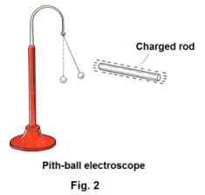
Electric Force
Depends on:
Type of charge on the objects (positive, negative, neutral – push, pull, nothing)
Amount of charge on the objects.
Distance between objects
Notes:
What kind of a relationship is this? Direct, Inverse

Slide 4
Electric Force
If objects are really far away, would they have the same attraction (force drawing them together) as two objects very close together?
Where have we witnessed this?
Notes:
What kind of a relationship is this? Direct, Inverse

Slide 5
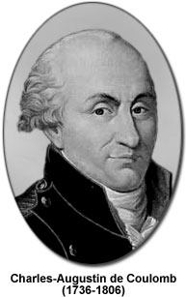
Coulomb’s Law
The strength of the electric force increases with increasing electric charges and decreases with distance.
Simply: Electrostatic force increases with charge, decreases with distance.
Notes:
Charles Coulomb recognized the relationships between electric force, size of charge and distance
Force increases with charge, decreases with distance.

Slide 6
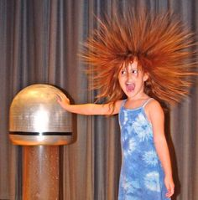
Van de Graaff Generator
Generates very high electric charge.
Used to investigate electrostatic force.

Slide 7
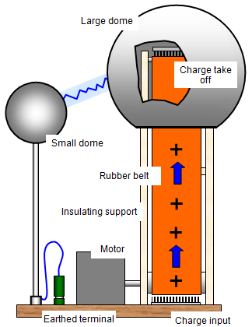
How does it work?
Motor turns rubber belt
Charge comb picks up negative charges from belt
Belt transfers charge to dome
Notes:
An electrostatic generator
Used to research static electricity and to make static charges available for experimentation

Slide 8
Van de Graaf Generator, Activity p286
Safety
Always stand on insulated surface
Discharge dome often with grounding rod
Wait for dome to be grounded and belt to be turned off before taking hands off

Slide 9
Van de Graaff and Coulombs’s Law
As the charge builds up on the dome, the electric force between the dome and the discharge ball increases.
DIRECT RELATIONSHIP: as the electric force increase as the charge increases.
However, as distance decreases, the electric force increases (INVERSE RELATIONSHIP)

Slide 10
Van de Graaff
Explain the behaviours of the bubbles by describing the movement of the charges
Describe how the electric force varies with the distance between the ball and the dome
Describe how the electric force varies with the size of the charge on the dome

Slide 11
Practice
Read pages 285-286
Answer CYU questions p 287 #1-3, 7-9

Slide 12
Uses and Examples of Static Electricity
Notes

Slide 13
Homework
Read pages 285-286
Answer CYU p287 #1, 2, 3, 9

Slide 14
EXTRAS

Slide 15
Check Your Understanding
During a physics lab, a plastic strip was rubbed with cotton and became positively charged. The correct explanation for why the plastic strip becomes positively charged is that ...
a. the plastic strip acquired extra protons from the cotton.
b. the plastic strip acquired extra protons during the charging process.
c. protons were created as the result of the charging process.
d. the plastic strip lost electrons to the cotton during the charging process.

Slide 16
CYU #2
Saran Wrap has a larger electron affinity (attraction) than Nylon. If Nylon is rubbed against Saran Wrap, which would end up with the excess negative charge? ____________ Explain.

Slide 17
CYU #3
A physics teacher rubs a glass object and a felt cloth together and the glass becomes positively charged. Which of the following statements are true? Choose all that apply.
a. The glass gained protons during the rubbing process.
b. The felt became charged negatively during this rubbing process.
c. Charge is created during the rubbing process; it is grabbed by the more charge-hungry object.
d. If the glass acquired a charge of +5 units, then the felt acquires a charge of -5 units.
e. This event violates the law of conservation of charge.
f. Electrons are transferred from glass to felt; protons are transferred from felt to glass.
g. Once charged in this manner, the glass object and the felt cloth should attract each other.
h. In general, glass materials must have a greater affinity for electrons than felt materials.

Slide 18
CYU #4
Which statement best explains why a rubber rod becomes negatively charged when rubbed with fur?
a. The rubber that the rod is made of is a better insulator than fur.
b. The fur is a better insulator than the rubber.
c. Molecules in the rubber rod have a stronger attraction for electrons than the molecules in the fur.
d. Molecules in the fur have a stronger attraction for electrons than the molecules in the rubber rod.

Slide 19
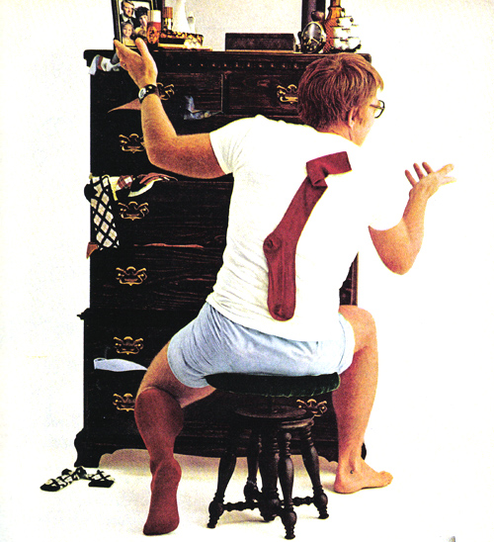
What’s happening here?

Slide 20
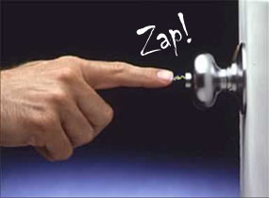
Example
You transfer some of your charge to the metal door knob.

Slide 21
Why are neutral objects attracted to charged objects?
because the neutral objects are temporarily charged by induction.
A negatively charged balloon sticks to a neutral wall because the balloon’s negative charges repel the wall’s negative charges.
A positive charge is induced on the surface of the wall
the negative balloon is attracted to the positive wall surface.

Slide 22
Check Your Understanding
Two neutral conducting pop cans are touching each other. A positively charged balloon is brought near one of the cans as shown below. The cans are separated while the balloon is nearby, as shown. After the balloon is removed the cans are brought back together. When touching again, can X is ____.
a. positively charged
b. negatively charged
c. neutral
d. impossible to tell

Slide 23
CYU #2
Two neutral conducting pop cans are touching each other. A positively charged glass rod is brought near Can X as shown below. Which of the following occur as the glass rod approaches Can X? List all that apply.
a. Electrons jump from the glass rod to can X.
b. Electrons jump from the glass rod to can Y.
c. Electrons jump from can X to the glass rod.
d. Electrons jump from can Y to the glass rod.
e. Protons jump from the glass rod to can X.
f. Protons jump from can X to the glass rod.
g. ... nonsense! None of these occur.

Slide 24
CYU #3
TRUE or FALSE?
Two neutral conducting pop cans are touching each other. A negatively charged balloon is brought near Can X as shown below. As the balloon approaches Can X, there is a movement of electrons between the balloon and can X (in one direction or the other).
a. TRUE b. FALSE

Slide 25
CYU #4
A positively charged balloon is brought near a neutral conducting sphere as shown below. While the balloon is near, the sphere is touched (grounded).
At this point, there is a movement of electrons. Electrons move ____ .
a. into the sphere from the ground (hand)
b. out of the sphere into the ground (hand)
c. into the sphere from the balloon
d. out of the sphere into the balloon
e. from the ground through the sphere to the balloon
f. from the balloon through the sphere to the ground
g. .... nonsense! Electrons do not move at all.

Slide 26
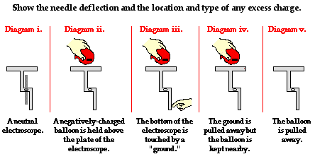
CYU #5
Suppose that a negatively charged balloon is used to charge an electroscope by induction.
Draw the orientation of the needle and indicate the location and type of any excess charge in steps ii. - v.
Explain in terms of electron movement what is happening in each step.

Slide 27
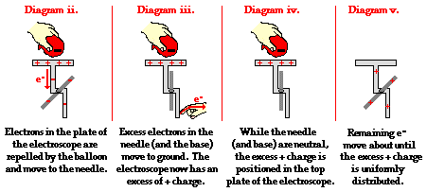
Answer #5

Slide 28
CYU #6
A negatively charged balloon is brought near a neutral conducting sphere as shown below. As it approaches, charge within the sphere will distribute itself in a very specific manner. Which one of the diagrams below properly depicts the distribution of charge in the sphere?

Slide 29
CYU #7
A positively charged piece of Styrofoam is placed on the table. A neutral aluminum pie plate is brought near as shown below. While held above the Styrofoam, the aluminum plate is touched (grounded).
At this point, there is a movement of electrons. Electrons move ____ .
a. out of the aluminum plate into the ground (hand)
b. into the aluminum plate from the ground (hand)
c. into the aluminum plate from the Styrofoam
d. out of the aluminum plate into the Styrofoam
e. from the ground through the aluminum plate to the Styrofoam
f. from the Styrofoam through the aluminum plate to the ground
g. .... nonsense! Electrons do not move at all.

Slide 30
CYU #2
Which of the diagrams below best represents the charge distribution on a metal sphere when a positively charged plastic tube is placed nearby?

Slide 31
CYU #5
Charged rubber rods are placed near a neutral conducting sphere, causing a redistribution of charge on the spheres.
Which of the diagrams below depict the proper distribution of charge on the spheres?
List all that apply.

