Slide 1
Scientific Drawing

Slide 2
What is this???
putting green?
donut?
cell?
key?
landscape?
bottle opener?
egg?

Slide 3
A Egg Frying
November 17, 2011
Egg white
Egg yolk
1 x

Slide 4
Each diagram MUST include:
Use pencil, not pen
Title (specimen)
Total Magnification
Stipple, not shading
Labels:
Print labels, no cursive writing
Lines are straight and do not cross, No arrows

Slide 6
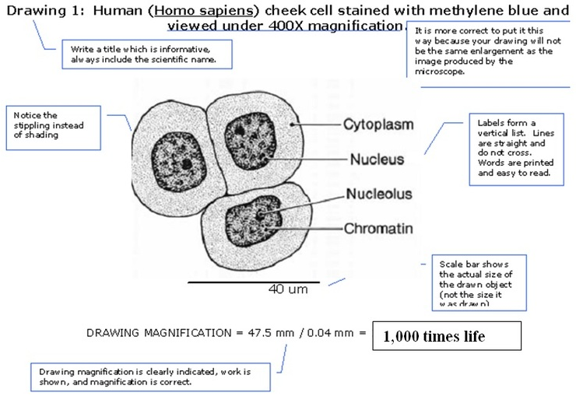
Extending:
Notes:
Extending

Slide 7
