Slide 1
Examining Questioned Documents

Slide 2
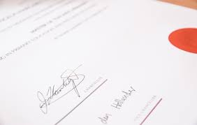
Commonly forged documents
Copying someone else's signature on a cheque.
Copying someone else's signature on artwork.
Copying doctor's signature on drug prescriptions.
Forging doctor's notes on medical documents.
Creating false marriage/birth/death certificates.

Slide 3
Counterfeit
made in exact imitation of something valuable or important with the intention to deceive or defraud.
"two men were remanded on bail on a charge of passing counterfeit $10 bills“
a fraudulent imitation of something else; a forgery.

Slide 4
“Collected” vs “Requested” documents
written by a person during his or her normal day-to-day activities.
May be difficult to match letters/words
Unknown conditions at time
produced solely for the comparison.
More controlled – contains words/letters in the forged doc. Same materials used
BUT writer is aware: more nervous or can change writing on purpose

Slide 5
Requested vs Collected samples
"Requested" samples should contain repetitions of the same letters and letter combination appearing in the questioned text.
Requested specimens are writings dictated by the investigator to the writer. These specimens are created under carefully controlled conditions, with the writer being closely monitored.
.

Slide 6
Advantages of Requested Documents
Contain letters and combinations similar to those that appear in the questioned writing.
• Contain repetitions of the questioned text and thus better represent a person's range of writing habits.
Easy to prove because they have been prepared before a witness.
• Can use the same writing materials (i.e. pen, pencil, paper, cardboard)
• can duplicate same Format or arrangement
• Can be prepared under similar writing conditions
Notes:
Easier comparision because more variables are controlled

Slide 7
Collected Advantages
Disguise or nervousness not usually factors.
• They can selected so as to be written around the same date of the questioned document.

Slide 8
Disadvantages of Collected Docs
Can be difficult to prove who wrote them.
• Unknown conditions at time of writing
• Different materials may have been used
• It is difficult to locate enough repetitive examples

Slide 9
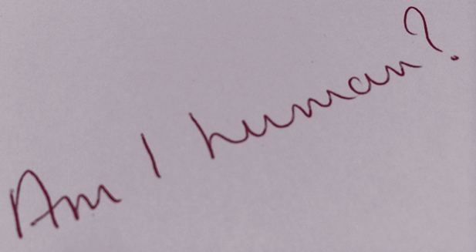
Fake Handwriting?
An article in The Times by James Dean, about handwriting robot scribes in America (where else!).
Some greeting card firms there are using handwriting robots that have been designed to hold a real pen and to mimic the real handwriting styles of humans, in response to the increased popularity of handwritten notes.

Slide 10
How could you identify Fake Handwriting?
1. Dots on the “i”s will always be in exactly the same place
2. Pressure of ink on the page will be uniform
3. Margins on the left will be straight

Slide 11
Handwriting changes over time
Age
Mood
How much time they have to write
The writing instrument used
Drink and drugs
Illness

Slide 12
Create a sample of your own writing now

Slide 13
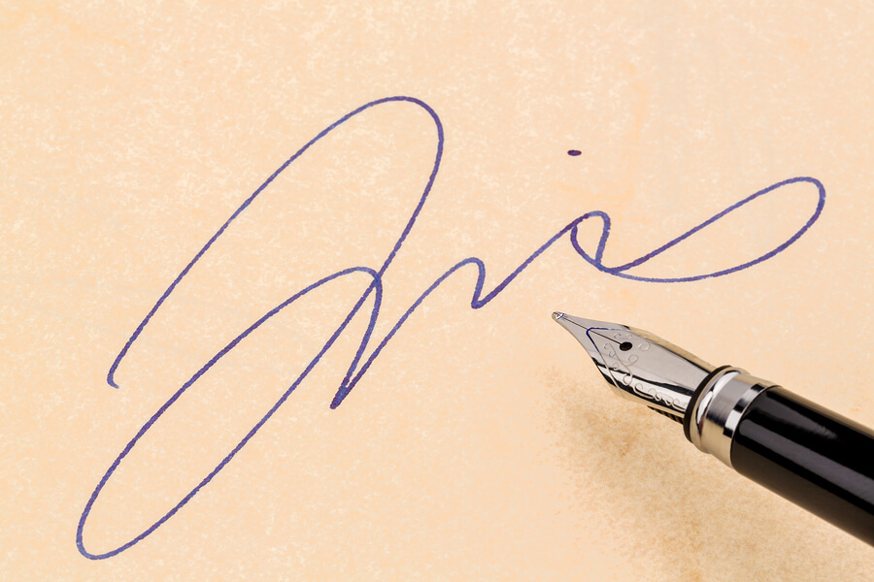
12 Characteristics of Handwriting

Slide 14
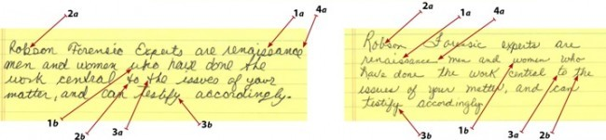
Basic Differences
1) Structural differences
2) Connecting strokes to letters
3) Slant
4) Baseline alignment - one consistently writes on the baseline and the other repeatedly deviates below the baseline.

Slide 15
Notes:
The handwriting examples below are from two different writers.
In the example: 1) Structural Difference 2) Connecting Strokes 3) Slant 4) Baseline Alignment

Slide 16
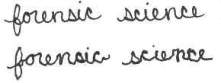
1. LINE QUALITY
Do the lines flow or are they shaky and irregular? This can indicate the speed of the writing. Prolonged writing can hint at someone copying the handwriting of another or trying to alter their own in some other way.

Slide 17
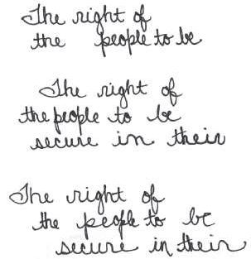
2. WORD AND LETTER SPACING
Are the letters and words equally spaced out, or are they bunched together?
Or, is there seemingly no pattern to the spacing?

Slide 18
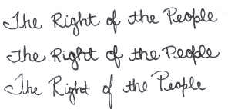
3. SIZE CONSISTENCY
Is the ratio of height to width consistent in each letter?

Slide 19

4. PEN LIFTS
Does the writer lift the pen from the paper or is the writing continuous?
Excessive pen lifts can hint at simulation — someone deliberately altering their natural handwriting or copying that of another.

Slide 20
5. CONNECTING STROKES
Are uppercase and lowercase letters connected and continuous?

Slide 21

6. LETTERS COMPLETE
Are the letters fully formed, or are parts missing?

Slide 22
7. CURSIVE AND PRINTED LETTERS
Are the letters cursive, printed, or a combination of both?

Slide 23
8. PEN PRESSURE
Is the pen pressure equal for upward and downward strokes? When is the pressure applied?

Slide 24
9. SLANT
Do the letters slant to the left or the right, or does this vary?

Slide 25
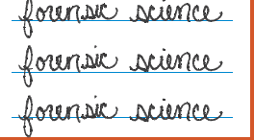
10. BASELINE HABITS
Is the writing on the baseline of the paper, above the line, or below the line?

Slide 26
11. FLOURISHES AND EMBELLISHMENTS
Are there any fancy curls, loops or anything else unusual in the writing?

Slide 27

12. DIACRITIC PLACEMENT
Where are the crosses on t’s and dots on i’s? Are the t’s crossed? Is the cross on the t at the top, middle or bottom of the letter? Are the I’s dotted? If so, are they dotted to the left, the centre, or the right of the I?
It is worth noting that a person may form a letter differently depending on where it appears in a word. Analysts like to find an example of each in the writing they are viewing.

Slide 28
Practice
Analyze your own handwriting using the 12 characteristics

Slide 29
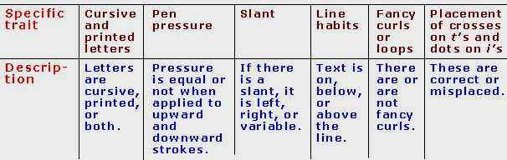
Introduction to Handwriting
The traits are functions of formatting or of letter or line form. Here are the other 6 of the 12 major, specific traits.

Slide 30
