Slide 1
Bioaccumulation
And Biomagnification

Slide 2
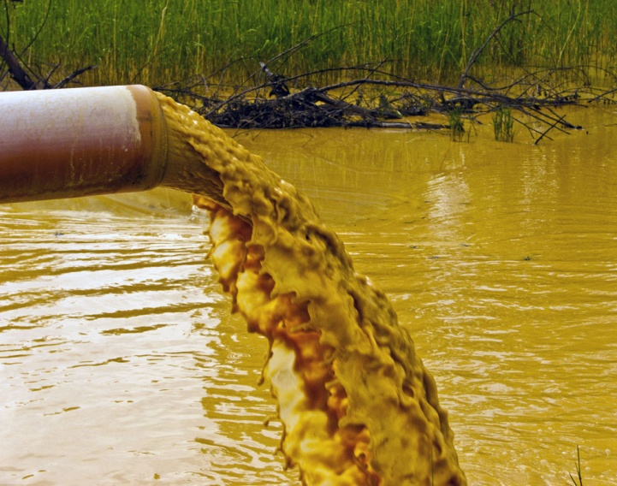
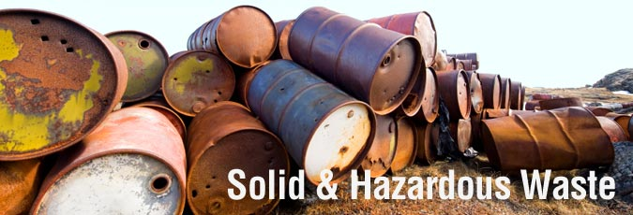
Not just energy is transferred up the food chain.
Toxins in the environment can bind to nutrients in the soil or water and can also be taken up.
These toxins can be difficult to break down and may accumulate in the fatty tissues consumers.

Slide 3
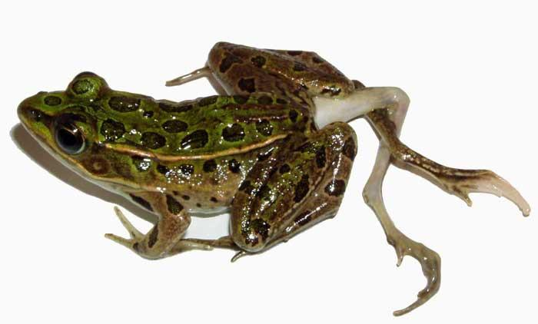
If the accumulation is too high, it can be harmful.
Notes:
Indicator species

Slide 4
Bioaccumulation
the gradual build-up of toxic chemicals in a living organism at a faster rate than can be excreted or broken down.
The longer an organism lives, the more time to accumulate, resulting in a higher concentration in older individuals.

Slide 5
Chemical accumulation is measured in Parts per million (ppm)
1 particle of a substance mixed with 999 999 other particles
(1 drop of dye in 150 L of water)
Toxins build up and are stored in the tissues.
Notes:
Hot water tank about 150 L

Slide 6
Some chemicals are get stored in fat tissue
When energy is needed, fat is burned to release the energy
The chemicals then also get released into blood stream

Slide 7
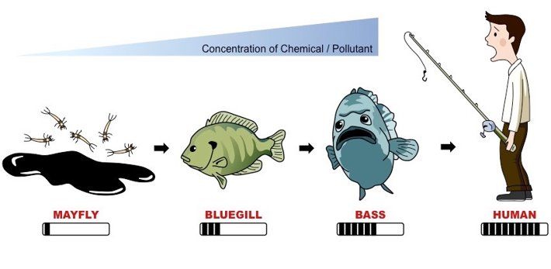
Biomagnification:
Toxins become increasingly concentrated at subsequent trophic levels.
Notes:
Herbivores eat large quantities of plants
Predators must eat many times their weight in prey over their life time.

Slide 8
Biomagnification
Some chemicals are get stored in fat tissue
When energy is needed, fat is burned to release the energy
The chemicals then also get released into blood stream
Notes:
Herbivores eat large quantities of plants and carnivores eat many times their body weight of prey during their lifetimes.
Therefore even small concentrations of chemicals in producers and primary and secondary consumers can build up to cause problems at higher trophic levels.

Slide 9
Biomagnification
https://www.youtube.com/watch?v=E5P-UoKLxlA&feature=related
Ameoba Sisters: https://www.youtube.com/watch?v=TZk6vcmLcKw

Slide 10
Eg. Minamata Disease (Warning: Disturbing Content)
Industrial mercury poisoning at Minamata Bay, Japan.
May 1956 Chisso Corp. polluted Minamata Bay and the Shiranui Sea with deadly methylmercury
https://www.youtube.com/watch?v=ihFkyPv1jtU&feature=related
Notes:
a neurological syndrome caused by severe mercury poisoning. Symptoms include ataxia, numbness in the hands and feet, general muscle weakness, narrowing of the field of vision and damage to hearing and speech.

Slide 11
Bioremediation
Bioremediation is the use of living organisms to help break down contaminants in the environment
Usually micro organisms
Some bacteria are used to clean up oil spills
Plants such as fescue, alfalfa, juniper, and poplar trees also act as natural traps to biodegrade hazardous wastes in soil, taking in and concentrating heavy metals in their tissues.
In wetland ecosystems, water hyacinth and bullrushes may be used.

Slide 12
What types of toxic substances?
PCBs – synthetic chemicals that don’t break down (used in transformers, capacitors, motor oil, etc)
POPs - Persistent organic pollutants (pesticides like DDT)
Heavy Metals - Mercury, Cadmium, Lead
Nanoparticles – electronics, sporting goods, cosmetics, clothing.

Slide 13
How do chemicals enter the environment?

Slide 14
Record High PCBs in Arctic
https://www.pbslearningmedia.org/resource/ipy07.sci.life.eco.arcticpcb/contaminants-in-the-arctic-human-population/

Slide 15
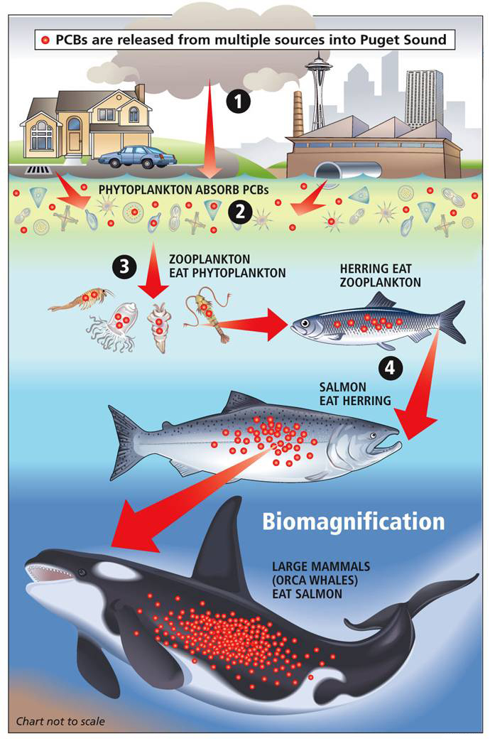
Eg. PCBs and Orcas
Because Orcas live for so long, they accumulate a lot of PCBs
A study found that PCBs will interfere with Orcas' reproduction – until 2030. Even though banned for decades
Orcas retain high levels of PCB's, especially in calves.

Slide 16
Eg. Bees and Neonicotinoids
Neonicotinoids are pesticides used to protect crops from nuisance insects by coating the seeds of food crops including corn and soybeans.
Studies have found a link between neonicotinoids and declining bee populations
https://www.youtube.com/watch?v=CLuX5TjRDdg
Death of Bees Explained: Kurzgesagt, 6min https://www.youtube.com/watch?v=GqA42M4RtxE
Notes:
As neonicotinoids became more common and popular in the United States, scientists noticed wild bee populations began to drop and commercial beekeepers reported that their hives were being killed off.
Studies have since shown that the neonicotinoids disrupt the bees’ nervous systems, causing seizures, impairing their movement and memory, eventually killing their hives.
Dropping bee populations are a serious threat to human food sources because about one-third of the world’s food crops rely on bees for pollination.
Farmers who rely on effective pest control to grow those same food crops have complained that restricting available pesticides could threaten human food supplies.

Slide 17
Extra slides on toxic substances…

Slide 18
Polychlorinated biphenyls (PCBs)
PCBs are synthetic chemicals that were widely used from 1930s to 1970s in industrial products such as paints, plastics, and lubricants.
They were banned in 1977
PCBs have a long half-life (Half-life is the time it takes for the amount of a substance to decrease by half.).
In humans they can suppress the immune system, disrupt hormones and cause cancers.

Slide 19
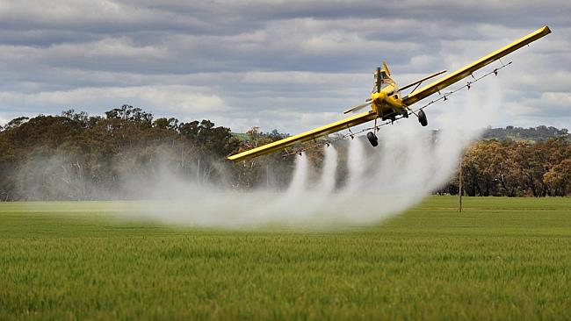
Persistent Organic pollutants (POPs)
POPs where used in insecticides
remain in water and soil for many years.

Slide 20
Example: DDT (dichloro-diphenyl trichloroethane)
DDT was an insecticide introduced in 1941 to control disease-carrying mosquitoes.
Binds strongly to soil and persists for as long as 15yrs
Banned in 1972 (Canada and US)
Affects nervous system, immune system and reproduction
Harmful at 5 ppm
Notes:
Accumulates in plants and then fatty tissue of the fish, birds, and animals that eat the plants.
Washed into streams and lakes, it affects aquatic food chains by first accumulating in plankton.

Slide 21
There were very few safety regulations or when these chemicals were first produced.

Slide 24
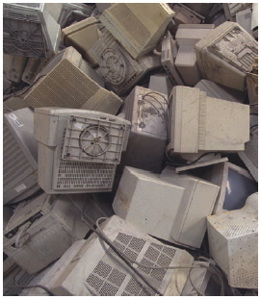
Heavy Metals also bioaccumulate
Heavy Metals – high density, toxic metals
Examples: Lead, Cadmium, Mercury

Slide 25
Heavy Metals – high density, toxic metals
Lead – extremely toxic, not considered safe at any level,
Can be ingested, absorbed through skin, inhaled
Was used in insecticides, paints and gasoline
Batteries , electronics
can cause anemia, nervous & reproductive system damage, kidney failure.

Slide 26
Heavy Metals: Lead
extremely toxic, not considered safe at any level,
Can be ingested, absorbed through skin, inhaled
Was used in insecticides, paints and gasoline
Also found in Batteries , electronics
Can cause anemia, nervous & reproductive system damage, kidney failure.

Slide 27
Heavy Metal: Cadmium
Highly toxic at 0.1 ppm
Binds to organic matter in soil
Extremely dangerous in soil – plants take it up, animals eat plants
causes lung diseases, cancer, nervous & immune system damage in humans
Used in the manufacture of plastics and nickel-cadmium batteries
Also get it from smoking
Half-life in bone tissue is 30yr

Slide 28
Heavy Metal: Mercury
Coal burning
Highly toxic
Accumulates in brain heart, and kidneys
Suppresses immune system

Slide 29
Practice
In class: Bioaccumulation Activity
At home: Bioaccumulation WS

