Slide 1
Seed Plants: Sub Phylum Spermopsida

Slide 2
Seed plants in General
Roots, Stems, Leaves, Vascular tissue
Don’t require water for reproduction
Produce Seeds
Cell walls with cellulose (all plants)
Alternation of Generation:
Sporophyte dominant
Gametophyte microscopic
Notes:
True roots (with vascular tissue)
Improved conductive tissue (stronger, thicker xylem) →Taller

Slide 3
Gymnosperm Distinguishing Features
Sub Phylum SPERMOPHYTA
seed-producing plants that include Conifers, Cycads, Ginkgo, and Gnetophytes
“Gymnosperm” means ‘naked seed’ (needs cone to protect it)
Reproductive structures are cones.
Each gymnosperm species has a different cone. Male and female cones present on same plant.
Notes:
Spermatophyta
Adapted better to life on land. Not because they wanted to.
Evolution occurs slowly.
Meristematic tissue - The meristem (also called meristematic tissue) is responsible for the growth of plants. type of tissue found in plants. It consists of undifferentiated cells capable of cell division. Cells in the meristem can develop into all the other tissues and organs that occur in plants. These cells continue to divide until a time when they get differentiated and then lose the ability to divide.
Plants grow larger via cell division and cell elongation. Simple plant growth is facilitated by meristem tissue because it is the primary site of cell division (mitosis) in the plant. Plants develop new organs (stems, leaves, flowers, roots) via cell division and cell differentiation.
Much variation in organisms. Some are better adapted than others to survive the environment. Those are the ones that get to reproduce, passing on their genetic info (characteristics better suited to environment) to the next generation, etc

Slide 4
Gymnosperm Distinguishing Features
Gametophyte phase are only a few cells
Gametophyte develops in cones
Gametophyte depends on sporophyte for nutrition
Notes:
Spermatophyta
Adapted better to life on land. Not because they wanted to.
Evolution occurs slowly.
Meristematic tissue - The meristem (also called meristematic tissue) is responsible for the growth of plants. type of tissue found in plants. It consists of undifferentiated cells capable of cell division. Cells in the meristem can develop into all the other tissues and organs that occur in plants. These cells continue to divide until a time when they get differentiated and then lose the ability to divide.
Plants grow larger via cell division and cell elongation. Simple plant growth is facilitated by meristem tissue because it is the primary site of cell division (mitosis) in the plant. Plants develop new organs (stems, leaves, flowers, roots) via cell division and cell differentiation.
Much variation in organisms. Some are better adapted than others to survive the environment. Those are the ones that get to reproduce, passing on their genetic info (characteristics better suited to environment) to the next generation, etc

Slide 5
Structure
Needle-like leaves - adaptation in most but not all conifers to function with less water. an example of one that doesn’t have pine needles is the cupressaceae.
Vascular tissue – Specialized tissue in plants that transport water, nutrients and the products of photosynthesis:
Notes:
Roots- anchor the plant into the soil and absorb and send water up the plant for photosynthesis.

Slide 6
Life Cycle
Sporophyte is dominant phase
Gametophyte is tiny, grows and matures within the sporophyte in cones. (dependent on sporophyte).
Male gametophyte is just a few cells inside a grain of pollen.
Female gametophyte produces an egg inside an ovule.
Notes:
This is a very big adaptation to life on land. HUGE
Cones produce spores → gametophyte

Slide 7
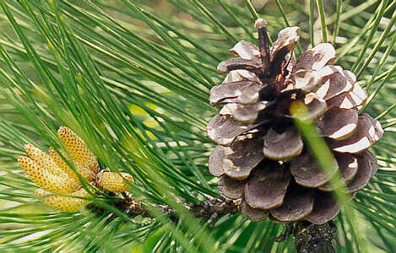
Male and Female Cones
Cones are made up of scales.
Scales hold sporangia – structures that produce spores that will develop into gametophytes.

Slide 9
Male Cones (Pollen Cones)
Smaller, less woody
microsporangia on scales make microspores → male gametophytes, consisting of several cells enclosed within pollen grain.
Pollen grains are released into the air.
Notes:
Male spores develop into male gametophytes, consisting of several cells enclosed within pollen grain.
An ovule develops on each scale of a female cone. Inside the ovule, an egg cell is produced.
Some trees have both. Some separate

Slide 10
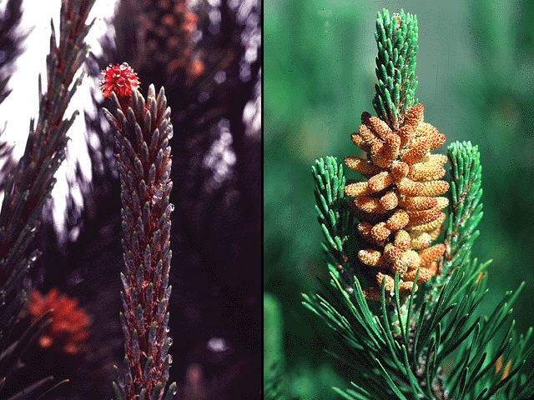
Male Cones appear in the spring

Slide 11
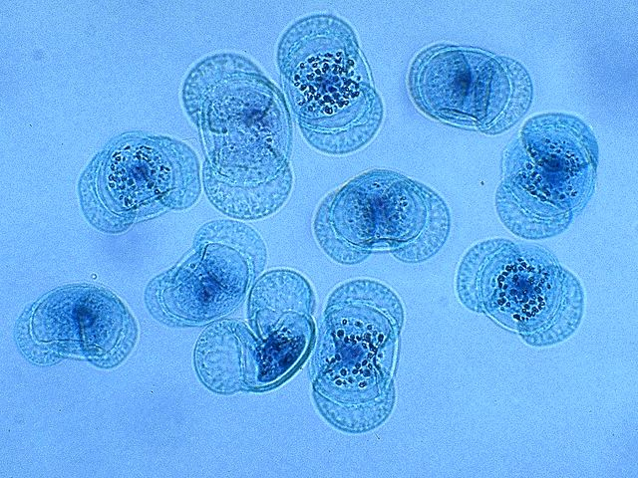
Pollen grains

Slide 12
Female Cones (Seed Cones)
Bigger, woodier
Megasporangia on scales of female cones → meiosis→ megaspores → female gametophytes → eggs inside ovules →seed, if fertilized.
Notes:
Each carry two ovules that develop to seeds.
Scales on female cones have (mega)sporangia that produce (mega)spores that develop into female gametophytes that produce ovules which will eventually develop into a seed, if fertilized.
Female gametophyte totally dependent on sporophyte for nutrition and protection.
In megasporangium, a single cell undergoes meiosis to produce 4 haploid megaspores. Three degenerate. Megaspore → mitosis→ gametophyte.
An ovule develops on each scale of a female cone. Inside the ovule, an egg cell is produced.
Some trees have both. Some separate

Slide 13
Notes:
Cones form on a mature sporophyte plant. Inside male cones, male spores develop into male gametophytes. Each male gametophyte consists of several cells enclosed within a grain of pollen.
Inside female cones, female spores develop into female gametophytes. Each female gametophyte produces an egg inside an ovule.

Slide 14
Ovule:
Structure that contains female gametophyte
develops into seed if fertilized.
megasporangium

Slide 15
POLLINATION
Pollination is the transfer of pollen to a female cone
If pollen grain lands inside the female cone, each pollen grain forms a tiny pollen tube. And produces sperm cells by mitosis.
Pollen tube grows into female gametophyte until it reaches an ovule.
Notes:
Before fertilization can occur, pollination must happen.

Slide 16
Fertilization: If sperm reaches an egg.
Gametes fuse → a (2n) zygote
Occurs deep within the protective tissues of the parent sporophyte (seed cone)
A sperm nucleus from the pollen grain unites with the egg → zygote
In Pine, it takes 15 months from pollination to fertilization
Notes:
Occurs deep within the protective tissues of the parent sporophyte
A sperm nucleus from the pollen grain unites with the egg → zygote
In Pine it takes 15 months from pollination to fertilization

Slide 17
Zygote → Embryo
Zygote (still within ovule) develops into embryo (baby sporophyte) with primordial roots and leaves.
Embryo → Seed

Slide 18
Seed (Fertilized ovule)
Seed contains embryo, food source, seed coat:
Gametophyte tissue becomes food storage
Parental sporophyte tissue forms seed coat.
Multicellular (in contrast to spore)

Slide 19
Notes:
Megaspore = female spore → female gametophyte→ egg (n)
Female gametophyte becomes nutrition for developing embro

Slide 21
Importance of Conifers
Economical:
Lumber: timber, pulp, paper, turpentine
Ecological:
Habitat for many animals
Prevent soil erosion
Clean the air
Dead trees add nutrients to soil
Source of food
Notes:
Turpentine is a fluid obtained by the distillation of resin harvested from living trees, mainly pines

Slide 22
What Adaptations have Seed plants evolved?

Slide 23
Reduced Gametophyte
Microscopic Gametophyte fits into tiny pollen grains: Transfer of pollen grains by wind and development of pollen tube eliminates the need for water for sexual reproduction.
Gametophyte does not develop in the soil as an independent generation, instead female gametophyte is nourished and protected within the moist reproductive tissue of the sporophyte.
Notes:
Gametophyte develops into food sources for baby sporophytes, thereby allowing plants to have seeds, which as a form of dispersal, can be far more successful than spores.

Slide 24
Seeds
Food supply for embryo (provided by gametophyte).
Seed coat protects embryo and food supply from drying out, extreme heat, or cold.
Aids in dispersal to new habitats. Prevent overcrowding.
Notes:
No water needed.
Gametophyte develops into food sources for baby sporophytes, thereby allowing plants to have seeds, which as a form of dispersal, can be far more successful than spores.
Important adaptation - Seeds allow plants to survive in habitats where mosses and ferns cannot.

Slide 25
Vascular tissue
Roots, Xylem: Nutrients and water can be moved up from soil to rest of plant.
Phloem: Nutrients distributed anywhere within the plant

Slide 26
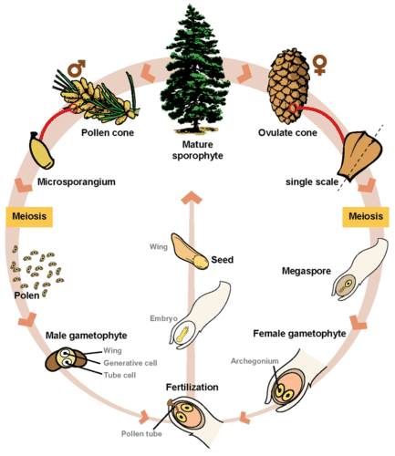

Slide 27
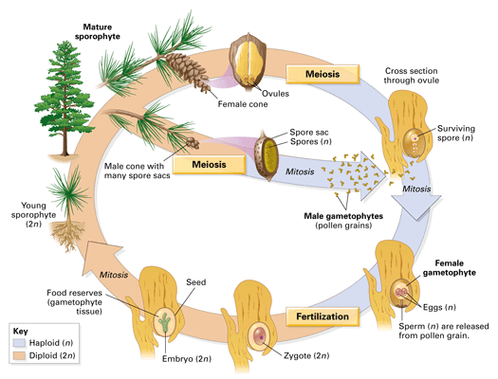

Slide 30
Gymnosperm reproduction differs from that of angiosperms in several ways
In angiosperms, the female gametophyte exists in an enclosed structure—the ovule—which is within the ovary;
in gymnosperms, the female gametophyte is present on exposed bracts of the female cone.
Double fertilization is a key event in the lifecycle of angiosperms, but is completely absent in gymnosperms.
The male and female gametophyte structures are present on separate male and female cones in gymnosperms, whereas in angiosperms, they are a part of the flower.
Lastly, wind plays an important role in pollination in gymnosperms because pollen is blown by the wind to land on the female cones. Although many angiosperms are also wind-pollinated, animal pollination is more common.
(a) Angiosperms are flowering plants, and include grasses, herbs, shrubs and most deciduous trees, while (b) gymnosperms are conifers. Both produce seeds but have different reproductive strategies.

Slide 31
Female gametophytes are entirely dependent on the parent sporophyte for nutrition and protection.
Megasporangia, “naked” on scales or modified leaves of often-woody cones, produce haploid megaspores by meiosis.
The much-reduced gametophyte develops from a megaspore, producing one or more egg cells.
Together with the megasporangium and layers of parental tissue (the integument), the gametophyte forms an ovule, which eventually develops into a seed.

Slide 32
Inside female cones, female spores develop into female gametophytes, which produces an egg inside an ovule.

