Slide 1
How are the elements organized?
Welcome to the periodic table

Slide 2
How are the Elements Organized?
By mid-1800s, scientists has identified nearly 60 elements.
They needed a classification system that would organized their observations.
They started grouping elements into “families” based on similar properties.
Notes:
Mendeleev was a Russian teacher and chemist, youngest of 17 children

Slide 3
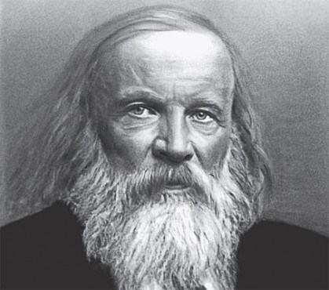
Dmitri Mendeleev (1834-1907)
He knew that properties of elements tended to repeat over regular intervals.
Wrote the properties of elements on cards to rearrange and compare
Realized that he needed to leave gaps in his arrangement – blank spaces predicting the existence of elements not yet found.
The gaps helped him accurately predict properties of elements not yet known.
Notes:
Mendeleev was a Russian teacher and chemist, youngest of 17 children

Slide 4
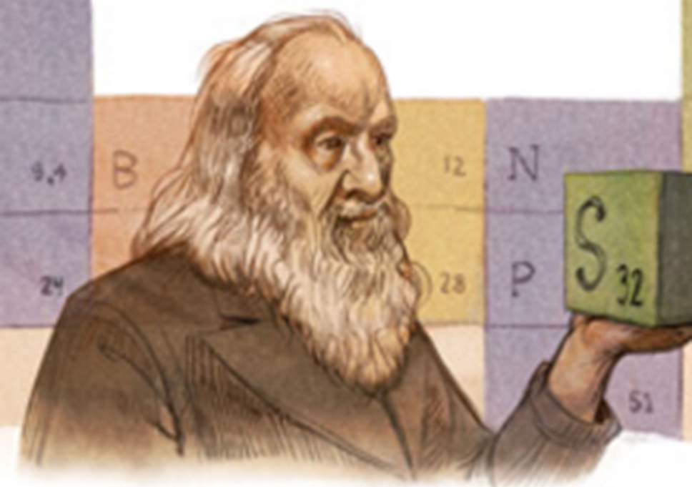
Patterns of the Periodic Table
Crash Course Video
https://www.youtube.com/watch?v=0RRVV4Diomg

Slide 5
Periodic Organization
Originally the elements were organized only by atomic mass. But it was discovered that many elements had similar properties and that the similarities were PERIODIC.
The Periodic Law states that the physical and chemical properties of the elements recur in a systematic and predictable way (periodic) when the elements are arranged in order of increasing atomic number in horizontal rows according to atomic mass

Slide 6
Dmitri Mendeleev (1834-1907) created first Periodic Table
He organized the elements :
In rows according to their ATOMIC NUMBER​
In columns according to their PROPERTIES
Another name for a ROW on the periodic table is a PERIOD.

Slide 7
Periodic Table Song
ASAP Science
https://www.youtube.com/watch?v=rz4Dd1I_fX0

Slide 8
Think it’s easy? Create your own Periodic Table
Create your own PT
PT Colouring WS
Intro to Elemental Superhero Assignment

