Slide 7
Modeling Atoms:
Bohr Diagrams

Slide 8
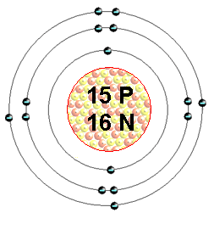
Bohr Model
A Bohr Model is a diagram of the number of electrons in each of the energy level (shell) around the nucleus of an atom.

Slide 9
Bohr Model
Each shell can only hold a CERTAIN NUMBER of electrons:
First shell can only hold a maximum of 2 electrons
2nd shell = 8, 3rd shell = 8, 4th = 18.
The outermost shell is called the VALENCE SHELL.

Slide 10
Practice: Draw a Bohr Diagram of Potassium

Slide 11
Practice: Draw a Bohr Diagram of Potassium
First find the number of protons by looking at its atomic number (19)
Now you know the number of electrons (19).
Place the electrons in corresponding shells at compass points (North, East, West, South).
Remember that the first shell can only hold 2 electrons, next shell 8, 8, etc

Slide 12
Bohr Model of Potassium

Slide 13
Draw a Bohr Diagram of Nitrogen

Slide 14
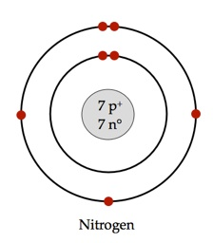
Draw a Bohr Diagram of Nitrogen

Slide 15
Draw a Bohr Diagram of Phosphorous

Slide 16
Bohr Model of Phosphorous:

Slide 17
What element is this?
_{18 p}
^{22 n}
Notes:
Argon

Slide 18
What element is this?
_{18 p}
^{22 n}
If you know the number of protons, you know it’s atomic number.
Or count the electrons…
Notes:
Argon

Slide 19
What element is this?
_{18 p}
^{22 n}
It has 2 + 8 + 8 = 18 electrons, and therefore 18 protons.
The element with atomic number of 18 is Argon.
Notes:
Argon

Slide 20
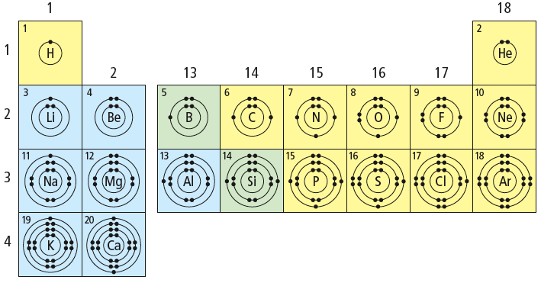
What patterns do you notice?

Slide 21
Patterns of Electron Arrangement in the Periodic Table
Have a look at the three Bohr models you drew.
What relationship can you find between number of OCCUPIED SHELLS and the ROW that it is found on the periodic table?

Slide 22
Patterns of Electron Arrangement in the Periodic Table
Have a look at the three Bohr models you drew.
What relationship can you find between number of OCCUPIED SHELLS and the ROW that it is found on the periodic table?
ROW = # of OCCUPIED SHELLS

Slide 23
Patterns of Electron Arrangement in the Periodic Table
Look at the Alkali Metals (Group 1).
What relationship can you find between number of VALENCE ELECTRONS and the COLUMN that it is found on the periodic table?

Slide 24
What patterns do you notice?

Slide 25
Patterns of Electron Arrangement in the Periodic Table
Look at the Alkali Metals (Group 1).
What relationship can you find between number of VALENCE ELECTRONS and the COLUMN that it is found on the periodic table?
GROUP/COLUMN # = #VALENCE ELECTRONS

Slide 26
Group number determines the number of valence electrons

Slide 27
What about Argon?
_{18 p}
^{22 n}
It has 3 electron shells, so it is in period 3
It has 8 electrons in the outer (valence) shell, therefore it is a noble gas.
Notes:
Argon

Slide 28
Patterns in the Periodic Table regarding electron arrangement
Elements in same family (group) have same number of valence electrons
Period (Row) = the number of occupied shells.

Slide 29
Practice Drawing Bohr Diagrams.
HW: Bohr WS
CYU page 223 #2,4,6, 9, 12,13

Slide 30
Why are Noble gases so stable?
Noble gases have FILLED valence shells
STABLE OCTECT = 8 electrons in the outermost shell.
This makes them very STABLE.

Slide 31
How do atoms become more stable?
Atoms want to look like Nobel Gases because they are very stable.
Atoms will attempt to obtain a STABLE OCTECT (8 electrons in their valence shell)
Atoms become more stable by GAINING or LOSING electrons in their valence shell.
Example: Sodium has 1 valence electron

Slide 32
How does an atom become more stable?
To become more stable, this sodium atom will LOSE that outer electron.

Slide 33
But what happens to sodium’s charge if it loses an electron?

Slide 34
What happens to an atom’s charge if it gains or loses electrons?
It becomes POSITIVE.
An atom that has gained a charge is called an ION.
A positive ion is called a CATION.
A negative ion is called an ANION.

Slide 36
Atoms, Ions & Bohr Models
In a neutral atom:
The number of protons = electrons
In an ION:
You can calculate the # of electrons by taking
#PROTONS – ION CHARGE (use the charge indicated in the upper right corner of each element on periodic table)

Slide 37
Example: Magnesium Atom
In a Neutral atom:
# protons _______
# neutrons _______
# electrons ______

Slide 38
Magnesium Ion
# protons _______
# neutrons _______
# electrons ______
(we got this by # protons – ion charge = 12- (+2) = 10

Slide 39
Another Example: Nitrogen
In a neutral atom:
# protons _______
# neutrons _______
# electrons ______
In an ION
# protons _______
# neutrons _______
# electrons ______
( we got this by #protons – ion charge = 7 – (-3) = 10

Slide 40
Quick Review
Find Sodium on the Periodic Table:
What is sodium’s atomic number?
How may protons does sodium have?
How many neutrons does sodium have?
How many electrons does sodium have?
If you have an ION of sodium, what is it’s charge?
How many electrons in an ION of sodium?

Slide 41
Quick Review
Find Sodium on the Periodic Table:
What is sodium’s atomic number? 11
How may protons does sodium have? 11
How many neutrons does sodium have? 12
How many electrons does sodium have? 11
If you have an ION of sodium, what is it’s charge? +1
How many electrons in an ION of sodium? 10

Slide 42
Patterns of the Periodic Table and Ions
What is the charge of the ions of the ALKALI METALS?
What is the charge of the ions of the ALKALI EARTH METALS?
What about the Transitions Metals?

Slide 43
Patterns of the Periodic Table and Ions
Metals tend to LOSE electrons and become positive ions (CATIONS).

Slide 44
Patterns on the other side
What is the charge of the ions of the HALOGENS (Group 17)?
Group 16?

Slide 45
Patterns on the other side
Non-metals tend to GAIN electrons, forming NEGATIVE IONS (anions).

Slide 46
Representing Ions
Charge of an ion is shown with SUPERSCRIPT:
+ or – to the upper right of the symbol:

Slide 47
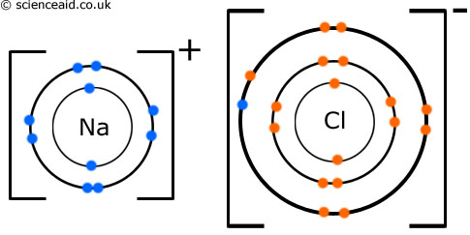
Bohr Model of an Ion
The Bohr Model indicates the charge with a
“ + or – ” and brackets.
Notes:
Note

Slide 48
Practice: Draw the Bohr model for an aluminium atom and ion.
aluminum-27 atom | aluminium-27 ion

Slide 49
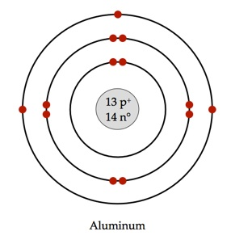
Practice: Draw the Bohr model for an aluminium atom and ion.
aluminum-27 atom | aluminium-27 ion

Slide 53
Homework
Bohr WS
https://www.youtube.com/watch?v=5PyVoMnRTlQ

