Slide 1
Eating Choices
Why do we eat the types of foods we do?

Slide 2
What is a Food Allergy?
A food allergy is an immune response.
Caused when the body mistakes an ingredient in food — usually a protein — as harmful and creates a defense system (antibodies) to fight it.
An allergic reaction occurs when the antibodies are battling an "invading" food protein.
A substance that causes an allergic reaction is an Allergen

Slide 3
Common Food Allergens
Milk (mostly in children)
Eggs
Peanuts
Tree nuts (like walnuts, almonds, pine nuts, brazil nuts, and pecans)
Soy
Wheat
Fish (mostly in adults)
Shellfish (mostly in adults)
Notes:
#1 in world is peanut cow's milk, eggs, tree nuts, peanuts, shellfish, fish, soy and wheat.

Slide 4
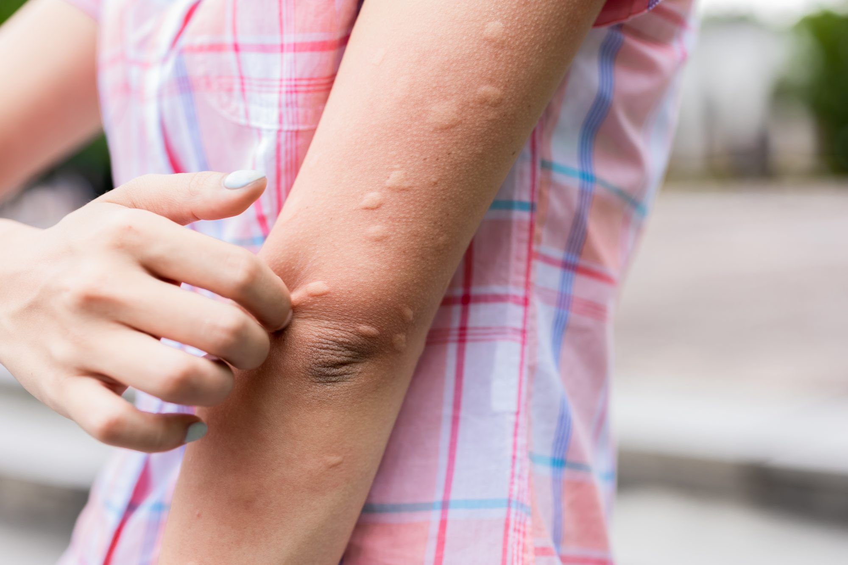
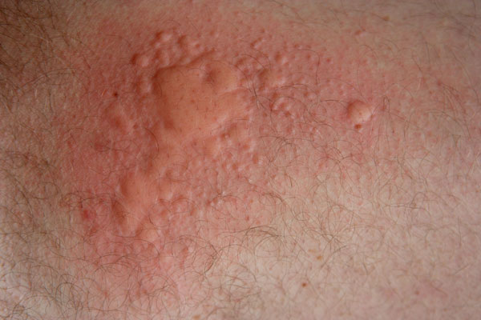
Symptoms of a Food allergy
Tingling or itching in the mouth.
Hives, itching or eczema.
Swelling of the lips, face, tongue and throat or other parts of the body.
Wheezing, nasal congestion or trouble breathing.
Abdominal pain, diarrhea, nausea or vomiting.
Dizziness, lightheadedness or fainting
Notes:
Immune Response

Slide 5
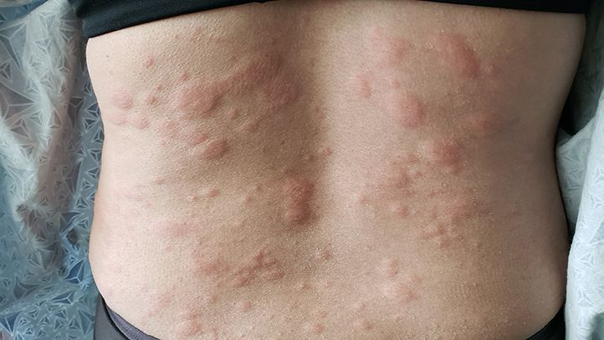
Hives

Slide 6
Treating mild allergic reactions
1. Stop eating the food. Don’t “test” the food by eating more. Repeated exposures when recovering makes it worse.
2. Take Antihistamines – may help with symptoms. Benadryl may help with hives and itching
3. Try Acupuncture -ancient Chinese practice utilizing small, painless needles in “meridian points” throughout the body has been shown to be effective for everything from weight loss to chronic pain
Notes:
Occasionally, a food allergy is first discovered by what feels like a mild reaction, like tingling of the mouth and lips, hives or itchy skin, or an upset stomach. Some of these symptoms, however, can also indicate early stages of anaphylaxis, so caution is always recommended. Unfortunately, the list of home remedies for any allergic reaction is short.

Slide 7
Acupunture

Slide 8
Food Allergy video
https://www.youtube.com/watch?v=AKVjKC3u9hk

Slide 9
Anaphylaxis
Allergic Reactions can be SEVERE
Severe food allergies can be VERY series and lead to Anaphylaxis - a severe, potentially life-threatening allergic reaction.
It can occur within seconds or minutes of exposure to something you're allergic to, such as peanuts or bee stings.
Notes:
What happens during anaphylactic shock?
https://youtu.be/9Qmzt94rRAw

Slide 10
In case of EMERGENCY
Call 911.
Use an EPIPEN (epinephrine autoinjector), if available, by pressing it into the person's thigh.
Make sure the person is lying down and elevate his or her legs.
Check the person's pulse and breathing and, if necessary, administer CPR or other first-aid measures.

Slide 11
How to work an Epipen
https://youtu.be/uBvdO9a9NTQ
Blue to the sky (remove cap)
Orange to the thigh
Stab to click
Count to 3

Slide 12
ABC → CPR
ABC: Open Airway, check for Breathing, Circulation
CPR: 30 chest compressions, 2 breaths, Repeat
https://www.readersdigest.ca/health/conditions/essential-cpr-steps/
Disco Saves Lives: https://youtu.be/KK-ZtH3jlhU

Slide 13
Food Intolerance
Food intolerance is a digestive system response
It occurs when something in food irritates a person’s digestive system or when a person is unable to properly digest, or break down, the food.
Makes you feel ill but won’t kill you

Slide 14
Common Food Intolerances
Dairy. Lactose is a sugar found in milk and dairy products.
Gluten. Gluten is the general name given to proteins found in wheat, barley, rye and triticale.
Caffeine.
Salicylates.
Amines.
FODMAPs.
Sulfites.
Fructose.

Slide 15
Symptoms of a food intolerance
Nausea.
Stomach pain.
Gas, cramps or bloating.
Vomiting.
Heartburn.
Diarrhea.
Headaches.
Irritability or nervousness.
Notes:
Make you feel ill

Slide 16
Example: Lactose Intolerance
Lactose intolerance is when your body can't break down or digest lactose.
Lactose is a sugar found in milk and milk products.
Lactose intolerance happens when your small intestine does not make enough of a digestive enzyme called lactase.
Lactase breaks down the lactose in food so your body can absorb it.

Slide 17
When lactose moves through the large intestine (colon) without being properly digested, it can cause uncomfortable symptoms such as gas, belly pain, and bloating.
Some people who have lactose intolerance cannot digest any milk products.
Others can eat or drink small amounts of milk products or certain types of milk products without problems.
Notes:
Lactose intolerance is common in adults. It occurs more often in Indigenous peoples and people of Asian, African, and South American descent than among people of European descent.
A big challenge for people who are lactose-intolerant is learning how to eat to avoid discomfort and to get enough calcium for healthy bones.

Slide 18
Symptoms of Lactose Intolerance
Bloating.
Pain or cramps in the lower belly.
Gurgling or rumbling sounds in the lower belly.
Gas.
Loose stools or diarrhea. Sometimes the stools are foamy.
Throwing up.

Slide 20
Disorders: Eg. Celiac Disease
Celiac disease is not a food allergy nor intolerance, but an autoimmune condition;
(wheat allergy involves an immune (not auto-immune) response)
Sometimes called celiac sprue or gluten-sensitive enteropathy, is an immune reaction to eating gluten, a protein found in wheat, barley and rye.
If you have celiac disease, eating gluten triggers an immune response in your small intestine.
Notes:
n an autoimmune disease, the immune system mistakes part of your body, like your joints or skin, as foreign.

Slide 21
Celiac Disease in Children
weight loss
vomiting
abdominal bloating
abdominal pain
persistent diarrhea or constipation
pale, fatty, foul-smelling stools

Slide 22
Celiac Disease in Adults
Adults with celiac disease may experience digestive symptoms. In most cases, however, symptoms also affect other areas of the body. These symptoms may include:
iron-deficiency anemia
joint pain and stiffness
weak, brittle bones
fatigue
seizures
skin disorders
numbness and tingling in the hands and feet
tooth discoloration or loss of enamel
pale sores inside the mouth
irregular menstrual periods
infertility and miscarriage
Notes:
If left untreated/ignored it can increase your risk for developing certain types of digestive system cancers. Lymphoma of the small intestine is a rare type of cancer but may be 30 times more common in people with celiac disease

Slide 23
FOOD SENSITIVITIES
A food sensitivity is a diffuse and poorly understood reaction to food that may be associated with increased levels of certain IgG class antibodies that are reactive to that food.
Symptoms can be delayed for a few days after ingesting the trigger food.

Slide 24
What’s the difference between food allergy and intolerance?

Slide 25
Food Allergy vs Food Intolerance
A true food allergy causes an immune system reaction that affects numerous organs in the body.
can be severe or life-threatening.
Food intolerance symptoms are generally less serious and often limited to digestive problems.

Slide 26
Practice
Food Allergy WS – to be handed in
You will need to look some responses. You may use your phone.

Slide 27
Assignment: Food Allergen. 2 classes
People can be allergic to any food, but some allergies are more common than others.
To learn more about food allergens and how to prevent reactions, research and report on a food allergy of your choice.
Create an electronic presentation that includes the following information about the food allergen:
Food sources
Non-food sources
Other names
Emergency Treatment
Consideration when dining out

Slide 28
Assignment: Create a Brochure
Advising someone on how to live with a Food Allergy/…

