Slide 1
Resistors and Ohm’s Law

Slide 2
RESISTORS
A RESISTOR any object that slows down the flow of electric current (providing resistance).
Can be a load
Symbol:
RESISTANCE is measured in Ohms (Ω), with an ohmmeter.

Slide 3
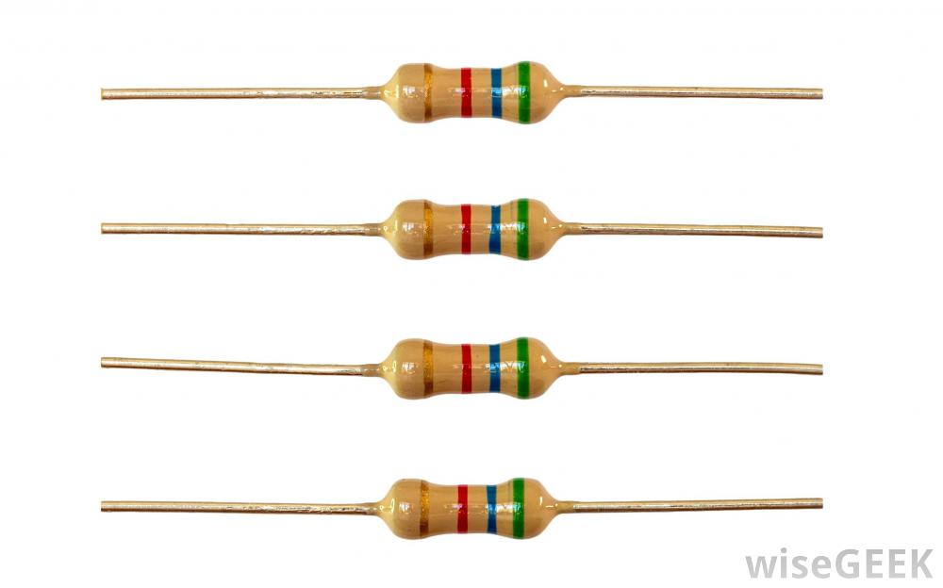
RESISTORS
Resistors can be used for safety reasons since high currents can cause wires to overheat, and catch fire.
Resistors are colour coded to show the amount of resistance they provide.

Slide 4
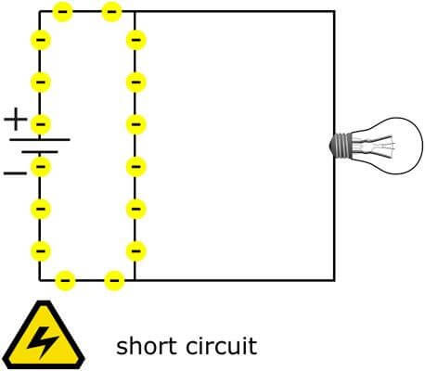
Aside: What is a Short Circuit?
a connection on a circuit that allows a current to follow an unintended path.

Slide 5
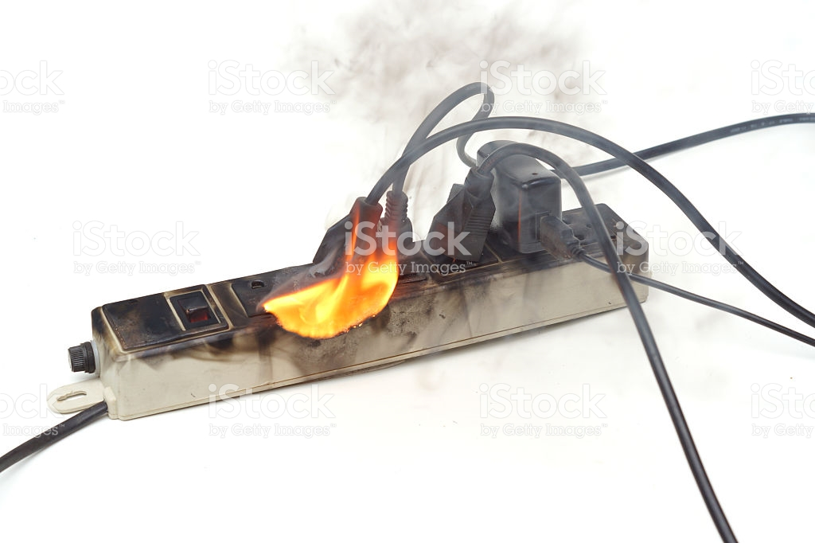
Short Circuit
Short circuits cause the overload of current → heat → damage/fire
The result can be appliance damage, electrical shock, or even a fire.

Slide 6
Short Circuits
The usual cause is bare wires touching one another or wire connections that have come loose.

Slide 7
Good conductors have low resistance, so electrons flow through them easily
Poor conductors have high resistance, so electrons are slowed down. (good insulators)

Slide 8
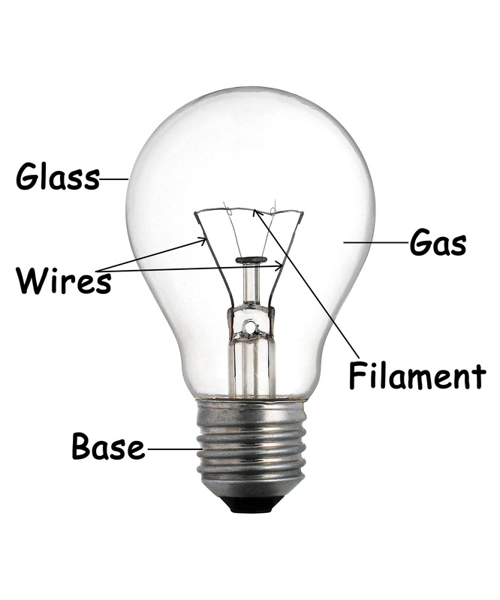
How is a light bulb a resistor?
The filament in a light bulb is a thin wire which has resistance to the flow of electricity.
As a result, the filament heats up and starts glowing due to the gas inside the bulb, converting electrical energy to light energy (and heat).
Tungsten wire has 400x more resistance than copper wire.
Notes:
Electricity flows through a thin wire in the light bulb called the filament. The filament used in a bulb has a property called "resistance." ... A filament has a lot ofresistance to electricity. Therefore as a result of this, the filament heats up and starts glowing, converting electrical energy to light energy.
Resistance is the amount of friction that an object will put against electricity flowing through it. A filament has a lot of resistance to electricity. Therefore as a result of this, the filament heats up and starts glowing, converting electrical energy to light energy. This is because of the Joule-effect, which means that resistances heat up when electrical current runs through them.

Slide 9
How are Current, Voltage and Resistance related?
Current is the movement of electrons (charge) though a conductor
Voltage is what makes electrons move through conductor
Resistance works against and slows down motion of electrons

Slide 10
Ohm’s Law:
Ohm’s Law states that the potential difference (voltage) across a conductor is proportional to the current through it.
V = I R
where V is the potential difference between two points which include a resistance R.

Slide 11
Ohm’s Law:

Slide 12
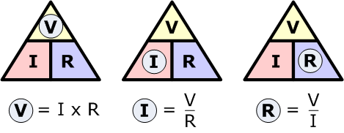
We can rewrite the equation

Slide 13
Practice
1. An alarm clock draws 0.5 A of current when connected to a 120 volt circuit. Calculate its resistance.

Slide 14
Practice
An alarm clock draws 0.5 A of current when connected to a 120 volt circuit. Calculate its resistance.
R = V / I
= 120 V/0.5 A
= 240 Ohms

Slide 15
Practice
2. How much voltage would be necessary to generate 10 amps of current in a circuit that has 5 ohms of resistance?

Slide 16
Practice
How much voltage would be necessary to generate 10 amps of current in a circuit that has 5 ohms of resistance?
V = I x R
= 10 x 5
= 50 volts

Slide 17
Resistors in Series: Add them up
When resistors are arranged in a series, the current has only one path to take and is the same through each resistor.
The total resistance of the circuit is found by adding up the individual resistors:
R = R₁ + R₂ + R₃ + ...

Slide 18
Resistors in Series
Calculate the total resistance for these three resistors in series

Slide 19
Resistors in Series
Calculate the total resistance for these three resistors in series

Slide 20
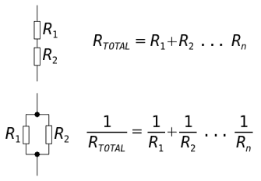
Resistors in Parallel
The combined resistance of two or more resistors is less than that of either resistor by itself.

Slide 21
Practice
Calculating Ohm’s Law WS
Lab: PHET simulation

Slide 22
Extra Slides Beyond here

Slide 25
Practice: Circuit with Resisters in Parallel
Voltage = 12V
R1 = 4 Ohm
R2 = 4 Ohm
R3 = 1 Ohm
Find current.
First need to Find total Resistance

Slide 26
Practice
First need to Find total Resistance
1/R total = 1/R ₁ + 1/R₂ + 1/R₃
1/R total = ¼ + ¼ + 1/1
1/ R total = 0.25 + 0.25 + 1
1/R total = 1.5
R total = 1/1.5 = 0.667 Ohm

Slide 27
Practice
Then calculate Current:
I = V/R
I = 12/0.667
18 Amps

Slide 28
Practice
A refrigerator and an oven are wired in parallel across a potential difference of 120 V. The refrigerator has a resistance of 75 Ω and the oven has a resistance of 91 Ω.
How much current is in the circuit of each appliance?

Slide 29
Practice
A refrigerator and an oven are wired in parallel across a potential difference of 120 V. The refrigerator has a resistance of 75 Ω and the oven has a resistance of 91 Ω. How much current is in the circuit of each appliance?
First find total Resistance
R1 = 75 Ω
R2 = 91

Slide 30
Practice
A refrigerator and an oven are wired in parallel across a potential difference of 120 V. The refrigerator has a resistance of 75 Ω and the oven has a resistance of 91 Ω. How much current is in the circuit of each appliance?
First find total Resistance:
1/R Total = 1/75 Ω + 1/91
1/ R = 0.013 + 0.011
1/R = 0.024
R = 1/0.024 = 41.7 Ohms

Slide 31
Practice
A refrigerator and an oven are wired in parallel across a potential difference of 120 V. The refrigerator has a resistance of 75 Ω and the oven has a resistance of 91 Ω. How much current is in the circuit of each appliance?
Then Calc Current:
I = V/R
I = 120V / 41.7
I = 2.88 amps

Slide 32
Lick a battery for science
https://www.sparkfun.com/news/1385

Slide 33
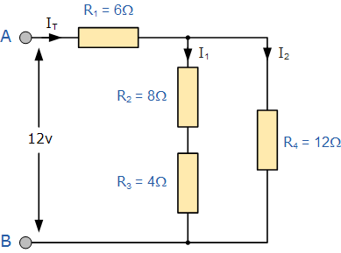
Resistors in Parallel
When resistors are connected in parallel, the current splits up and is equal to the sum of the currents through each resistor.
In other words the currents in the branches of a parallel circuit add up to the supply current.
When resistors are connected in parallel, they have the same potential difference (voltage) across them.

Slide 34
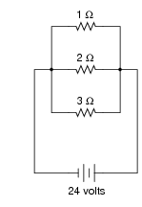
Calculate Current through each resistor
In this circuit, three resistors receive the same amount of voltage (24 volts) from a single source.
Calculate the amount of current “drawn” by each resistor, as well as the amount of power dissipated by each resistor:

Slide 35
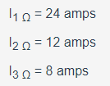
Answer
The lowest value of resistor dissipates the greatest power

Slide 36
Resistance in Parallel
a “heavy” load is one that draws a large amount of current, and thus has a large resistance.
This circuit, which shows how the lowest resistance in a parallel circuit consumes the most power. (“heavy” load).

Slide 37
According to Ohm’s Law, how much current goes through each of the two resistors in this circuit?

Slide 38
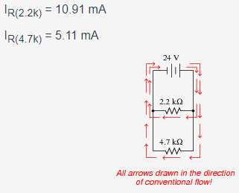
According to Ohm’s Law, how much current goes through each of the two resistors in this circuit?

Slide 39
Calculate the total amount of current that the battery must supply to this parallel circuit:
Now, using Ohm’s Law, calculate total resistance (R_{total}) from total (source) voltage V_{total} and total (source) current I_{total}.

Slide 40
Calculate the total amount of current that the battery must supply to this parallel circuit
I_{total} = 40.0 mA
R_{total} = 250 Ω
Follow-up question: without appealing to Ohm’s Law, explain why the total resistance is one-half as much as either of the individual resistances.

Slide 41
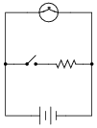
What will happen to the brightness of the light bulb if the switch in this circuit is suddenly closed?

Slide 42
In a SERIES Circuit:
Current: SAME through whole circuit
I_{T} = I₁ = I₂ = I₃ ….
Voltage: voltage across loads ADD UP to TOTAL VOLTAGE
V_{T} = V₁ + V₂ + V₃ ….
Resistance: Resistors INCREASE total resistance in circuit → TOTAL CURRENT DECREASES in circuit as resistors are ADDED.
R_{T} = R₁ + R₂ + R₃ ….

Slide 43
In Parallel Circuits:
Current through each path ADDS UP to Total current
I_{T} = I₁ +I₂ + I₃ ….
Voltage: is the SAME across each load as total voltage
V_{T} = V₁ = V₂ = V₃ ….
Resistance: Resistors DECREASE total resistance in circuit → TOTAL CURRENT INCREASES in circuit as resistors are ADDED.
1/Rt = 1/R1 + 1/R2 + 1/R3 …..

Slide 44
Try This Activity p 315

Slide 45
Practice Problems p322
HW:
CYU p 319 #1,2, 3, 4, 7, 9
WB p124 -127 (BC Sc 9)
Probe WB p 183-184

Slide 46
Series and Parallel Circuits
A series circuit is an electric circuit that has only one path for electrons to flow.
Electricity cannot go to just one electrical device, it must flow through all devices
All loads in a circuit share the electric pressure (voltage).
If you add electric loads, each one get less electric pressure (light bulbs will dim as more are added)
We use series circuits in:
Computers, radios, TV’s, rockets

Slide 47
Resistors in Parallel
When resistors are arranged in parallel, the current breaks up, with some flowing along each parallel branch and re-combining when the branches meet again.
(The voltage across each resistor in parallel is the same)
The total resistance is found by adding up the reciprocals of the resistance values, and then taking the reciprocal of the total:
equivalent resistance of resistors in parallel: 1 / R = 1 / R₁ + 1 / R₂ + 1 / R₃ +...

Slide 48
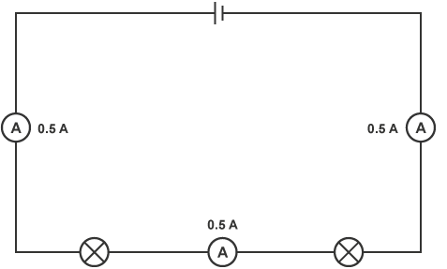
Circuit in Series
V1 + V2 = VT
2 V + 4V = 6 V
I1 = I2 = IT
0.5 A = 0.5 A = 0.5 A
Notes:
Voltmeter shows

Slide 49
Check your Understanding
a. Two 3-Ω resistors placed in series would provide a resistance that is equivalent to one _____-Ω resistor.
b. Three 3-Ω resistors placed in series would provide a resistance that is equivalent to one _____-Ω resistor.
c. Three 5-Ω resistors placed in series would provide a resistance that is equivalent to one _____-Ω resistor.
d. Three resistors with resistance values of 2-Ω , 4-Ω , and 6-Ω are placed in series. These would provide a resistance that is equivalent to one _____-Ω resistor.
e. Three resistors with resistance values of 5-Ω , 6-Ω , and 7-Ω are placed in series. These would provide a resistance that is equivalent to one _____-Ω resistor.
f. Three resistors with resistance values of 12-Ω, 3-Ω, and 21-Ω are placed in series. These would provide a resistance that is equivalent to one _____-Ω resistor.
Notes:
R_{eq} = R₁ + R₂ + R₃ + ...a. Two 3-Ω resistors placed in series would provide a resistance which is equivalent to one 6-Ω resistor.
b. Three 3-Ω resistors placed in series would provide a resistance which is equivalent to one 9-Ω resistor.
c. Three 5-Ω resistors placed in series would provide a resistance which is equivalent to one 15-Ω resistor.
d. Three resistors with resistance values of 2-Ω , 4-Ω , and 6-Ω are placed in series. These would provide a resistance which is equivalent to one 12-Ω resistor.
e. Three resistors with resistance values of 5-Ω , 6-Ω , and 7-Ω are placed in series. These would provide a resistance which is equivalent to one 18-Ω resistor.
f. Three resistors with resistance values of 12-Ω , 3-Ω , and 21-Ω are placed in series. These would provide a resistance which is equivalent to one 36-Ω resistor.

Slide 50
2. As the number of resistors in a series circuit increases, the overall resistance __________ (increases, decreases, remains the same) and the current in the circuit __________ (increases, decreases, remains the same).
Notes:
As the number of resistors in a series circuit increases, the overall resistance increases and the current in the circuit decreases.
close

