Slide 1
SUPPLEMENTS AND SUBSTANCES

Slide 2
Dietary Supplements
Manufactured Vitamins, minerals, herbs, to supplement one's diet
pill, capsule, tablet, powder, or liquid.
extracted from food sources or are synthetic (human-made)

Slide 3
Performance Enhancing Supplements
Called ergogenic aids,
Anything that gives you a mental or physical edge while exercising or competing.
Range from caffeine and sports drinks to illegal substances

Slide 4
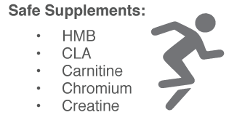
Performance Enhancing Supplements
However, scientific proof of their effectiveness is sometimes lacking or contradictory (opposite).
Some are recognized as safe by Food and Drug Administration (FDA):

Slide 5
Harmful or Illegal Ergogenic Aids
The NCAA and the Olympics commission have banned some substances because they offer an unfair advantage or can cause harm to the athlete.
Anabolic and other Steroids
DHEA (synthetic steroid)
Diuretics – make you pee
Blood doping – boosting red blood cells
Ephedrine – similar to adrenaline
HGH – human growth hormone

Slide 6
Steroids
Naturally Produced in the body
Corticosteroids
Anabolic Steroids

Slide 7
Naturally Produced Steroids
Part of cell membranes
Signaling molecules (like hormones).
Eg. testosterone – helps body build muscle tissue, among other important bodily processes.
Steroid hormones help control metabolism, inflammation, immune functions, salt and water balance, development of sexual characteristics, and the ability to withstand injury and illness.

Slide 8
Corticosteroids
Man-made steroids
When taken in doses higher than the amount your body normally produces, steroids reduce redness and swelling (inflammation).
help with inflammatory conditions such as asthma and eczema.
Steroids also reduce the activity of the immune system, which is the body's natural defence against illness and infection.

Slide 9
How do you take them?
Orally – by mouth
Topically – on the skin
Nasal sprays and inhalers – breathe in

Slide 10
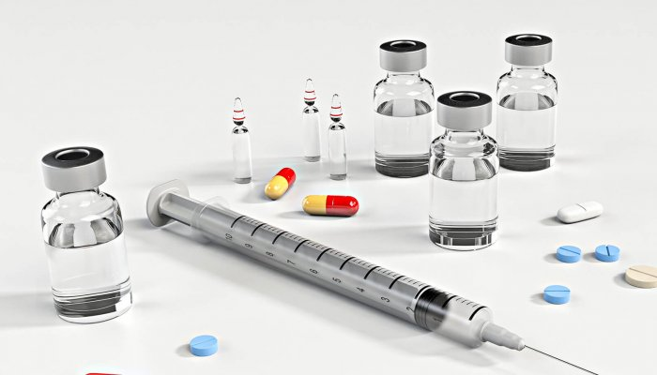
Anabolic Steroids
Synthetic, (human-made), variations of the male sex hormone testosterone.
The proper term: anabolic-androgenic steroids.
"Anabolic" refers to muscle building,
“Androgenic" refers to increased male sex characteristics.

Slide 11
How do anabolic Steroids Work?
Stimulate muscle tissue to grow and "bulk up" in response to training by mimicking the effect of naturally produced testosterone on the body.
Anabolic steroids can remain in the body anywhere from a couple of days to about a year.
Steroids have become popular because they may improve endurance, strength, and muscle mass. However, research has not shown that steroids improve skill, agility, or athletic performance.

Slide 12
Risks for Girls
increased facial and body hair growth
development of masculine traits, such as deepening of the voice, and loss of feminine body characteristics, such as shrinking of the breasts
enlargement of the clitoris
menstrual cycle changes

Slide 13
Risk for Guys
testicular shrinkage
pain when urinating
breast development
impotence (inability to get an erection)
reduced sperm count and infertility

Slide 14
Any Side Effects?
acne
premature balding or hair loss
weight gain
mood swings
aggression
problems sleeping
high blood pressure
greater chance of injuring muscles and tendons
jaundice (yellowing of the skin); liver damage
stunted growth
increased risk of developing heart disease, blood clots, stroke, and some types of cancer

Slide 15
Psychological Effects “Roid Rage”
Aggressive or combative,
Delusions: believe things that aren't true.
Paranoia: have extreme feelings of mistrust or fear
Higher risk for using other drugs, such as alcohol or cocaine, often to counteract some of the negative effects of steroids.
Steroid users who inject the drugs with a needle are at risk for infection with HIV (human immunodeficiency virus), the virus that causes AIDS, if they share needles with other users. People who use dirty needles are also at risk for contracting hepatitis, a liver disease, or bacterial endocarditis, an infection of the inner lining of the heart.

Slide 16
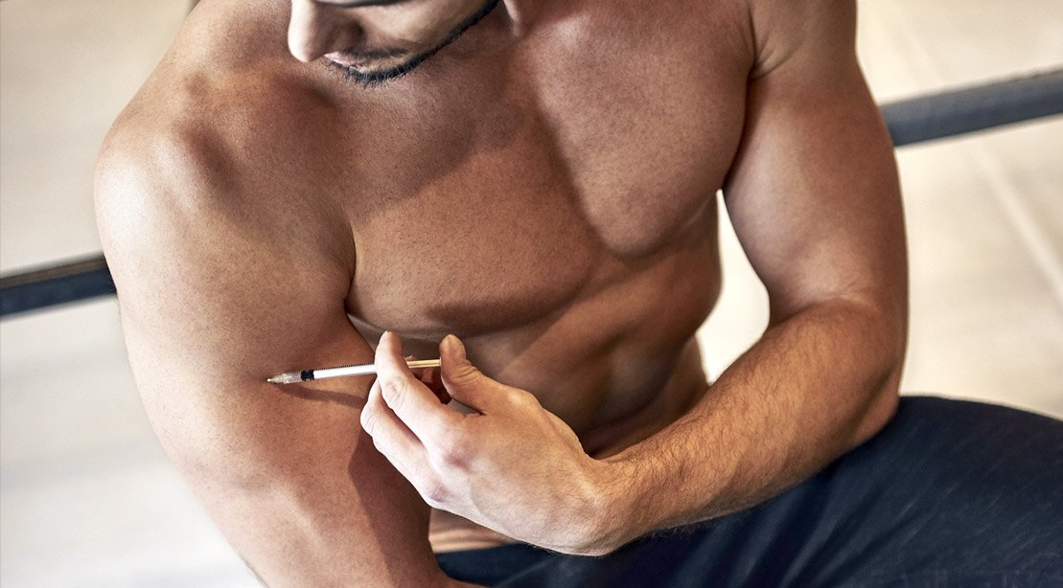
Who uses them? Body Builders, Professional Athletes, Average Joe
Notes:
18min

Slide 17
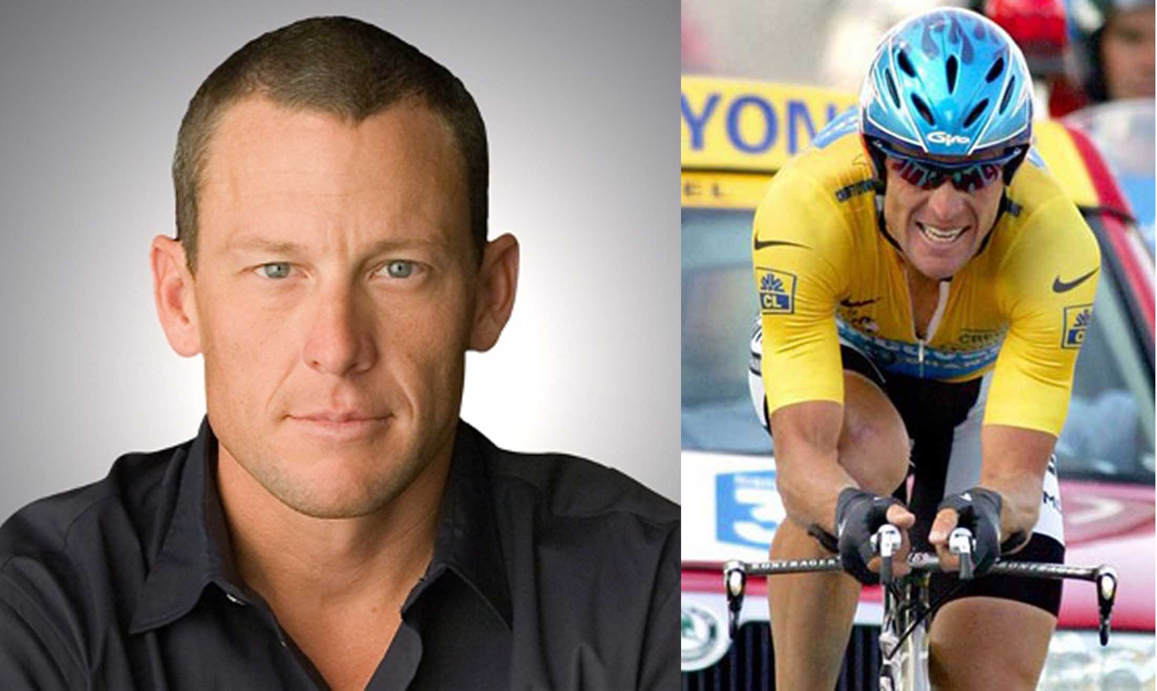
Lance Armstrong
7 time winner of Tour de France.
October 22, 2012, formally stripped of the seven Tour de France titles he won from 1999 to 2005 and banned for life from competitive cycling after being charged with systematically using illicit performance-enhancing drugs and blood transfusions as well as demanding that some of his Tour teammates dope in order to help him win races.
Notes:
the mastermind of what it described as "the most sophisticated, professionalized and successful doping program that sport has ever seen." The report detailed numerous blood test results that proved Armstrong was guilty of blood doping, as well as over US$1 million in payments to Ferrari.

Slide 18
Lance Armstrong
Confession on Oprah
https://youtu.be/N_0PSZ59Aws
I’d do it again
https://youtu.be/wzvZNQKowMU

Slide 19
Russia in the Olympics
Banned from Olympics in 2016

Slide 20
Blood Doping
Injecting oxygenated blood into an athlete before an event
Or injecting drugs to make the body produce more red blood cells
Epoetin injection is a man-made version of human erythropoietin (EPO). https://www.science.org.au/curious/people-medicine/drugs-sport
Notes:
EPO is produced naturally in the body, mostly by the kidneys. It stimulates the bone marrow to produce red blood cells. If the body does not produce enough EPO, severe anemia can occur.

Slide 21
Icarus on Netflix
2017 Academy Award winning documentary film, Icarus, examines the history of blood doping in Russia.

Slide 22
Assignment
(CRAAP Detection),
In class: Performance Enhancer WS – pick any 5
Project: Research Performance Enhancing Drugs used in profession Sports, 2 classes
Write a paragraph summarizing Steroids
Notes:
Synthesis, Communicate, evaluate.

Slide 23
source
https://kidshealth.org/en/teens/steroids.html

