Slide 1
IDENTIFYING MINERALS

Slide 2
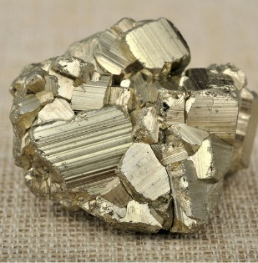
PHYSICAL PROPERTIES OF MINERALS
Can you identify this mineral? How would you do it? By color? Shape? Whether it's shiny or dull? Are there lines (striations) running across? This mineral has shiny, gold, cubic crystals with striations, and smells like sulfur. What is it?
Notes:
When geologists are "in the field," and don’t have all the fancy lab equipment with them, they use the process of elimination including things like colour, hardness, smell, solubility in acid, streak, striations, and/or cleavage to identify the mineral. Some minerals can be identified with little more than the naked eye. We do this by examining the physical properties.

Slide 3
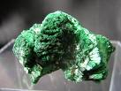
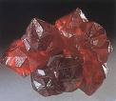
Color
First and most easily observed mineral property.
Some minerals have very characteristic colors that help identify them..
Cinnabar
Malachite
Sulfur
Azurite

Slide 4
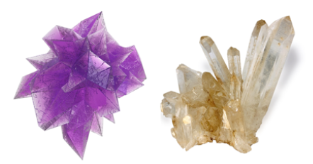
COLOUR – not always the best way to ID
The same mineral can have different colours
Eg. quartz can be colorless, purple (amethyst), or a variety of other colors depending on chemical impurities.

Slide 5
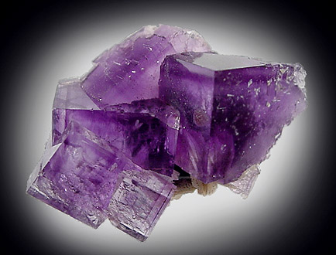
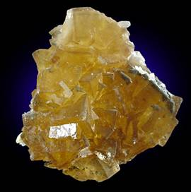
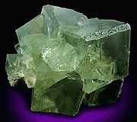
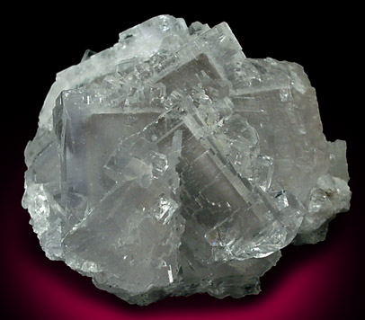
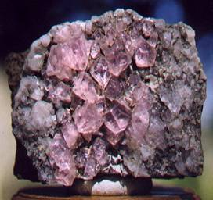
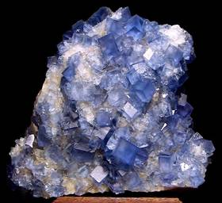
Colour
Examples of colour variation in Fluorite

Slide 6
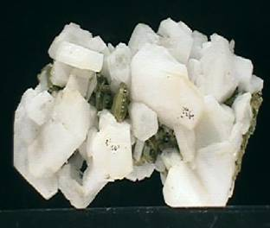
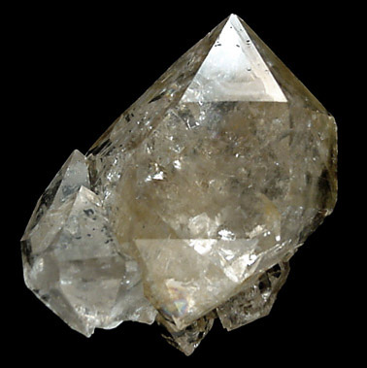
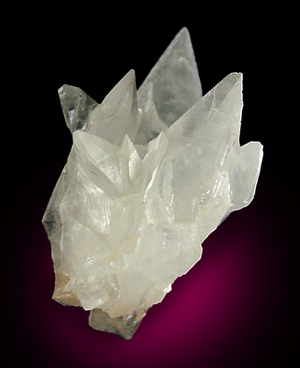
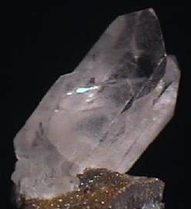
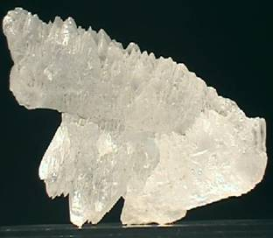
2. Different minerals may have the SAME colour
Plagioclase feldspar
Quartz
Calcite
Barytes
Fluorite
Gypsum
All these minerals are grey or white in colour

Slide 7
3. Minerals can change colour when exposed to air
So always inspect freshly-exposed surfaces!

Slide 8
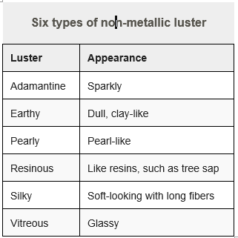
LUSTER
Luster its shininess or the reflection of light off its surface.
a mineral’s lustre is either metallic - shines like polished metal eg. pyrite, galena
or non-metallic eg. quartz).

Slide 10
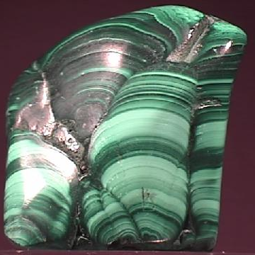
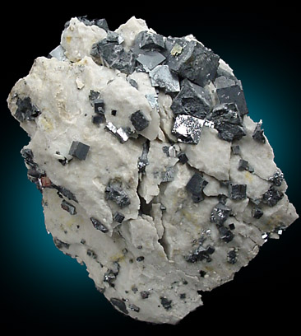
Metallic Lustre
Malachite
Galena
Minerals reflect light like metals.
Metallic lustre often tarnishes to a dull lustre

Slide 11
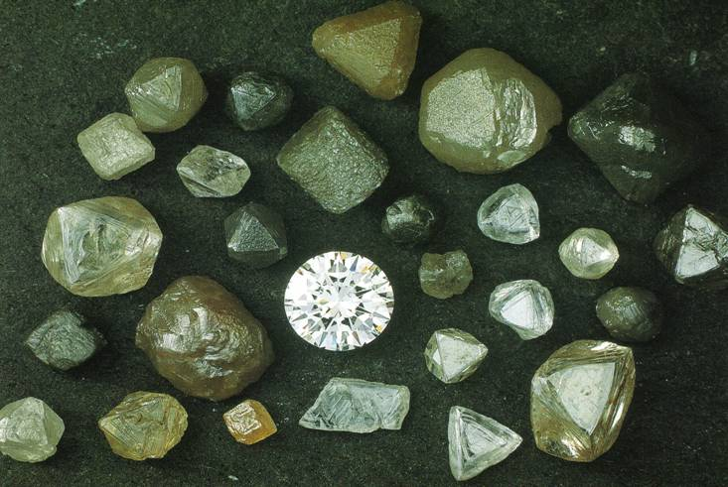
Adamantine Lustre
5mm
The lustre of a diamond

Slide 12
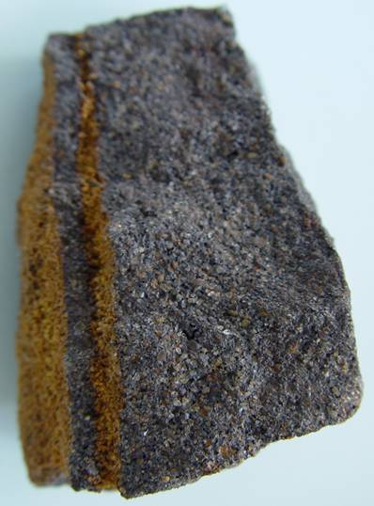
Dull or Earthy Lustre:
Does NOT reflect light
same appearance as soil.
1cm
Limonite has a dull or earthy lustre

Slide 13
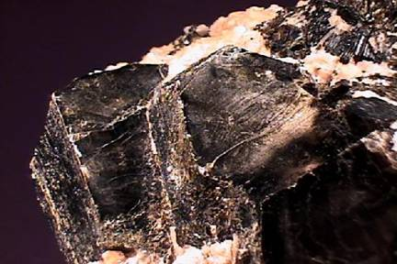
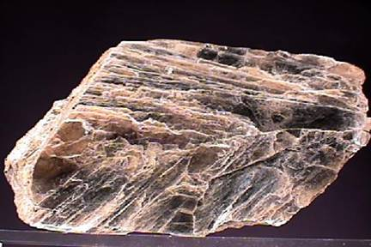
Pearly Lustre
The lustre of a pearl or mother of pearl.
Shows clearly on the cleavage surfaces of biotite and muscovite mica.
Also shown by Talc and selenite (a variety of gypsum)
Biotite Mica
Muscovite Mica

Slide 14
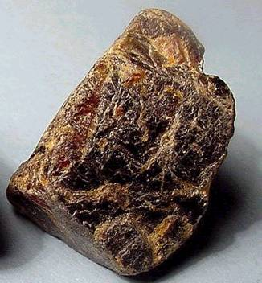
Resinous Lustre
1cm
The lustre of resin.
The mineral has a grainy appearance.
Sphalerite, opal and amber show resinous lustre
Sphalerite (Zinc Blende)

Slide 15
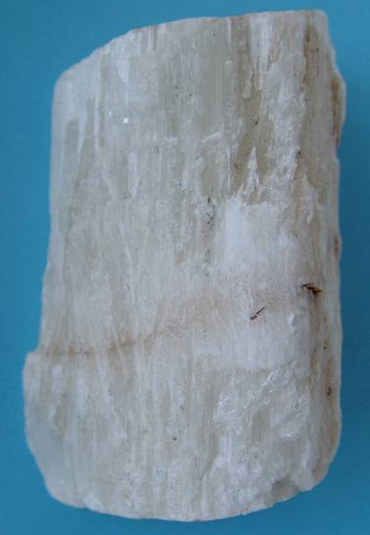
Silky Lustre
The lustre of silk.
Occurs in minerals with a fibrous structure.
Satin spar (a fibrous form of gypsum) shows this to good effect.
Gypsum (Satin Spar)

Slide 16
Vitreous Lustre
Fluorite
Dog-Tooth Calcite
The mineral reflects light like glass.
Sometimes glassy lustre is used instead of vitreous

Slide 18
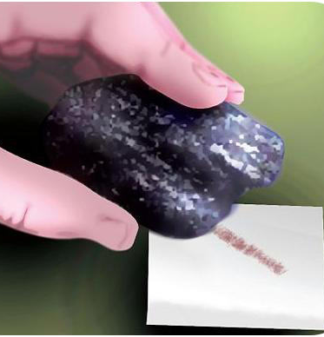
STREAK
Streak is the color of a mineral's powder,
Often is NOT the same color as the mineral itself.
NOT ALL minerals have streak.
Hematite is an example of a mineral that displays a certain color in hand sample (typically black to steel gray, sometimes reddish), and a different streak color (red/brown).

Slide 19
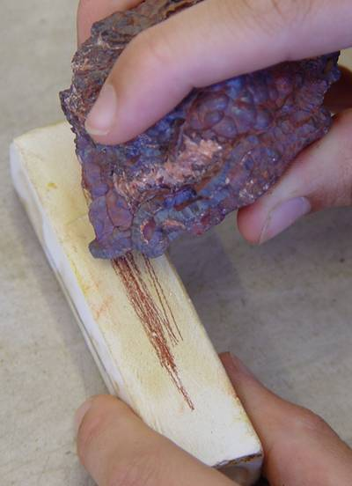
Streak Test:
Rub a mineral sample on an unglazed white porcelain tile.
METALLIC ores usually leave a dark streak.
Silicates usually have no streak.
White minerals streaked on a white tile leave a white streak.
Haematite gives a cherry red streak

Slide 20
Streak
Not all minerals will leave a streak:
Minerals that are HARDER than the tile will not leave a powder residue.
Why would the minerals colour be different from it`s streak?

Slide 21
Streak
Not all minerals will leave a streak:
Minerals that are HARDER than the tile will not leave a powder residue.
Why would the minerals colour be DIFFERENT from it`s streak.
Translucent minerals may be coloured by trace elements. These tiny trace amounts may not show up on the streak.

Slide 22
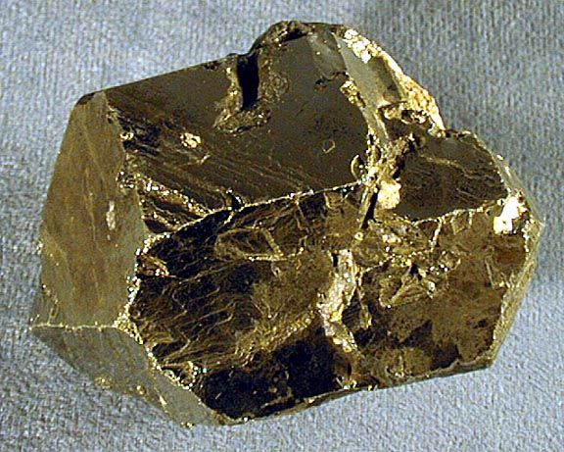
DENSITY
Density = mass/volume.
Pure gold has a density of about 19 g/cm³;
Pyrite has a density of about 5 g/cm³ .
Quartz is even less dense than pyrite and has a density of 2.7 g/cm³.
The specific gravity of a substance compares its density to that of water. Substances that are more dense have higher specific gravity.

Slide 23
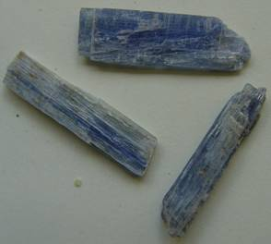
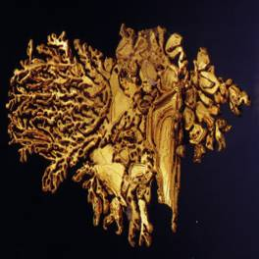
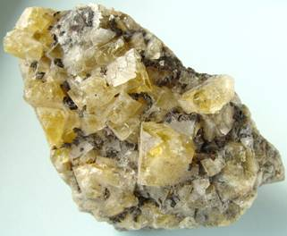
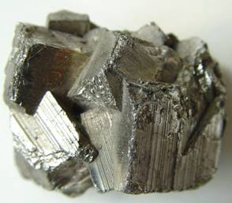
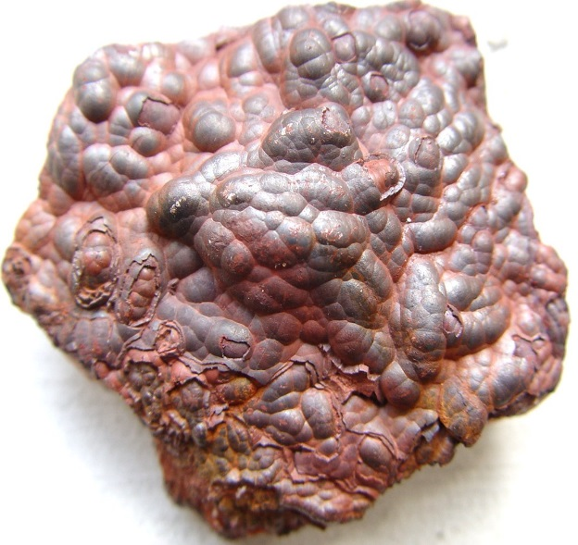
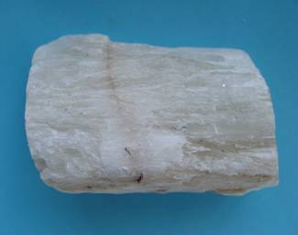
Relative Density- Some Examples
Kyanite 3.5-3.7
Gold 12.0-20.0
Fluorite 3.2
Iron Pyrite 4.9-5.2
Haematite 4.9-5.3
Gypsum 2.3

Slide 24
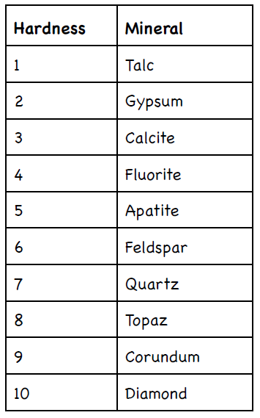
HARDNESS
Measure of whether a mineral will scratch or be scratched.
Mohs Hardness Scale, is a reference for mineral hardness.
Scale from 1-10 (1 being the softest, 10 hardest)
Notes:
With this scale anyone can test an unknown mineral for its hardness. For example, if you find an unknown mineral that can scratch fluorite or even apatite, but feldspar scratches it, you would know then that the mineral’s hardness is between 5 and 6. Note that no other mineral can scratch diamond.

Slide 25
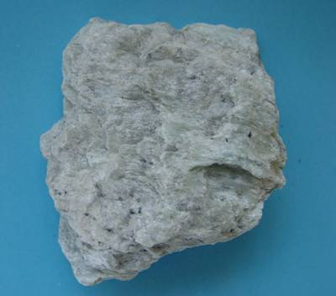
Hardness
Scale was devised by measuring the amount of noise and powder produced from rubbing a mineral on a metal file
Talc 1.0
Diamond 10.0

Slide 26
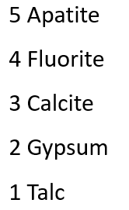
Moh’s Scale of Hardness
10 Diamond
9 Corundum
8 Topaz
7 Quartz
6 Orthoclase Feldspar
Note diamond is over 30 x harder than corundum

Slide 27
Moh’s Scale of Hardness
10. Diamond
9. Corundum
8. Topaz
7. Quartz
6. Orthoclase Feldspar

Slide 28
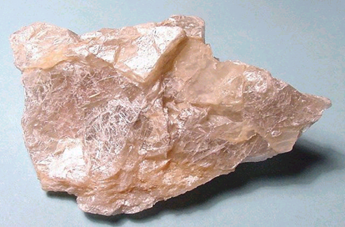
Moh’s Scale of Hardness
5. Apatite
4. Fluorite
3. Calcite
2. Gypsum
1. Talc

Slide 29
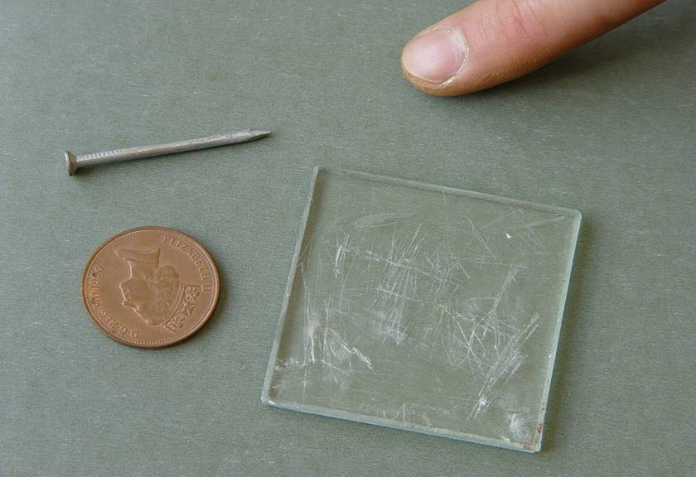
Moh’s Scale of Hardness
Steel nail 5.5-6.0
Fingernail 2.5
Copper coin 3.0
Window glass 5.0
Everyday objects can be substituted for minerals on Moh’s scale

Slide 30
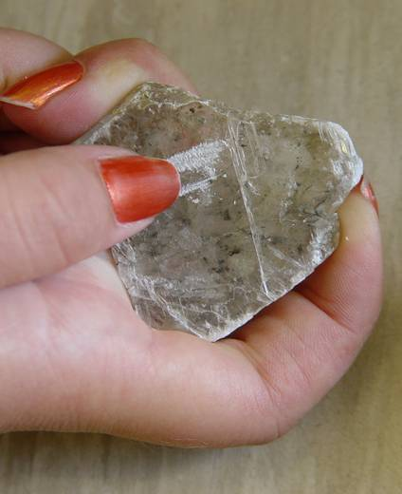
Testing For Hardness
Try to scratch mineral specimens with substances of known hardness.
If a mineral is not scratched by your fingernail, but is scratched by a copper coin then it will have a hardness of 2.5–3.0
If a mineral cannot be scratched by steel it has a hardness of over 6.0
Gypsum is scratched by a fingernail, hardness <2.5

Slide 31
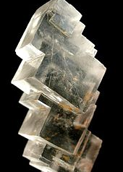
CLEAVAGE
The tendency to break along certain planes to make smooth surfaces.
Cleavage planes make attractive crystal shapes with smooth surfaces – making gemstones beautiful.
Eg. Halite breaks between layers of sodium and chlorine to form cubes with smooth surfaces.

Slide 32
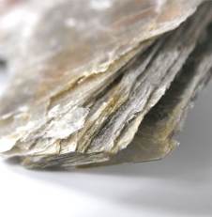
CLEAVAGE
Some minerals cleave into sheets
Eg. Mica

Slide 33
CLEAVAGE
Some minerals can cleave into polygons
Fluorite forms octahedrons.

Slide 35
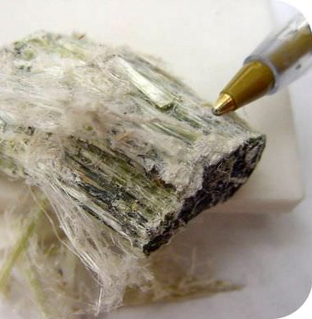
FRACTURE
A break in a mineral that is NOT along a cleavage plane, producing an uneven or curved surface.
Fracture is not always the same in the same mineral because fracture is not determined by the structure of the mineral.
Metals usually fracture into jagged edges.
Fibrous minerals splinter like wood.
Quartz fractures to form smooth curved surfaces.

Slide 36
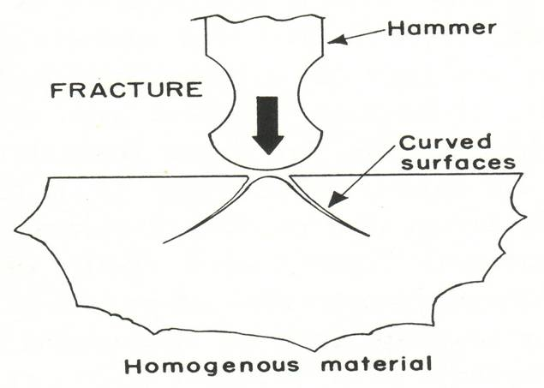
Fracture
The way a mineral breaks when struck by a hammer
The type of fracture is not controlled by any weaknesses in the atomic structure of the mineral.

Slide 37
Types of Fracture
Conchoidal – Like Glass
Even – Flat fracture surface
Uneven – Irregular fracture surface
Hackly – Very jagged like cast iron
Fracture is only described when the mineral has no cleavage

Slide 38
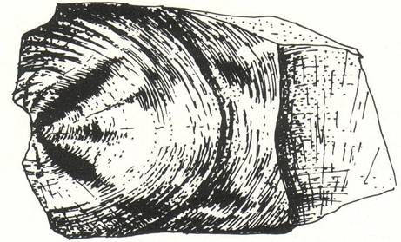
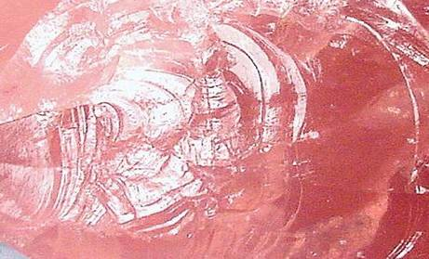
Conchoidal Fracture
Concentric curved lines
Same fracture as that shown by window glass
A diagnostic property of the mineral quartz
5mm
Rose quartz showing conchoidal fracture

Slide 39
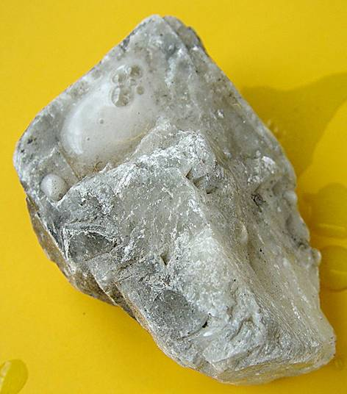
Acid Reaction
Use dilute hydrochloric acid to test for CARBONATES.
Calcite effervesces (FIZZES) and gives off carbon dioxide gas.
Calcite reacting and giving off carbon dioxide bubbles
2cm

Slide 40
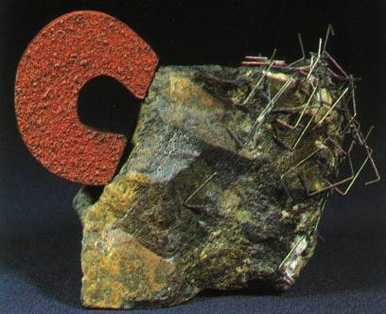
Magnetism
Ability to attract iron fillings or steel pins
Examples:
Magnetite
Lodestone

Slide 41
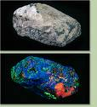
Fluorescence/Phosphorescence
Fluorescence: ability to glow under ultraviolet (UV) light
Some fluorite, calcite
Phosphorescence: ability to glow after UV light is cut off.
Some willemite, sphalerite

Slide 42
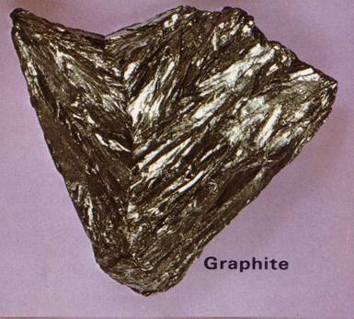
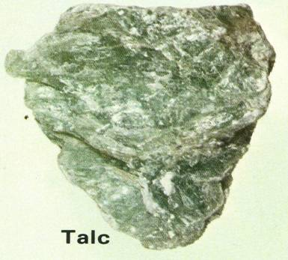
Feel
A characteristic sensation experienced when a mineral is held and rubbed between the fingers.
2cm
2cm
Graphite feels very cold upon the touch as it is a very good conductor of heat
Talc feels very greasy when rubbed between the fingers

Slide 43
Double Refraction
Refraction: the bending of light rays as they pass through a translucent substance.
Double refraction: the splitting of light rays into two parts, causing a double image
Eg. Calcite

Slide 44
OTHER IDENTIFYING CHARACTERISTICS
Property | Description | Example of Mineral
Fluorescence | Mineral glows under ultraviolet light | Fluorite
Magnetism | Mineral is attracted to a magnet | Magnetite
Radioactivity | Mineral gives off radiation that can be measured with Geiger counter | Uraninite
Reactivity | Bubbles form when mineral is exposed to a weak acid | Calcite
Smell | Some minerals have a distinctive smell | Sulfur (smells like rotten eggs)
Taste | Some minerals taste salty | Halite

Slide 45
Extras

Slide 46
Streak
Malachite – pale green
Haematite – cherry red
Iron Pyrite – greenish black
Galena – lead grey
Sphalerite – pale brown
Limonite – yellowish brown

Slide 47
Metallic Ore Minerals – Characteristic Streaks

