Slide 1
Human Reproduction
Chapter 4
Pages 108-119

Slide 2
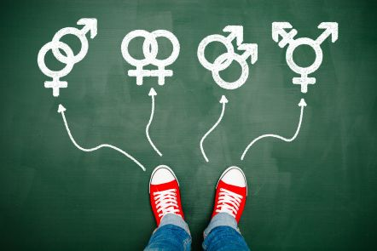
Sex vs Gender
SEX – biological characteristics of typically “male” and “female” such as reproductive organs, chromosomes, hormones.
SPECTRUM - there is MUCH variation in between.
GENDER - refers to the socially constructed roles, behaviours, expressions and identities. Also a spectrum.
Notes:
Canadian Institutes of Health Research

Slide 3
Disclaimer
For the purpose of discussing the parts necessary for reproduction, the structures represent individuals with either ovaries that produce eggs and individuals with testes that produce sperm.
These individuals will sometimes be referred to as “male” or “female”

Slide 4
LGBTQIA2S+
lesbian,
gay,
bisexual,
transgender and trans,
queer and questioning,
intersex,
asexual or agender, and
two-spirit. This
plus-sign signifies additional identity terms.
How individuals identify will not be discussed

Slide 5
15 Different Sexualities
Straight - heterosexual.
Lesbian.
Gay.
Bisexual.
Pansexual.
Polysexual.
Asexual.
Demisexual….
https://www.lovepanky.com/my-life/reflections/how-to-dream-of-someone

Slide 6
Did you know?
Chromosomes determine what parts you will be born with
Those will XX → develop ovaries and “female” external genitalia
Those with XY → develop testes and “male” genitalia

Slide 7
Did you know?
We all start as females.
Around 7 weeks of embryo development, the Y chromosome activates changes

Slide 9
Transgender
Umbrella term for persons whose gender identity, gender expression, or behavior does not conform to that typically associated with the gender they were assigned at birth.
Notes:
What about transgender athletes

Slide 10
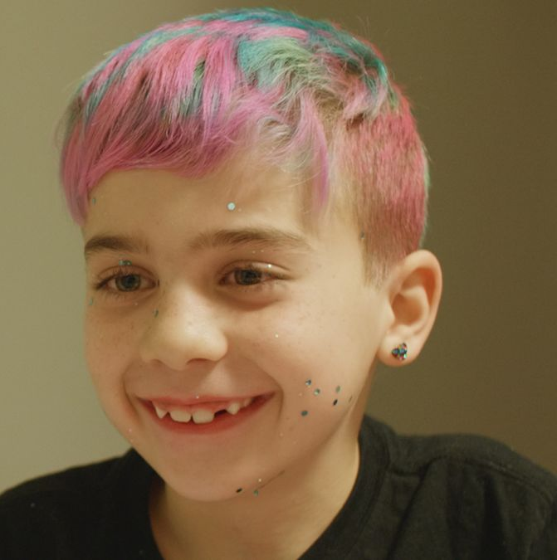
Intersex
People who have atypical genitals, chromosomes, or reproductive organs that don't fit into a male/female sex binary.
Their genitals might not match their internal reproductive organs, or they may have traits of both.
About 1.7% of all births.
Notes:
Or a person may be born with genitals that seem to be in-between the usual male and female types—for example, a girl may be born with a noticeably large clitoris, or lacking a vaginal opening, or a boy may be born with a notably small penis, or with a scrotum that is divided so that it has formed more like labia.

Slide 11
Byrne Creek Stats
According to recent survey this year, about 21% of the student population and Byrne Creek Secondary DO NOT identify as typical “Male” or “Female”.
That’s about 5-6 per class.

Slide 12
Humans have both Primary and Secondary Sexual Characteristics
Primary Sex characteristics:
present at birth.
Necessary for reproduction
Eg. Penis, testes, E.g. Vaginal, ovaries,

Slide 13
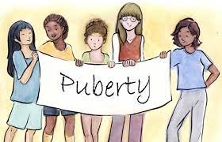
Secondary sex characteristics:
Occur later in life during puberty
NOT directly involved in reproduction
What’s the purpose then? To help distinguish “male” from “female” for mating purposes
Helps identify someone to mate with.
Notes:
For

Slide 14
Secondary Sexual Characteristics
growth spurt;
hair - under arm, and pubic region
for those with testes: Voice deepens , shoulders broaden.
Average onset; around 12 yr, Until around 18

Slide 15
Puberty in those with ovaries
Hips Widen
Development of Breast

Slide 16
Puberty
Puberty is the time of maturation into an adult body capable of sexual reproduction.

Slide 17
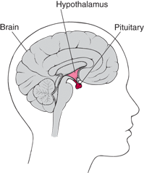
What triggers Puberty?
Starts in the brain.
Regulated by hormones
Hypothalamus in brain secretes gonadotropin-releasing hormone (GnRH).
GnRH stimulates pituitary gland in the brain.

Slide 18
What triggers Puberty? Both sexes:
Pituitary gland releases two hormones:
Follicle Stimulating Hormone (FSH) and
Luteinizing Hormone (LH).

Slide 19
Puberty
For those with testes: begins age 11-13 until around 18.
Hormones from pituitary gland in brain cause the testicles to grow and produce the male hormone testosterone.
Testosterone causes:
reproductive organs to mature,
muscle and bone to grow,
facial and pubic hair to appear,
voice to deepen

Slide 20
Puberty in those with ovaries
Pituitary gland in the brain stimulates ovaries to produce hormones:
progesterone and estrogen
Average onset: Around 11 yr

Slide 21
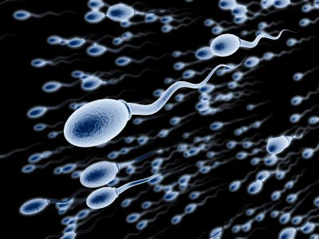
Reproductive System for those with testes
The whole purpose of the male reproductive system is to produce sperm AND to deliver sperm to egg.

Slide 22
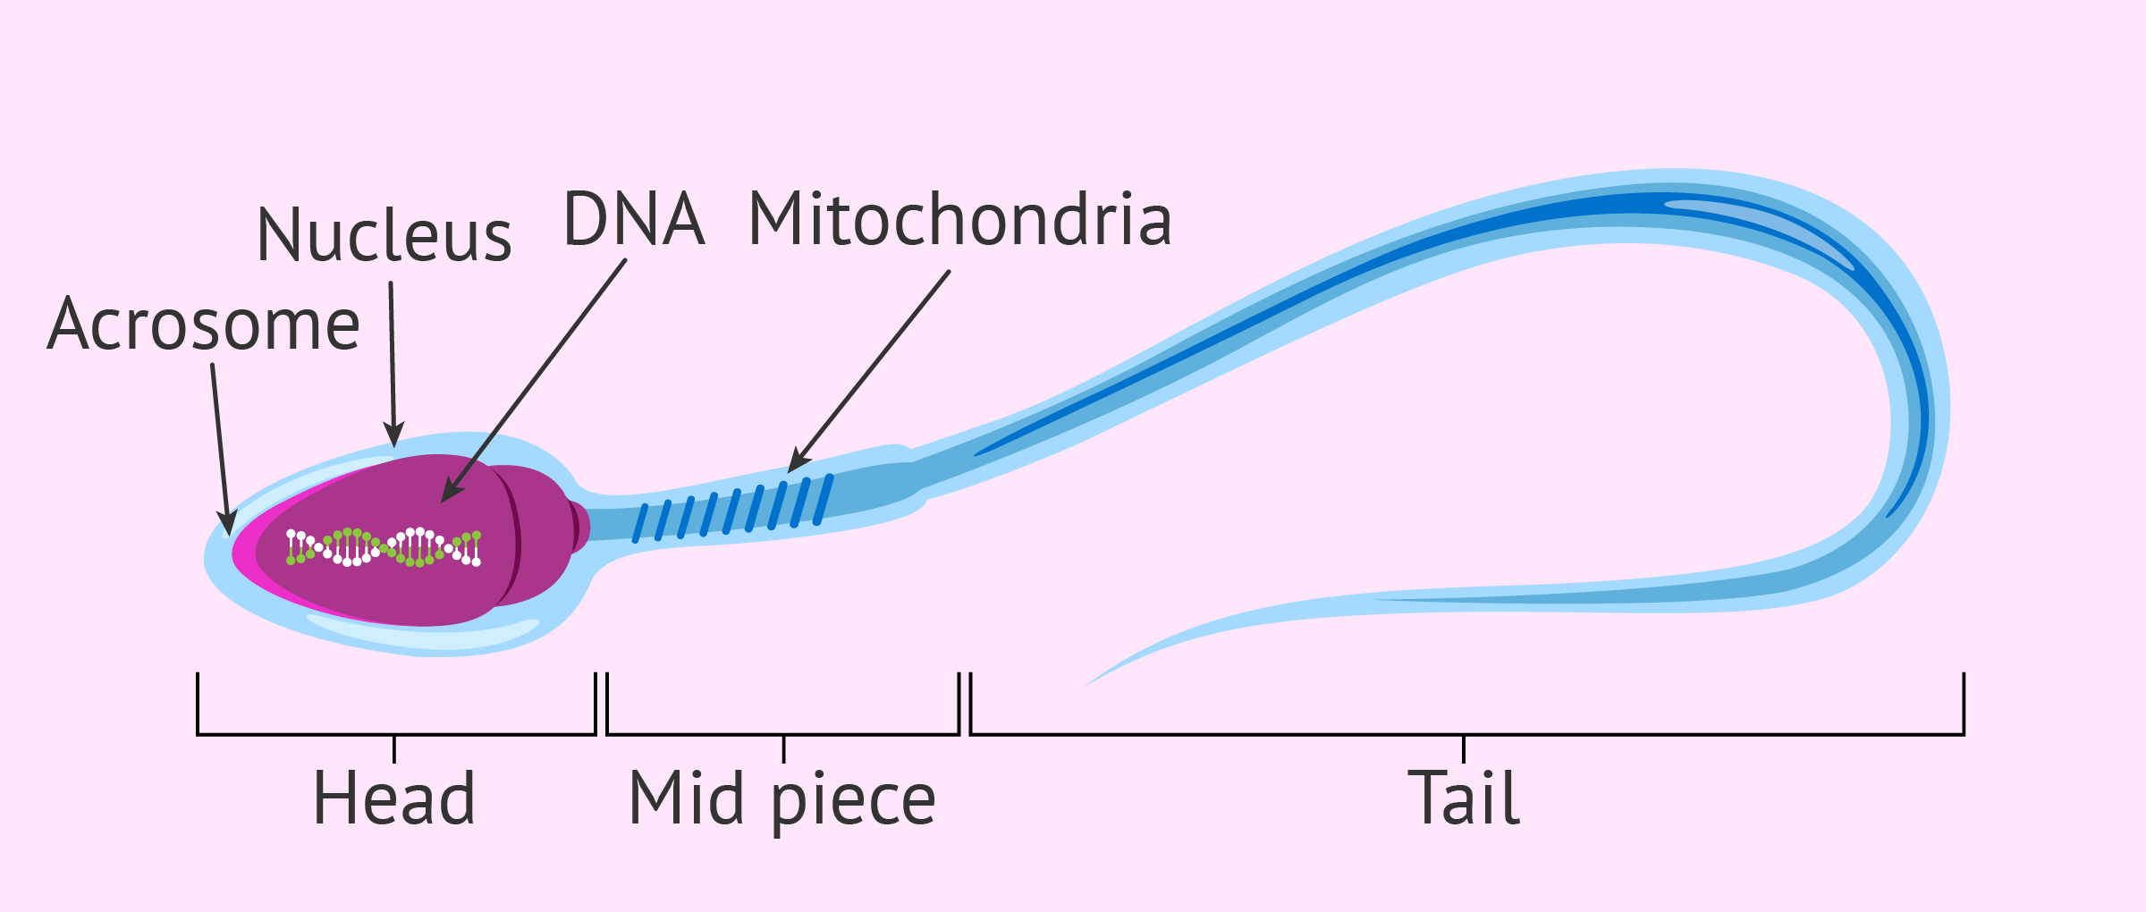
Structure of Human Sperm Cell
Notes:
Head – contains haploid nucleus, acrosome – contains enzymes
Middle piece – mitochondria ( )
Tail – is a flagellum (for locomotion)
List the functions of each section of sperm

Slide 23
Structure of Human Sperm Cell
Notes:
Head – contains haploid nucleus, acrosome – contains enzymes
Middle piece – mitochondria ( )
Tail – is a flagellum (for locomotion)
List the functions of each section of sperm

Slide 24
Each Region has important function
Head Region:
Acrosome contains enzymes
Nucleus contains DNA
Middle Piece – contains mitochondria
Tail is a Flagella – moves sperm forward

Slide 25
Be able to...
Explain how sperm’s structure is related to its function.

Slide 26
Sperm are MUCH smaller than egg

Slide 28
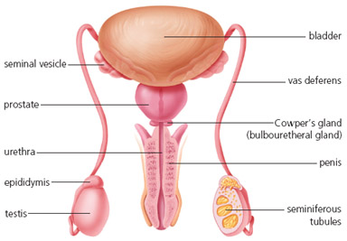
Two TESTES – Or testicles (outside body)
Produce sperm and testosterone
SCROTUM – sac containing testes
SEMINIFEROUS TUBULES –
coiled tubes in testes
Where diploid cells undergo meiosis →haploid sperm
Notes:
Testicle derives from the Latin word testis, meaning 'witness'. In pre-biblical times men sometimes placed their hand on another man's testicles when swearing an oath, because the testicles gave witness to a man's virility.

Slide 29
Male Reproductive Structures
EPIDIDYMIS – where mature sperm are stored.
VAS DEFERENS – tube carries sperm to urethra
URETHRA – tube leading to outside of body
located in the penis
PENIS – specialized organ to enter female during sexual intercourse
Notes:
What connects ---- to urethra

Slide 30
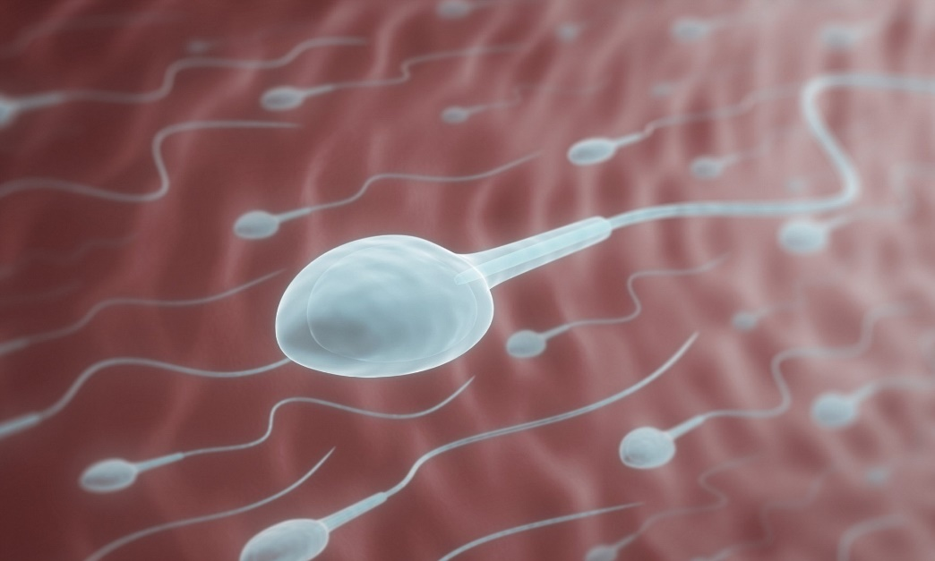
ACCESSORY GLANDS:
Seminal vesicles
Prostate gland
Cowper’s gland (Bulbourethral gland)
They secrete seminal fluid which provides
fluid for sperm to swim
sugars for energy
Alkaline pH for sperm to better survive acidic environment of vagina
SEMEN = SPERM + SEMINAL FLUID

Slide 31
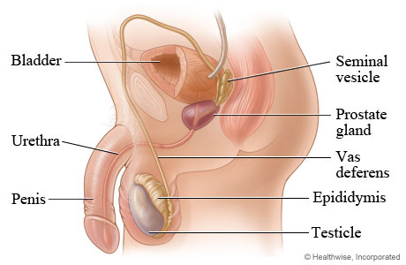

Slide 32
Questions

Slide 33
What’s a vasectomy
What’s affected? What’s not?
How is sperm production affected?
Can you still ejaculate?

Slide 34
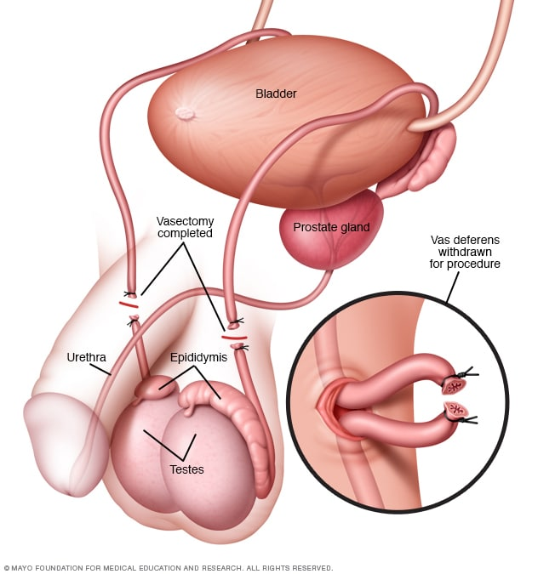
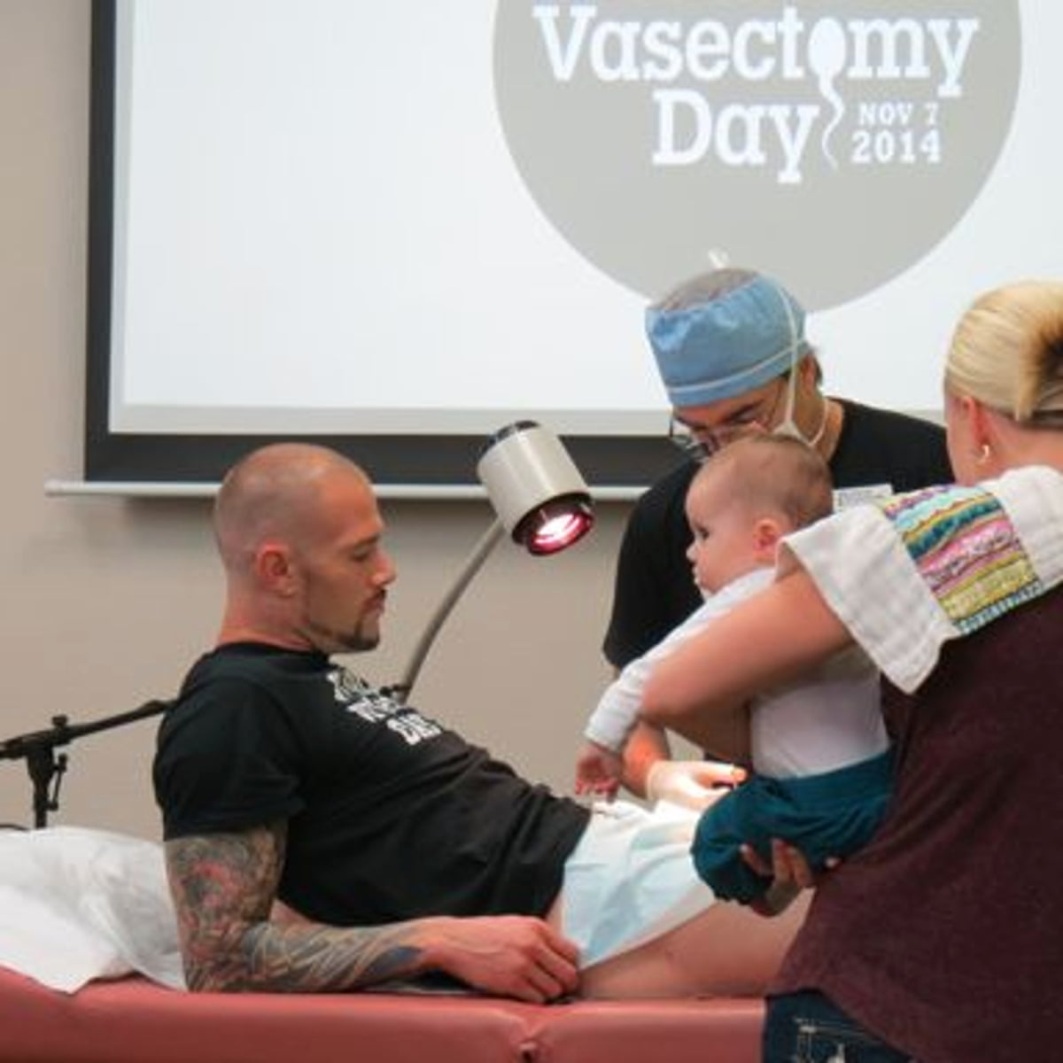
Vasectomy
Vas deferens are cut.
Why?

Slide 35
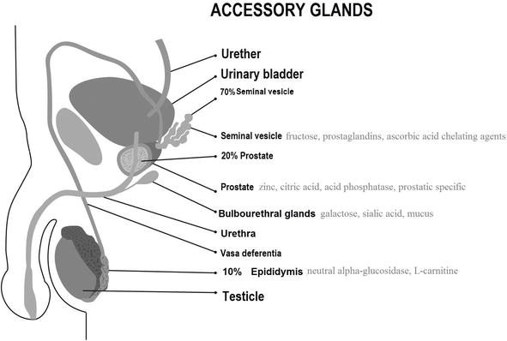
DID YOU KNOW?
Sperm don’t actually travel through the accessory glands.
The glands secrete fluid through ducts that connect to the vas deferens.
Sperm don’t travel through bladder either

Slide 36
Common Cancers
Testicular Cancer - An estimated 1,200 Canadians will be diagnosed with testicular cancer in 2022. An estimated 35 will die from the disease. CHECK THEM REGULARLY!
Prostate cancer
67 Canadians will be diagnosed with prostate cancer every day.
4,600 Canadians will die from prostate cancer (10% of all cancer deaths in men in 2022).
13 Canadian will die from prostate cancer every day.
Guess how this is checked...
Notes:
Check prostate at 50

Slide 37
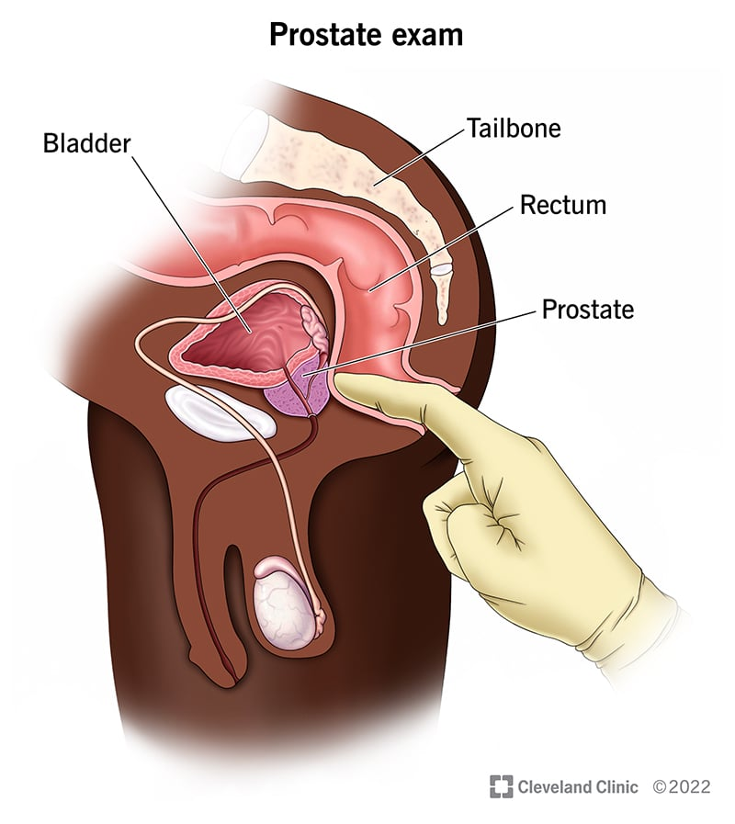
D-R Exam
Blood test now available

Slide 38
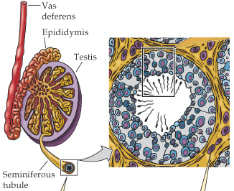
Sperm Production and Development
Sperm begin as diploid cells that undergo mitosis to increase in number
Gradually pushed closer to center
Undergo meiosis → haploid
Sperm finish maturing in epididymis, ~ 74 days
200-300 million sperm produced each day
Notes:
Why so many?

Slide 39
Check your Understanding
HW: Read pages 108-110
Answer CYU p111
Be able to describe the path the sperm take from production to leaving the body.
What structure does the sperm NOT pass through?

Slide 40
Reproductive System for those with testes

Slide 41
Notes:
What is the purpose of …
How does function relate to form?

