Slide 1
9.2 Calculating Acceleration
The acceleration of an object depends on the change in velocity and the time required to change the velocity.
When stopping a moving object, the relationship between time and acceleration is:
  Increasing the stopping time decreases the acceleration.
  Decreasing the stopping time increases the acceleration.
Airbags cause the person to slow down in a longer period of time compared to hitting a solid object, such as the dashboard. This increased time results in a smaller deceleration.
See page 392

Slide 2
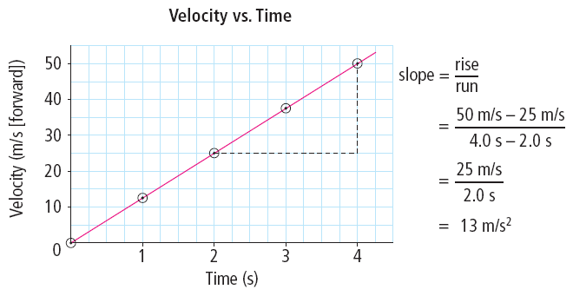
Velocity-Time Graphs
Recall: The motion of an object with uniform motion can be represented by a position-time graph.
The motion of an object with a changing velocity can be represented by a velocity-time graph.
The slope of a velocity-time graph is average acceleration.
Acceleration is measured in m/s².
The slope of a velocity-time graph is the average acceleration of the object.
See pages 393 - 394

Slide 3
Determining Motion from a Velocity-Time Graph
A velocity-time graph can be analyzed to describe the
motion of an object.
  Positive slope (positive acceleration) – object’s velocity is increasing in the positive direction
  Zero slope (zero acceleration) – object’s velocity is constant
  Negative slope (negative acceleration) – object’s velocity is decreasing in the positive direction OR increasing in the negative direction
State during which time interval:
the acceleration was zero.
the acceleration was negative.
the acceleration was positive.
the object was increasing its velocity north.
the object was decreasing its velocity north.
the object was moving at a constant velocity north.
See pages 394 - 395
Answers are on the next slide

Slide 4
Determining Motion from a Velocity-Time Graph
State during which time interval:
the acceleration was zero. (t₁ to t₂)
the acceleration was negative. (t₂ to t₃)
the acceleration was positive. (0 to t₁)
the object was increasing it’s velocity north. (0 to t₁)
the object was decreasing it’s velocity north. (t₂ to t₃)
the object was moving at a constant velocity north. (t₁ to t₂)
See pages 394 - 395

Slide 5
Calculating Acceleration
The relationship of acceleration, change in velocity, and time interval :
Example:
  A pool ball travelling at 2.5 m/s towards the cushion bounces off at 1.5 m/s. If the ball was in contact with the cushion for 0.20 s, what is the ball’s acceleration? (Assume towards the cushion is the positive direction.)
The ball’s velocity changes from 2.5 m/s toward the cushion (A) to 1.5 m/s away from the cushion (B).
See pages 396 - 397

Slide 6
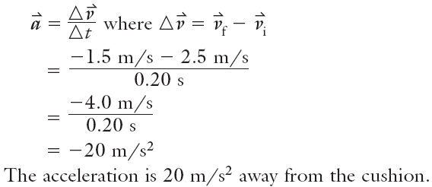
Calculating Acceleration
The relationship of acceleration, change in velocity, and time interval is given by the equation:
Example:
  A pool ball travelling at 2.5 m/s towards the cushion bounces off at 1.5 m/s. If the ball was in contact with the cushion for 0.20 s, what is the ball’s acceleration? (Assume towards the cushion is the positive direction.)
The ball’s velocity changes from 2.5 m/s toward the cushion (A) to 1.5 m/s away from the cushion (B).
See pages 396 - 397

Slide 7
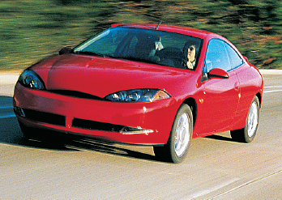
Calculating Acceleration
To find the change in velocity when we know acceleration and time we use the equation:
Example:
  A car accelerates from rest at 3.0 m/s² forward for 5.0 s. What is the velocity of the car at the end of 5.0 s?
The car accelerates from rest for 5.0 s.
See pages 396 - 397

Slide 8
Calculating Acceleration
To find the change in velocity when we know acceleration and time we use the equation:
Example:
  A car accelerates from rest at 3.0 m/s² forward for 5.0 s. What is the velocity of the car at the end of 5.0 s?
The car accelerates from rest for 5.0 s.
The car’s change in velocity is 15 m/s forward, therefore...
See pages 396 - 397

Slide 9
Calculating Acceleration
To find the change in velocity when we know acceleration and time we use the equation:
Example:
  A car accelerates from rest at 3.0 m/s² forward for 5.0 s. What is the velocity of the car at the end of 5.0 s?
The car accelerates from rest for 5.0 s.
The car’s change in velocity is 15 m/s forward, therefore
The car’s velocity after 5.0 s is 15 m/s forward.
See pages 396 - 397

Slide 10

Calculating Acceleration
To find the time interval when we know change in velocity and acceleration we use the equation:
Example:
  A train is travelling east at 14 m/s. How long would to increase its velocity to 22 m/s east, if it accelerated at 0.50 m/s² east? Assign east direction positive (+).
See pages 396 - 397

Slide 11
Calculating Acceleration
To find the time interval when we know change in velocity and acceleration we use the equation:
Example:
  A train is travelling east at 14 m/s. How long would to increase its velocity to 22 m/s east, if it accelerated at 0.50 m/s² east? Assign east direction positive (+).
To find the value of Δt:
See pages 396 - 397

Slide 12
Calculating Acceleration
To find the time interval when we know change in velocity and acceleration we use the equation:
Example:
  A train is travelling east at 14 m/s. How long would to increase its velocity to 22 m/s east, if it accelerated at 0.50 m/s² east? Assign east direction positive (+).
To find the value of Δt:
It would take 16 s for the train to increase its velocity.
See pages 396 - 397

Slide 13



Calculating Acceleration
Try the following acceleration problems.
A truck starting from rest accelerates uniformly to 18 m/s [W] in 4.5 s. What is the truck’s acceleration?
A toboggan moving 5.0 m/s forward decelerates backward at -0.40 m/s² for 10 s. What is the toboggan’s velocity at the end of the 10 s?
How much time does it take a car travelling south at 12 m/s to increase its velocity to 26 m/s south if it accelerates at 3.5 m/s² south?
Answers are on the next slide.
See page 397

Slide 14
Calculating Acceleration (continued)
Try the following acceleration problems.
A truck starting from rest accelerates uniformly to 18 m/s [W] in 4.5 s. What is the truck’s acceleration? (4.0 m/s² [W])
A toboggan moving 5.0 m/s forward decelerates backward at -0.40 m/s² for 10 s. What is the toboggan’s velocity at the end of the 10 s? (1.0 m/s forward)
How much time does it take a car travelling south at 12 m/s to increase its velocity to 26 m/s south if it accelerates at 3.5 m/s² south? (4.0 s)
See page 397

Slide 15
Gravity and Acceleration
Objects near the surface of Earth fall to Earth due to the force of gravity.
  Gravity is a pulling force that acts between two or more masses.
Air resistance is a friction-like force that opposes the motion of objects that move through the air.
Ignoring air resistance, all objects will accelerate towards Earth at the same rate.
  The acceleration due to gravity is CONSTANT 9.8 m/s² downward (negative)
See pages 398 - 399
Notes:
Because acceleration due to gravity is downward, it will always be negative

Slide 16
Calculating Motion Due to Gravity
To analyze situation where objects are accelerating due to gravity, use the equations:
In these equations, the acceleration ( ) is 9.8 m/s² downward.
Example:
  Suppose a rock falls from the top of a cliff. What is the change in velocity of the rock after it has fallen for 1.5 s? Assign “down” as negative (-).
See page 400

Slide 17
Calculating Motion Due to Gravity
To analyze situation where objects are accelerating due to gravity, use the equations:
In these equations, the acceleration ( ) is 9.8 m/s² downward.
Example:
  Suppose a rock falls from the top of a cliff. What is the change in velocity of the rock after it has fallen for 1.5 s? Assign “down” as negative (-).
Since down is negative (-), the change in the rock’s velocity is 15 m/s down.
See page 400

Slide 18

Calculating Motion Due to Gravity
Try the following acceleration due to gravity problems.
What is the change in velocity of a brick that falls for 3.5 s?
A ball is thrown straight up into the air at 14 m/s. How long does it take for the ball to slow down to an upward velocity of 6.0 m/s?
A rock is thrown downwards with an initial velocity of 8.0 m/s. What is the velocity of the rock after 1.5 s?
See page 400
Answers are on the next slide.

Slide 19
Calculating Motion Due to Gravity (continued)
Try the following acceleration due to gravity problems.
What is the change in velocity of a brick that falls for 3.5 s? (34 m/s downward)
A ball is thrown straight up into the air at 14 m/s. How long does it take for the ball to slow down to an upward velocity of 6.0 m/s? (0.82 s)
A rock is thrown downwards with an initial velocity of 8.0 m/s. What is the velocity of the rock after 1.5 s? (23 m/s downward)
Take the Section 9.2 Quiz
See page 400

