Slide 1
Gene Expression
From code to protein

Slide 2
The sequence of bases is the code that determines the trait or protein.
Notes:
Who knows how this is done?
3 bases make a codon

Slide 3
What is the importance of proteins?
Proteins are made up of smaller building blocks called amino acids, joined together in chains.
Proteins are molecules that all the cells of the body need in order to work properly.
They determine the characteristics of the organism.
Some proteins carry out cell functions
Some proteins are parts of cell structures (collagen, keratin, elastin)
Some drive chemical reactions within the body (enzymes)
Some are messengers (hormones).
Some are in our blood (hemoglobin, antibodies, clotting factors)
Humans have as many as 100 000 proteins.

Slide 4
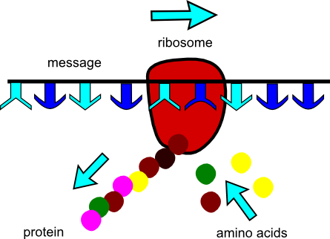
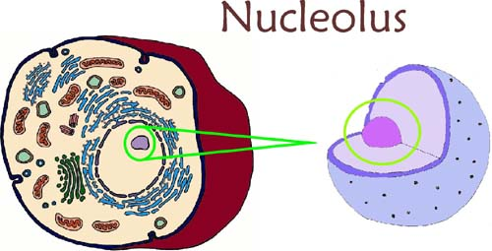
Where are proteins made?
Proteins are made in the cytoplasm of the cell by ribosomes.
Ribosomes are made in the nucleolus and then move to the cytoplasm.

Slide 5
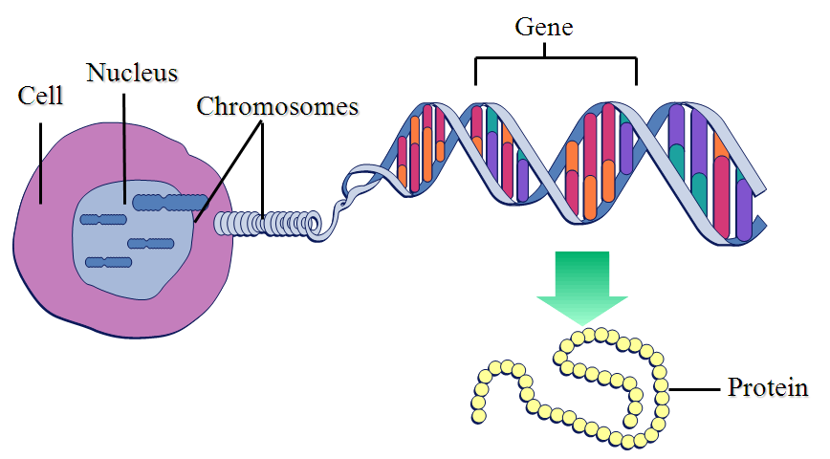
How does the genetic code become protein? (How is a gene expressed?)
Gene Expression: DNA Transcription and Translation

Slide 6
Gene Expression
Gene expression is the translation of genetic code into the production of a protein
occurs in processes: Transcription (in nucleus) and Translation (outside nucleus)
Notes:
Label the diagram
With so many base pairs replicating, the potential for a mismatch is common.
Transcription and translation video 5 min:
https://www.youtube.com/watch?v=2zAGAmTkZNY

Slide 7
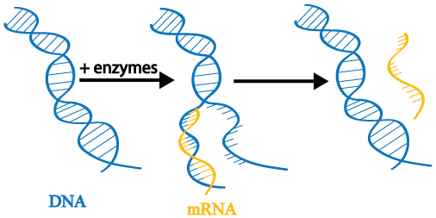
How does the code get out of the nucleus? Transcription:
When the nucleus receives a signal that a particular protein needs to be made, the section of DNA that codes for that protein (gene) is copied (process called transcription) and taken out into the cytoplasm.
This copied message is made of mRNA
Notes:
Label the diagram
With so many base pairs replicating, the potential for a mismatch is common.
Transcription and translation video 5 min:
https://www.youtube.com/watch?v=2zAGAmTkZNY

Slide 8
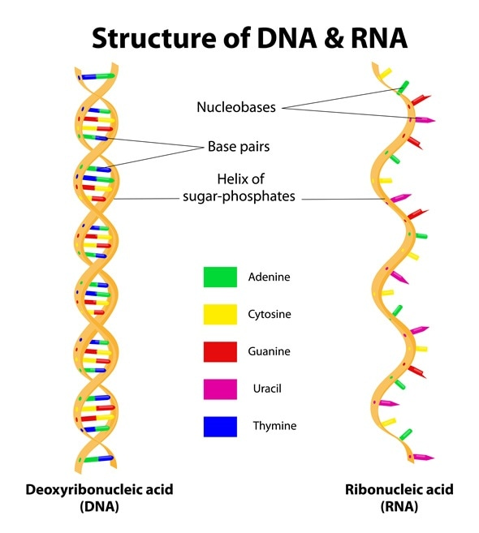
RNA
RNA is ribonucleic acid
Like DNA, it is also a strand of nucleic acids except:
it is single-stranded,
It’s sugar is ribose instead of deoxyribose
Uses Uracil instead of thymine to pair with adenine.
mRNA is called messenger RNA because it takes the copied message out to the ribosomes to make protein.

Slide 9
Video Amoeba Sisters RNA
https://www.youtube.com/watch?v=0Elo-zX1k8M&list=PL-Mqhdan0qYVBC8ILBb-AQKfNNRmBM0N-

Slide 10
Video
Amoeba Sisters Protein Synthesis
https://www.youtube.com/watch?v=h5mJbP23Buo

Slide 11
mRNA strand forms a copy of a portion of DNA strand coding for a protein
RNA uses Uracil instead of Thymine

Slide 12
Try This: What is the complementary RNA strand?
DNA CAGTTATGCCA

Slide 13
Try This: What is the complementary RNA strand?
DNA CAGTTATGCCA
RNA GUCAAUACGGU

Slide 14
Why is Transcription Important?
It is needed to get the DNA message out of the nucleus so the ribosomes know what protein to make.
Without transcription, the ribosome would have no idea what proteins the body needed and would not make any.

Slide 15
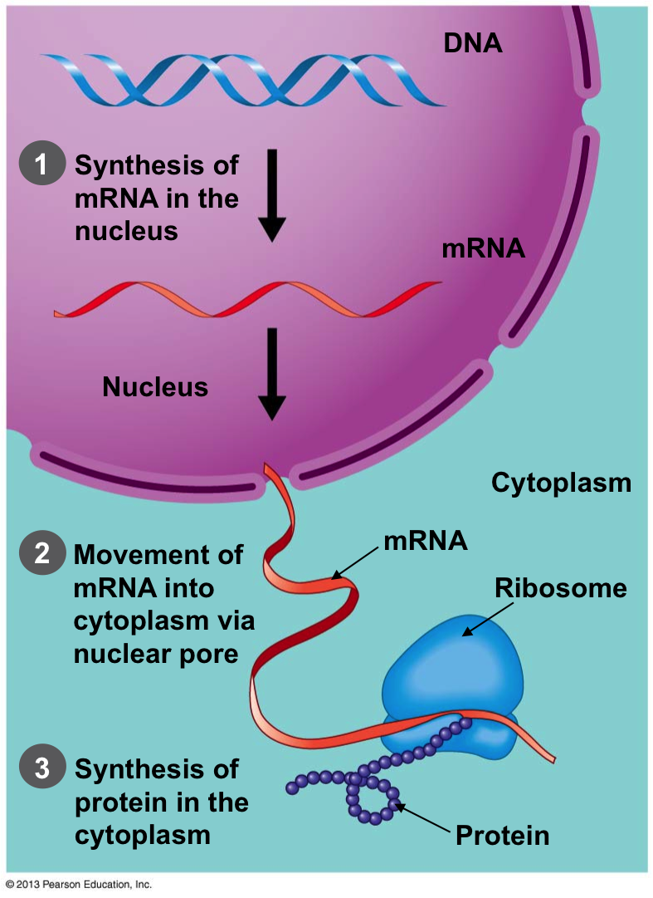
Message leaves Nucleus
Once the message is copied, the mRNA exits the nucleus through a nuclear pore and moves into the cytoplasm to the ribosomes.

Slide 16
How is the message translated into a protein?
The ribosomes “read” the message and build the protein in a process called translation

Slide 17
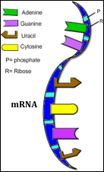
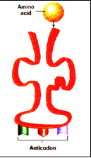
Three types of RNA
mRNA rRNA tRNA

Slide 19
Translation (Protein Synthesis) – from RNA to Protein
Ribosomes “read” the sequence of bases in groups of three (codon), starting at the “start” codon.
Each codon codes for a particular amino acid.
Amino acids are the building blocks of protein

Slide 20
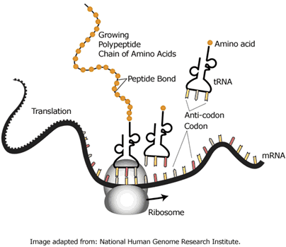
Translation (Protein Synthesis) – from RNA to Protein
Another form of RNA (tRNA) brings amino acids to the ribosome to create a chain, forming the protein
Ribosome moves along mRNA until it reaches “stop” codon.

Slide 21
Codon Chart What amino acid does CGU code for?
Notes:
Argenine
RNA used uracil instead of thymine.
Approx 3 billions bases in human genome
4 bases combine to form 20 different amino acids – endless combinations to make any protein,
Many redundant

Slide 22
Codon Chart What amino acid does CGU code for?
Notes:
Argenine
RNA used uracil instead of thymine.
Approx 3 billions bases in human genome
4 bases combine to form 20 different amino acids – endless combinations to make any protein,
Many redundant

Slide 23
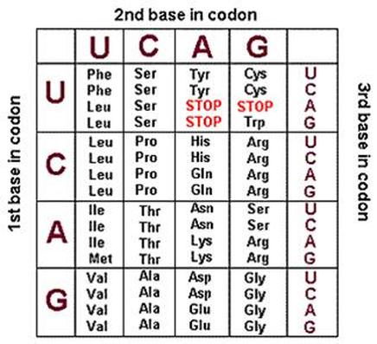
What is the resulting amino acid sequence?
RNA GUC AAU ACG GUA

Slide 24
What is the amino acid sequence?
RNA GUC AAU ACG GUA
Amino acids Val – Asn – Thr - Asp

Slide 25
Why is Translation Important?
Translation is need to synthesize (make) proteins.
Without translation, proteins wound not be made and we could not replace the proteins that are used by our bodies to grow, repair, or replace damaged tissue.
You could NOT replace the hair that we loose every day; could NOT grow long fingernails; be able to fight off diseases; cells would fall apart because the proteins were not being replaced

Slide 26
Protein Synthesis Animation
https://www.youtube.com/watch?v=Ikq9AcBcohA

Slide 27
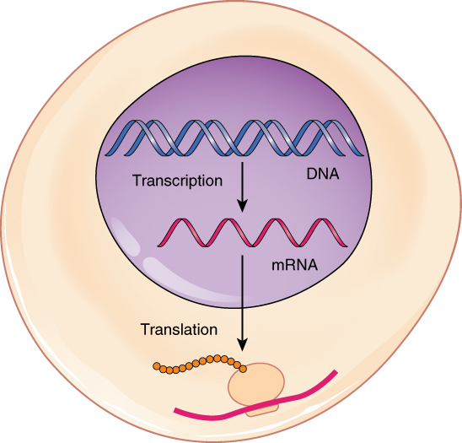
Gene Expression Summary

Slide 28
Gene Expression

Slide 30
Assignment
Protein Synthesis Worksheet – all except last 5 questions

Slide 31
Errors in DNA Replication cause Mutations

Slide 32
Protein Synthesis (Gene Expression)

