Slide 1
Resources
Chapter 6: p 85-107

Slide 2
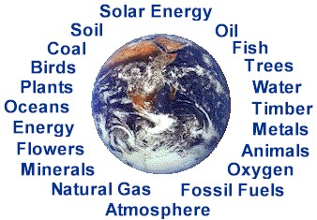
Chapter 6: Resources

Slide 3
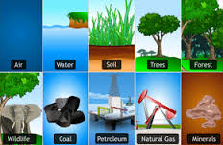
Resources: anything we use to support our way of life, including metal, wood, air, water and soil.

Slide 4
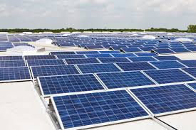
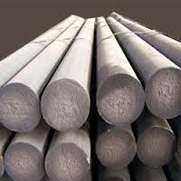
Types of Resources
Renewable Resources
can be replaced by nature at a rate close to its rate of use.
Ex. Solar energy from sun, air, trees, food
Non-renewable Resources
exists in a fixed amount, or is used up faster than it can be replaced by nature.
Metals,
Non-metals
Energy

Slide 5
Minerals and Ores (p90)
Ore: metallic mineral, or metal-containing rock that can be mined and separated at a profit. Eg. Iron ore, copper ore
Gangue: the non-valuable remainder

Slide 6
Resource vs. Reserve
Mineral Ore Resource: the estimate of the total amount of a mineral thought to exist
Mineral Ore Reserve: the amount of a known deposit of a mineral in ores that are worth mining at the present time

Slide 7
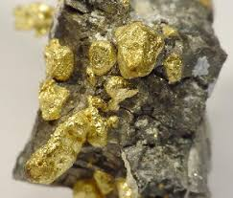
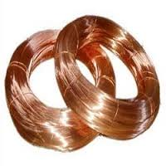
Types of Metal Mineral Resources
Precious Metals:
- Products which command a very
high market price
Ex. Gold, silver, platinum
Base Metals:
- Less expensive metals that have
many uses
Ex. Copper, lead, zinc, aluminum

Slide 8
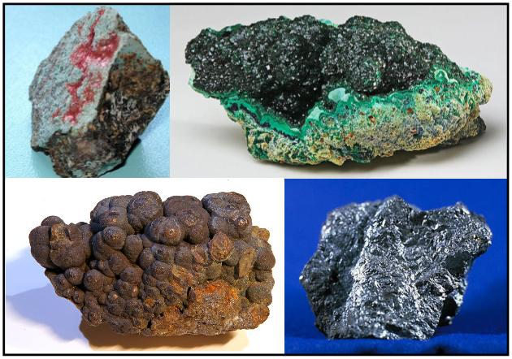
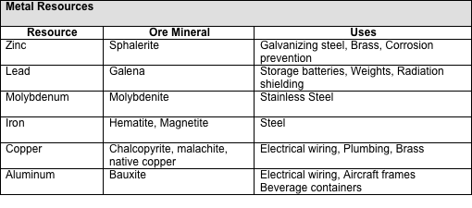

Slide 9
NON-METAL RESOURCES
Fossil Fuels:
Once-living plants and animals that have formed high-energy chemicals that we use as fuel sources Ex. Coal, crude oil, natural gas
Other Non-metal Resources:
Wide variety of materials that have properties that make them useful.
Ex. Limestone, gypsum, graphite, asbestos, potash

Slide 10
NON-METAL RESOURCES
Gemstones – non-metallic minerals considered to be valuable due to their beauty
Eg. Diamonds, ruby, sapphire, emerald, topaz and tourmaline.
Uranium - Uranium-238 isotope can be converted into plutonium-239, used as a fuel in nuclear reactors in a process called fission.

Slide 11
Complete Guided Notes
UP to but not including Mining
Oil 101
Natural Gas 101
Tar Sands 101

Slide 12
Use your text p91
to list some uses of the following metallic resources:
Iron
Copper
Aluminum
zinc

Slide 13
Use text p92
Resource | Use
Sand, gravel
Potash and nitrates
Salt
gypsum
Sulfur
Graphite
Talc
Uranium (p96)

Slide 14
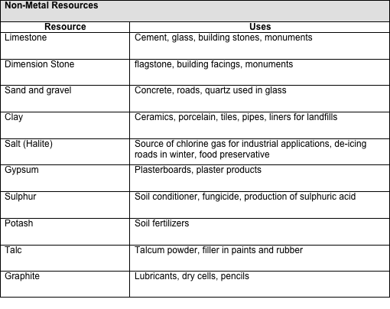

Slide 15
Alternate Energy Sources
Hydro
Wind Power
Solar Power
Geothermal Energy

