Slide 1
9.4 Disorders of the Digestive System
UNIT B
Chapter 9: Digestive System
Section 9.4
Disorders of the digestive system can be grouped into two categories:
Disorders of the digestive tract itself
Stomach ulcers, intestinal disorders (diarrhea, Crohn’s disease, constipation), polyps, and colon cancer
Disorders of the accessory organs
Pancreatic disorders (pancreatitis, pancreatic cancer), diabetes mellitus, hepatitis, cirrhosis, gallstones
TO PREVIOUS SLIDE

Slide 2
Disorders of the Digestive Tract
UNIT B
Chapter 9: Digestive System
Section 9.4
Stomach Ulcers
A stomach ulcer is an open sore in the stomach wall caused by a gradual disintegration of the tissue.
Mainly caused by infection by Helicobacter pylori, a bacterium that impairs the ability of mucous cells to produce protective mucus for the stomach wall
Also caused by viral infections, or overuse of anti-inflammatory medications that damage stomach lining
Can be treated with antibiotics that kill H. pylori bacterium, medications that reduce stomach acid
TO PREVIOUS SLIDE
Notes:
stomach ulcers: open sores in the stomach wall caused by a gradual disintegration of tissue

Slide 3
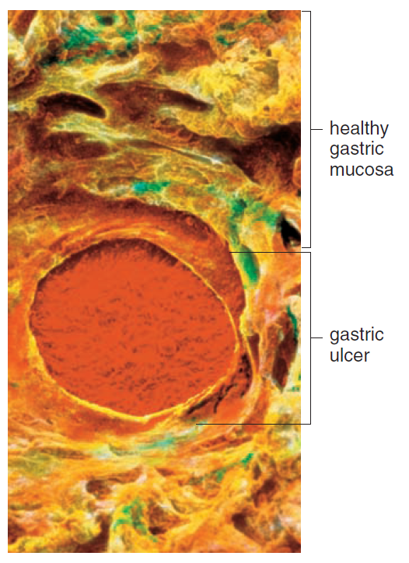
UNIT B
Chapter 9: Digestive System
Section 9.4
Figure 9B Stomach ulcer. Drs. Barry Marshall and Robin Warren won a Nobel Prize in 2005 for discovering that most stomach ulcers are caused by a bacterial infection.
TO PREVIOUS SLIDE

Slide 4
UNIT B
Chapter 9: Digestive System
Section 9.4
Intestinal Disorders
Diarrhea is loose, watery feces.
Acute: can be caused by infections of the small or large intestine with bacteria, viruses, or protozoas that cause the intestinal wall to be irritated.
Peristalsis increases, and less water is absorbed, resulting in loose, watery feces
Chronic: Persistent inflammation of the intestine due to a misdirected immune response against one’s own intestinal tissues and bacteria (Crohn’s disease)
Genetic predisposition and environmental triggers are factors.
TO PREVIOUS SLIDE
Notes:
diarrhea: loose, watery feces; can be acute or chronic

Slide 5
UNIT B
Chapter 9: Digestive System
Section 9.4
Constipation results in dry and hard feces.
Caused by ignoring the urge to defecate or by inadequate fluid or fibre in the diet
Chronic constipation can lead to hemorrhoids, which are inflamed blood vessels in the anus
Can be prevented by increasing the amount of water and fibre in diet
Laxatives and enemas can be used but can irritate the colon
TO PREVIOUS SLIDE
Notes:
constipation: dry and hard feces

Slide 6
UNIT B
Chapter 9: Digestive System
Section 9.4
Polyps and Colon Cancer
Polyps are small growths arising from the epithelial lining in the colon
Can be benign or cancerous
Usually detected by a colonoscopy, where an endoscope is inserted in the colon to enable a viewing of the wall of the large intestine
Colon cancer can be cured if detected early and surgically removed while it is still confined to a polyp
TO PREVIOUS SLIDE
Notes:
polyps: small growths arising from the epithelial lining

Slide 7
Disorders of the Accessory Organs
UNIT B
Chapter 9: Digestive System
Section 9.4
Disorders of the Pancreas
Pancreatitis is an inflammation of the pancreas.
Caused by excessive alcohol consumption, gallstones that block the pancreatic duct, or other unknown factors
Chronic pancreatitis: digestive enzymes secreted by the pancreas damage the pancreas and decrease insulin secretion
Pancreatic cancer is a cancer that is almost always fatal.
20% of patients are alive one year after diagnosis
Resistant to treatment and spreads to other organs before symptoms appear
TO PREVIOUS SLIDE
Notes:
pancreatitis: an inflammation of the pancreas
pancreatic cancer: a form of cancer that originates in the pancreas; one of the more fatal forms of cancer

Slide 8
UNIT B
Chapter 9: Digestive System
Section 9.4
Diabetes mellitus is a condition that affects the regulation of glucose metabolism.
Type I diabetes: individuals do not produce enough insulin
Type II diabetes: individuals cannot properly use the insulin they produce
In either case, blood glucose levels rise, but the use of glucose by the cells is impaired
Excess glucose in the blood is secreted into the urine
Because blood glucose cannot be used, the body metabolizes fat, which leads to the buildup of ketones
Ketones metabolize into acids, which can build up in the blood and lead to coma and death
TO PREVIOUS SLIDE
Notes:
diabetes mellitus: a condition that affects a person’s ability to regulate glucose metabolism

Slide 9
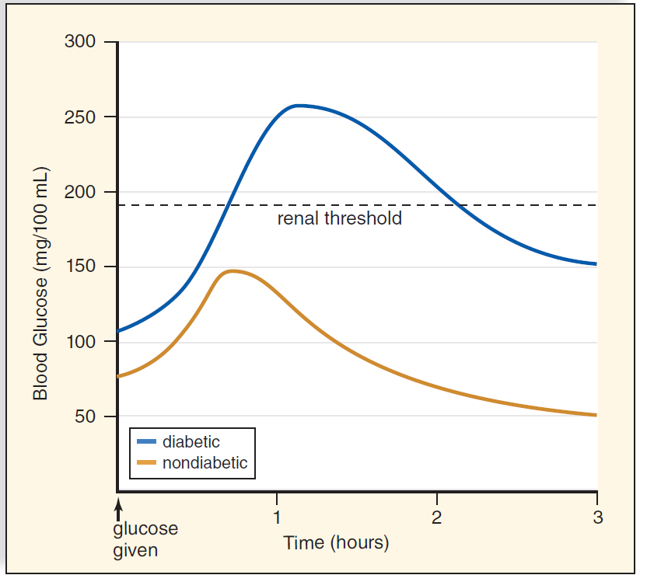
UNIT B
Chapter 9: Digestive System
Section 9.4
The glucose tolerance test is used to test for diabetes.
Person ingests a known amount of glucose, and blood glucose concentration is measured at intervals
In a person with diabetes, blood glucose rises greatly and remains elevated for hours
Figure 9.12 Glucose tolerance test. Following the administration of 100 g of glucose, the blood glucose level rises dramatically in the person with diabetes and glucose appears in the urine. Also, the blood glucose level at 2 hours is equal to or more than 200 mg/100 dL.
TO PREVIOUS SLIDE

Slide 10
UNIT B
Chapter 9: Digestive System
Section 9.4
Type 1 Diabetes (individuals do not produce enough insulin)
10% of individuals with diabetes in Canada have type 1
Usually begins in childhood (also known as juvenile-onset diabetes)
Can also occur due to a viral infection, autoimmune reaction, or environmental agent that destroys the pancreatic islets that produce insulin
Treatment is through daily insulin injections, which can be administered through an insulin pump
TO PREVIOUS SLIDE

Slide 11
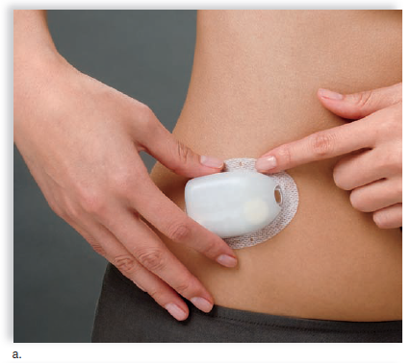
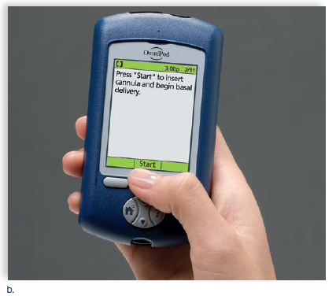
UNIT B
Chapter 9: Digestive System
Section 9.4
Figure 9.13 An insulin pump. Insulin pumps administer preprogrammed small doses of insulin throughout the day via an implanted catheter. Most insulin pumps can be worn under clothing.
TO PREVIOUS SLIDE

Slide 12
UNIT B
Chapter 9: Digestive System
Section 9.4
Type 2 Diabetes (individuals cannot use insulin properly)
90% of individuals with diabetes in Canada have type 2.
Can occur in adults or children
Individuals with type 2 diabetes are often overweight or obese, and fat tissue may produce a substance that impairs insulin receptor function
Normally, insulin binds to its receptor on cell surfaces to cause the number of glucose transporters to increase in the plasma membrane. This does not occur in individuals with type 2 diabetes.
Treatment involves weight loss, insulin injections, and medications to increase the effectiveness of the insulin produced
** see Insulin Sheet
TO PREVIOUS SLIDE

Slide 13
UNIT B
Chapter 9: Digestive System
Section 9.4
Disorders of the Liver and Gall Bladder
Hepatitis is inflammation of the liver.
Commonly caused by one of several viruses
Hepatitis A: acquired by consuming food or water that is contaminated with sewage (vaccine is available)
Hepatitis B: spread by sexual contact, blood transfusions, or contaminated needles (vaccine is available)
Hepatitis C: spread by sexual contact, blood transfusions, or contaminated needles (no vaccine, but antiviral drugs are available)
TO PREVIOUS SLIDE
Notes:
hepatitis: inflammation of the liver

Slide 14
UNIT B
Chapter 9: Digestive System
Section 9.4
Cirrhosis is a chronic disease of the liver.
Often seen in alcoholics due to malnutrition and toxic effects of excess amounts of alcohol
Liver becomes infiltrated with fat, and the fatty liver tissue is replaced with non-functioning fibrous scar tissue
Damage to the liver exceeds the rate of liver regeneration
Treatment involves a liver transplant
TO PREVIOUS SLIDE
Notes:
cirrhosis: a chronic disease of the liver; commonly caused by frequent alcohol consumption

Slide 15
UNIT B
Chapter 9: Digestive System
Section 9.4
Gallstones are small, hard masses that form in the gall bladder.
Cholesterol can precipitate out of the bile and form crystals that can grow into gallstones.
Passage of gallstones from the gall bladder may block the common bile duct and cause jaundice, a yellowing of the skin and eyes due to buildup of bilirubin.
If the gallstones cannot be removed, the gall bladder must be removed.
TO PREVIOUS SLIDE
Notes:
gallstones: hardened form of bile that may block the bile ducts and cause pancreatitis

